Slide 1
CacheMind:
Fast Performance Recovery
Using a Virtual Machine Monitor
Kenichi Kourai
Kyushu Institute of Technology, Japan

Slide 2
OS Recovery
OS reboot is a final but powerful recovery technique
  For recovery from OS crashes
    Against Mandelbugs
    A rebooted OS rarely crashes again
  For software rejuvenation
    Against aging-related bugs
    A rebooted OS restores
    its normal state
crash
reboot
recovered
OS
memory
leak
reboot
Notes:
OS reboot is a final but powerful recovery technique.
For example, it’s used for recovery from OS crashes due to Mandelbugs.
Mandelbugs are bugs that cause failure after long delays by error propagation.
Since the causes of Mandelbugs are so complex, a rebooted OS rarely crashes again.
Also, OS reboot is useful for software rejuvenation.
Software rejuvenation is a proactive technique to counteract aging-related bugs, for example, memory leaks.
OS reboot is a simple example and a rebooted OS restores its normal state.

Slide 3
Performance Degradation (1/2)
OS reboot degrades the performance of file accesses
  The file cache on memory is lost
    Disk access increases due to frequent cache misses
  It takes long time to fill the file cache
    Reading file blocks from a disk is slow
    Most of free memory is used for the file cache
file cache
reboot
slow disk
Notes:
However, OS reboot degrades the system performance, particularly, the performance of file accesses.
This is because all the file cache on memory is lost.
The file cache is used for speeding up file accesses.
When an OS reads a file block from a disk, it stores the data in the file cache.
OS reboot erases the memory contents and makes the file cache empty.
As a result, disk access increases due to frequent cache misses.
In addition, filling the file cache takes long time due to slow disk and large amount of memory.
Reading file blocks from a disk is slow, although SSD is faster than traditional hard disks.
Moreover, most of free memory is used for the file cache in modern OSes.

Slide 4
Performance Degradation (2/2)
Disk access also degrades the performance of the other virtual machines (VMs)
  VMs share a physical disk
    Frequent disk access occupies the bandwidth
  Prefetching makes the situation worse
    Burst of disk access
VM
VM
OS
rebooted
VM
disk
Notes:
If servers are consolidated using VMs, the situation is worse.
Such disk access degrades the performance of not only the rebooted VM but also the other VMs.
In such an environment, many VMs run on one physical machine and share only one or several physical disks.
Frequent disk access by the rebooted VM occupies the disk bandwidth and affects the performance of the other VMs.
Prefetching makes the situation much worse.
Prefetching is used to fill the file cache before applications access files and improves the performance after OS reboot.
However, it causes burst of disk access and affects the performance of the other VMs largely.

Slide 5
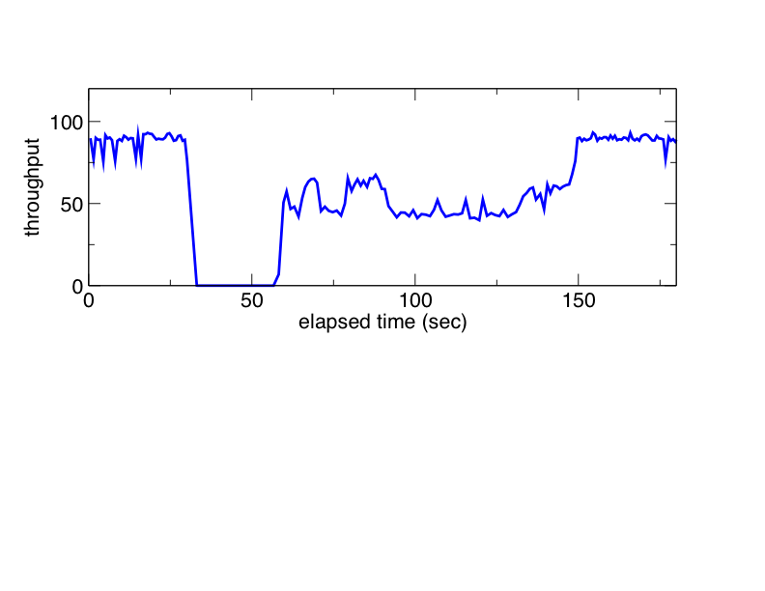
Performance Recovery is Needed
OS recovery does not complete until the performance is also recovered
  Traditional OS reboot restores only the functionalities
    Fast reboot techniques have been proposed
Notes:
To reduce the impact of such performance degradation, fast performance recovery is needed.
We claim OS recovery does not complete until the performance is also recovered.
Traditional OS reboot restores only the functionalities, although fast reboot techniques have been proposed such as kexec and snapshot boot.
This is a typical example of changes of server throughput.
In this period, the system is rebooted.
This period is critical because it becomes downtime, so shortening this period is important.
In addition, in this period, the throughput is degraded due to file cache misses.
Shortening this period and improving the performance are also important.

Slide 6
Warm-cache Reboot
A new OS recovery mechanism with fast performance recovery
  It preserves the file cache during OS reboot
    An OS can reuse it after the reboot
  It guarantees the consistency of the file cache
    Using the virtual machine monitor (VMM)
VM
discard
file
cache
file
cache
corrupted
cache
reboot
VMM
Notes:
For fast performance recovery, we propose a new OS recovery mechanism called the warm-cache reboot.
The warm-cache reboot preserves the file cache on memory during OS reboot and enables an OS to restore it after the reboot.
A rebooted OS can reuse the file cache and recover the performance of file accesses.
In addition, the warm-cache reboot guarantees the consistency of the file cache by using the VMM.
An OS should not reuse the file cache corrupted by its bugs.
Rather, it should read file blocks even from slow disks.
The VMM is a software layer underlying VMs.
It provides a consistency mechanism and makes an OS discard corrupted file cache.

Slide 7
Reusing the File Cache
Collaboration between an OS and the VMM
  The VMM re-allocates the same physical memory to a rebooted VM
  A rebooted OS reserves the memory pages used for the file cache
    Obtaining meta data from the VMM
VM
file
cache
file
cache
reserve
reboot
deallocate
re-allocate
VMM
Notes:
Reusing the file cache is achieved by the collaboration between an OS and the VMM.
When an OS is rebooted, the VM is destroyed and its memory is deallocated.
When a new VM is created just after that, the VMM re-allocates the same physical memory to the VM.
The VMM preserves the memory contents until the re-allocation.
Normally, it erases the memory contents before re-allocation for security, so that sensitive information is not stolen by another OS.
In case of the warm-cache reboot, preserving the contents is secure because the same OS is loaded.
Next, a rebooted OS reserves the memory pages used for the file cache.
It obtains the meta data for the file cache from the VMM.
The VMM maintains such meta data during the entire life cycle of each OS.

Slide 8
Cache Consistency
Our definition
  Consistent if the contents of the file cache are the same as those of disks
    Consistent when a file block is read from a disk
    Inconsistent when the file cache is modified
    Consistent when it is written back to a disk
read
modify
write back
VM
file cache
disk
Notes:
As I said before, the warm-cache reboot considers consistency of the file cache.
Our definition of cache consistency is this.
The file cache is consistent if those contents are the same as those of disks.
For example, when a file block is read from a disk, the file cache is consistent because the contents are the same.
When the file cache is modified by an OS, it becomes inconsistent because the contents become different.
At last, when the file cache is written back to a disk, it becomes consistent again because the contents become the same.

Slide 9
Maintaining Cache Reusability
The warm-cache reboot allows an OS to reuse only consistent file cache
  The VMM is suitable for maintaining the reusability
    It is isolated from an OS
    It can mediate all disk accesses
    It can track all modification to cache pages
modify
cache
pages
file cache
VM
VMM
disk
Notes:
The warm-cache reboot allows an OS to reuse only consistent file cache after OS reboot.
The VMM is suitable for maintaining cache reusability, that is, whether each cache page is reusable or not.
A cache page is a unit of cache management.
First, it is isolated from an OS, so it is reliable even when an OS becomes unreliable due to bugs.
Second, it can mediate all disk accesses.
When an OS reads file blocks, the VMM reads data in a disk to cache pages.
In contrast, when an OS writes back data, the VMM writes data in cache pages to a disk.
Third, the VMM can track all modification to cache pages by protecting them.

Slide 10
Reusability Management (1/3)
The VMM makes a cache page reusable after it reads data from a disk
  It protects the page before the read
    To detect page corruption by an OS during the read
    The VMM can still write data to the page
VM
possible
corruption
read
request
read request
VMM
protect
read
reusable
read
disk
Notes:
We’ll explain the details of reusability management.
After the VMM reads data from a disk, it makes a cache page reusable.
When an OS issues a read request, the VMM first protects the target cache page.
This is done before the disk read to detect accidental page corruption by an OS during the read.
Since the protection is applied only to the OS, the VMM itself can still write data read from a disk to the cache page.
Finally, the cache page becomes reusable if it is guaranteed that the contents are not corrupted.
This cache page is consistent.

Slide 11
Reusability Management (2/3)
The VMM makes a cache page non-reusable before an OS modifies its contents
  It unprotects the page at the same time
    To enable the OS to modify the page
VM
unprotect
possible
corruption
modify
request
write
modify request
VMM
non-reusable &
unprotect
Notes:
The VMM makes a cache page non-reusable before an OS modifies the contents of the page.
Before an OS modifies the cache page, it must issue a modify request to the VMM because the page is protected.
At that time, the VMM unprotects that page to enable the OS itself to modify the page.
This cache page becomes inconsistent when the OS modifies it.
We do not reuse such file cache because we cannot distinguish between normal writes and data corruption.

Slide 12
Reusability Management (3/3)
The VMM makes a cache page reusable again after it writes data in the page to a disk
  It protects the page before the write
    To detect page corruption during the write
VM
possible
corruption
write
request
write request
VMM
protect
write
reusable
write
disk
Notes:
After the VMM writes data in a cache page to a disk, it makes the page reusable again.
When an OS issues a write request, the VMM first protects the target cache page.
This is done before the disk write to detect page corruption during the write.
Finally, the cache page becomes reusable if it is guaranteed that the contents are not corrupted.
This cache page is consistent.
The written-back data may be already corrupted before the VMM protects the page.
However, we reuse it because the OS reads the same contents from a disk even if we do not use the warm-cache reboot.

Slide 13
Implementation
CacheMind
  Based on Xen/Linux
  Per-VM data
    Hash table from file blocks
    to cache pages
      Domain U adds/removes
    Bitmap for reusing
    cache pages
      Domain 0/VMM change
domain 0
domain U
blkback
blkfront
Per-VM
data
VMM
disk
Notes:
We have implemented a system enabling the warm-cache reboot, named CacheMind.
CacheMind is based on Xen and Linux.
Xen provides a normal VM called domain U and a privileged VM called domain 0.
Domain U communicates with domain 0 and domain 0 accesses a disk.
We modified the Linux kernel in domain U, the blkback device driver in domain0, and the VMM.
The VMM maintains per-VM data.
The first is a hash table from file blocks to cache pages.
Domain U adds and removes the entries for reusing cache pages.
The second is a bitmap for reusing cache pages.
Only domain 0 and the VMM change the bits.

Slide 14
Experiments
Purposes
  To show that the warm-cache reboot achieves fast performance recovery
    File access, web server
  To confirm that it does not reuse inconsistent file cache
    fault injection
Server
CPU: 2 dual-core Opteron
Memory: 12 GB
Disk: Ultra 320 SCSI
NIC: Gigabit Ethernet
Client
CPU: 2 Core 2 Quad
Memory: 4 GB
NIC: Gigabit Ethernet
Notes:
We conducted several experiments.
One purpose of the experiments is to show the warm-cache reboot achieves fast performance recovery on OS reboot.
For this purpose, we measured the performance of file accesses and a web server before and after OS reboot.
We used our CacheMind and, for comparison, the original Xen and Linux.
The other purpose is to confirm the warm-cache reboot does not reuse inconsistent file cache.
For this purpose, we performed fault injection into the OS kernel and examined the cache consistency.
The specs of server and client machines were here.
The server machine had enough memory and high-performance disk.

Slide 15
Throughput of File Reads
We measured the read throughput of a 1-GB file
  All file blocks were on the file cache
Our reboot achieved
better performance
16% degradation
at maximum
before reboot
after reboot
Notes:
We measured the read throughput of a 1-GB file.
Since we allocated enough memory to a VM, all file blocks were on the file cache.
The throughput of the first access was here.
The second and third accesses improve the throughput thanks to the file cache.
After normal reboot of the OS, the throughput of the fourth access was degraded to the same level of the first.
This is because the file cache is lost.
In contrast, after the warm-cache reboot, the throughput was not degraded largely.
The performance degradation was 16%.
This is because the other cache in the OS was lost.

Slide 16
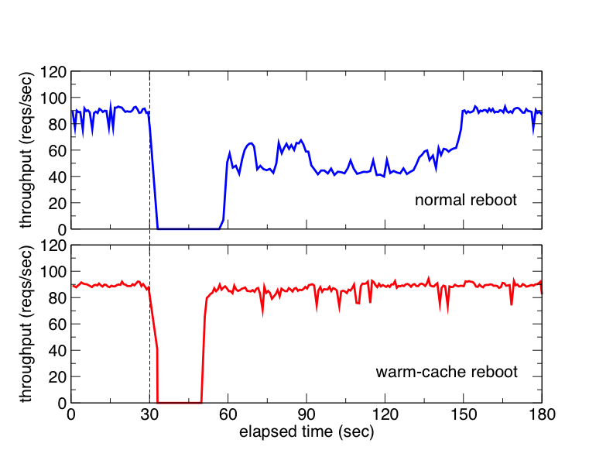
Throughput of a Web Server
We measured the changes of the throughput during OS reboot
60% degradation
for 90 seconds
5% degradation
for 60 seconds
Notes:
Next, we measured the changes of the throughput of a web server during OS reboot.
We prepared 4,000 files of 1MB and sent HTTP requests to the files one by one.
All files were on the file cache.
The above is when we performed normal reboot.
After we started to reboot the OS at 30 seconds, the web server was down for about 30 seconds.
In addition, after the OS is booted, the performance was degraded by 60% for 90 seconds.
On the other hand, when we performed the warm-cache reboot, the performance degradation was only 5% for 60 seconds.

Slide 17
Fault Injection (1/2)
We measured inconsistent cache reuses
  We injected various faults into the OS kernel
  First, we disabled the consistency mechanism
The file cache is
often corrupted
Notes:
Finally, we injected various types of faults into the OS kernel to examine the impact of faults to the file cache.
For each fault type, we injected 10 faults and waited for 60 seconds.
Then we rebooted the OS with the warm-cache reboot and compared the contents of the file cache with those of a disk.
We tried this 50 times for each.
We measured the number of reboots that accidentally reused inconsistent file cache.
First, we disabled the cache consistency mechanism of the warm-cache reboot.
Here is the ratio of inconsistent reuses.
On average, 30% of reboots caused cache inconsistency.

Slide 18
Fault Injection (2/2)
Next, we enabled the consistency mechanism
  Most of reboots did not reuse inconsistent cache
  Reused file cache was inconsistent only for DST
    Ext3 failed to write back
      Faults were injected
      into ext3
    The file cache was not
    corrupted
      Reusing it is correct
Notes:
Next, we enabled the cache consistency mechanism and examined the ratio.
Most of reboots did not reuse inconsistent cache.
However, only for one type of fault, reused file cache was inconsistent.
According to our deep inspection, faults were injected into the ext3 file system in Linux.
As a result, ext3 failed to write back the file cache to the disk.
In this case, the contents of the file cache and those of the disk were different, but the file cache was protected and it was not corrupted.
If the write-back succeeded, the file cache should be consistent.
So reusing it is correct.

Slide 19
Related Work
Rio File Cache [Chen et al.’96]
  Reusing dirty file cache after OS crash
  Relying on an OS
RootHammer [Kourai et al.’07]
  Preserving VMs during VMM reboot
Hybrid Hard Drive [Samsung&Microsoft],
Turbo Memory [Intel]
  Including large non-volatile disk cache
Notes:
The Rio file cache enables reusing dirty file cache after OS crash.
This is similar to CacheMind, but there are several important differences.
The first difference is the purpose.
Rio is for reliability, but CacheMind is for high performance.
Rio reuses only dirty file cache and discards clean file cache.
On the other hand, CacheMind reuses only clean file cache but discards dirty file cache.
Second, Rio relies on an OS for reusing and protecting file cache, but CacheMind relies on the below layer, the VMM.
Our previous work, RootHammer, uses the similar idea, that is, preserving memory during reboot.
RootHammer preserves VMs during rebooting the VMM.
Our target in this work is OS reboot.
Recent hybrid hard drives and Turbo Memory include large non-volatile disk cache.
That disk cache is preserved after OS reboot and helps performance recovery.
But the cache size is smaller than that of the file cache in general, so the performance improvement is limited.

Slide 20
Conclusion
We proposed the warm-cache reboot
  It achieves fast performance recovery by reusing the file cache
    16% degradation at maximum
  The VMM maintains consistency of the file cache
    Consistent, or not-corrupted at least
Future work
  Overhead measurement of the consistency mechanism
Notes:
In conclusion, we proposed the warm-cache reboot.
It achieves fast performance recovery by reusing the file cache after OS reboot.
According to our experimental results, the performance degradation was reduced to 16% at maximum.
In addition, the VMM maintains consistency of the file cache.
In most cases, reused file cache was consistent.
Even when file systems malfunctioned, the file cache was not corrupted at least.
Future work is the overhead measurement of the consistency mechanisms, for example, the cost of protecting and unprotecting cache pages.

