Slide 1
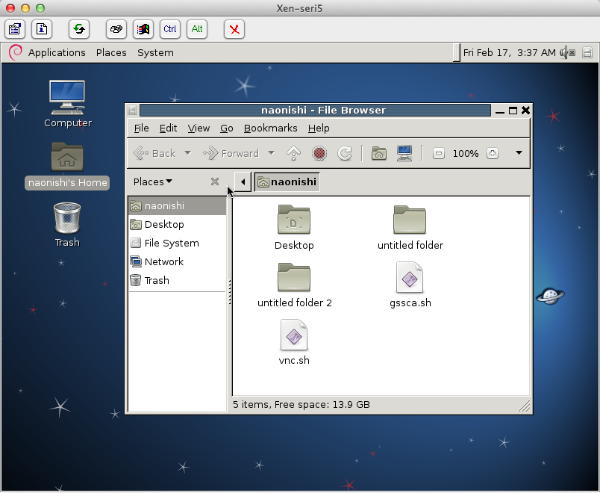
A0
841mmx1189mm
Secure Out-of-band Remote Management
in Infrastructure as a Service
Tomohisa Egawa, Naoki Nishimura, and Kenichi Kourai (Kyushu Institute of Technology)
Remote Management in IaaS
The Management VM is Not Always Trustworthy
Out-of-band remote management is useful
Users access their VMs via the management VM
Even on network/system failures in the VMs
Network configuration errors, OS crashes, etc.
Management VM can be compromised by outside attackers or abused by IaaS administrators
Such attackers can steal sensitive information of user VMs
Keystorokes, screenshots, etc.
IaaS
IaaS
User
management VM
user VM
User
management VM
user VM
VNC
client
VNC
server
user VM
VNC
client
VPN
VNC server
eavesdrop
Informationleakage
virtual
devices
password & screenshot
attacker
FBCrypt
Protecting the VMM inside IaaS
FBCrypt protects sensitive information against the attackers in the management VM
By encrypting the inputs and outputs between a VNC client and a user VM using the VMM
Keyboard/pointer inputs and framebuffer updates
FBCrypt performs remote attestation of the VMM
To guarantee the integrity of a booted VMM
The VMM is protected against the management VM by memory protection
The attackers cannot access code and data of the VMM
VNC client
management VM
user VM
management
VM
user VM
key encrypt
VNC server
screen decrypt
key decrypt
signed measuament
VMM
screen encrypt
VMM
Verifier
TPM
hash
Hardware
Encrypting Inputs
Encrypting a Framebuffer
The VMM decrypts the inputs encrypted by a VNC client
It converts these encoding, instead of a VNC server
The integrity of the inputs is also checked with the MAC
The decrypted inputs are written into the I/O ring
The VMM replicates a VFB and encrypts the replica
It synchronizes the two VFBs when pixel data is updated
A VNC server sends encrypted pixel data in the replica and a VNC client decrypts them
VNC client
management VM
user VM
VNC client
management VM
I/Oring
user VM
key encrypt
VNC server
screen decrypt
VNC server
VFB
I/O ring
VFB
monitor
decrypt
& convert
Integrity
check
VMM
screen encrypt
VMM
Experiments
We examined the response time in the client side
By the keyboard input VNC client received updated pixel data from the VNC server
By the keyboard input VNC client received full screen (800x600) updated data and re-drew the full screen
113
120
192
146
server | Xen-4.1.1
client | Tight-VNC Java viewer
original
FBCrypt
original
FBCrypt

