Slide 1
Zero-copy Migration for Lightweight Software Rejuvenation of Virtualized Systems
Kenichi Kourai
Hiroki Ooba
Kyushu Institute of Technology
Notes:
I'm Kenichi Kourai from Kyushu Institute of Technology.
In this talk, I'm gonna talk about zero-copy migration for lightweight software rejuvenation of virtualized systems.
This is joint work with my student, who has graduated.

Slide 2
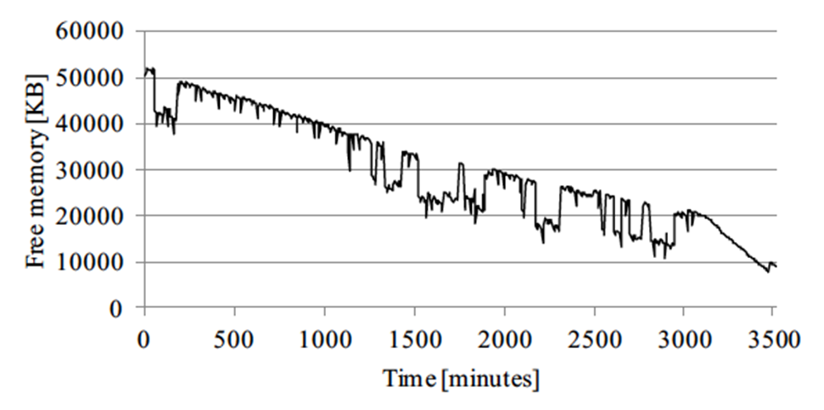
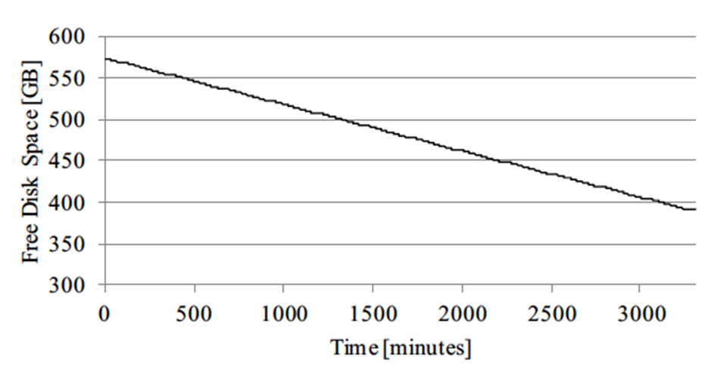
Software Aging [Huang+ FTC'95]
Virtualized systems tend to suffer from software aging
  The state of running software is degraded with time
    E.g., memory leakage
  Hypervisors (and management VMs) are long-running software
free memory
free disk space
Source: F. Machida et al., Combined Server Rejuvenation in a Virtualized Data Center, Proc. IEEE ATC 2012.
Notes:
Virtualized systems tend to suffer from software aging.
Software aging is the phenomenon that the state of running software is degraded with time.
For example, memory leakage can slow down the system.
Software aging progresses more in long-running software.
In virtualized systems, hypervisors and often used management VMs are long running.
These graphs show examples of software aging in Xen.
The free memory of the management VM decreased by 80% after 100 VM migration.
The free disk space decreased constantly whenever a VM was suspended and resumed.

Slide 3

Software Rejuvenation [Huang+ FTC'95]
Restore systems to the normal state
  Proactive technique for counteracting software aging
  Simplest method: system reboot
Cause a long downtime in virtualized systems
  Need to stop all VMs during the reboot
  Violate service level agreement (SLA)
VM
...
VM
aged hypervisor
Notes:
To counteract such software aging, a proactive technique called software rejuvenation is used.
Software rejuvenation restores systems to the normal state, which is before software aging progresses.
The simplest but powerful method for software rejuvenation is a system reboot.
The internal state of the system is initialized after the reboot.
However, in virtualized systems, this method causes a long downtime.
On software rejuvenation, a virtualized system needs to stop all the VMs on top of it and restart them again after the reboot.
This long downtime can violate service level agreement between users and providers.

Slide 4
Rejuvenation with VM Migration
Reduce downtime during rejuvenation
  Migrate all VMs to another host
    The downtime due to VM migration is usually negligible
  Reboot only the aged hypervisor
    No VMs on it
VM
...
VM
migration
VM
...
VM
aged hypervisor
clean hypervisor
source host
destination host
Notes:
To reduce such downtime during software rejuvenation, VM migration is often used with rejuvenation.
On software rejuvenation, an aged virtualized system first migrates all the VMs to a clean virtualized system at another host.
The downtime due to VM migration is usually negligible.
After that, the aged system can reboot only the hypervisor without VMs.
As a result, software rejuvenation almost doesn't affect the downtime of VMs.

Slide 5
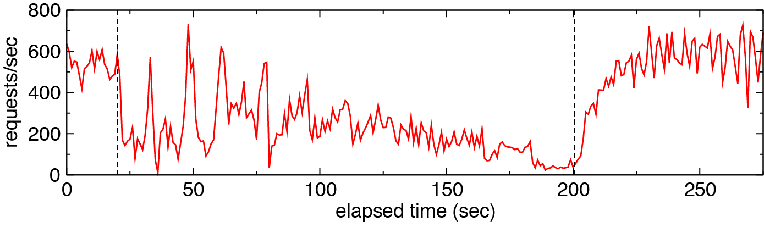
Performance Degradation
VM migration stresses hosts and network largely
  Transfer the memory images of VMs via network
    Several hundreds of GB in total
    Encrypted to prevent eavesdropping/tampering
  Occupy CPUs and memory/network bandwidths
    Degrade the performance of virtualized systems
start
end
web throughput
Source: K. Kourai et al., Fast Software Rejuvenation of Virtual Machine Monitors, TDSC, 2011.
Notes:
However, VM migration stresses hosts and network largely.
When migrating all the VMs, a virtualized system has to transfer the memory images of VMs via network.
The size of transferred memory images can be several hundreds of gigabytes in total.
In addition, such memory images are often encrypted to prevent eavesdropping and tampering during the transfer.
Therefore, VM migration occupies CPUs and memory and network bandwidths.
These high loads in hosts and network degrade the performance of virtualized systems running at both source and destination hosts.
For example, it is reported that the web servers in migrating VMs caused performance degradation by 57%.
As a result, VM migration can lead to SLA violations.

Slide 6
VMBeam
Enable lightweight software rejuvenation
  Start a new virtualized system at the same host
    Using nested virtualization
  Migrate all VMs from an aged system onto a clean one
    Using zero-copy migration
  Stop the aged system
...
...
VM
VM
zero-copy
migration
VM
VM
aged hypervisor
clean hypervisor
source virtualized system
destination virtualized system
Notes:
To enable lightweight software rejuvenation of virtualized systems, we propose VMBeam.
When rejuvenating an aged virtualized system, VMBeam first starts a new clean virtualized system at the same host by using nested virtualization.
After that, it migrates all the VMs from the aged virtualized system onto the clean one using zero-copy migration.
Zero-copy migration efficiently migrates VMs between virtualized systems by leveraging the fact that VM migration is performed inside a physical host.
Finally, VMBeam stops the aged virtualized system to complete software rejuvenation without rebooting it.

Slide 7
Nested Virtualization
Enable a virtualized system to run in a VM
  Guest hypervisor/VMs inside a virtualized system
  Host hypervisor/VMs in the outside
The overhead is 6-8% [Ben-Yehuda+ OSDI'10]
  1% in a special-purpose host hypervisor [Tan+ DCDV'12]
host VM
host VM
...
...
guest
VM
guest
VM
guest
VM
guest
VM
guest hypervisor
guest hypervisor
host hypervisor
Notes:
VMBeam uses nested virtualization to run two virtualized systems at the same host.
Nested virtualization is a technique for enabling a virtualized system to run in a VM.
We call the hypervisor and VMs inside a virtualized system the guest hypervisor and guest VMs, respectively.
In contrast, we call a VM for running a virtualized system a host VM and the hypervisor below host VMs the host hypervisor.
To reduce the overhead of nested virtualization, several techniques have been proposed.
The Turtles project reported the overhead was 6 to 8% for common workloads.
In special-purpose hypervisors such as TinyChecker, the overhead is about 1%.
So, using nested virtualization is realistic.

Slide 8
Zero-copy Migration
Relocate the memory of guest VMs between virtualized systems at the same host
  Step 1: Share the memory between src/dst guest VMs
    The src guest VM can continue to run
  Step 2: Release the memory of the src guest VM
    After the entire memory is shared
source
host VM
running
guest VM
inter-guest
memory sharing
cloned
guest VM
destination
host VM
aged guest hypervisor
clean guest hypervisor
host hypervisor
Notes:
To reduce the overhead of VM migration, VMBeam provides zero-copy migration.
Zero-copy migration just relocates the memory of guest VMs between virtualized systems at the same host.
It consists of two steps to enable live migration.
The first step is to share the memory between source and destination guest VMs.
A source guest VM is running, while a destination one is being cloned.
Thanks to this inter-guest memory sharing, the source guest VM can continue to run during VM migration.
The second step is to release the memory of the source guest VM.
This is done after the entire memory of the guest VM is shared.

Slide 9
No Memory Re-transfer
Zero-copy migration is completed in one iteration
  Not repeat to re-transfer modified memory areas
    Traditional live migration needs multiple iterations
  Modifications are directly reflected to a destination guest VM by memory sharing
  Reduce the migration time for memory-intensive VMs
source
host VM
running
guest VM
cloned
guest VM
destination
host VM
no
re-transfer
aged guest hypervisor
clean guest hypervisor
host hypervisor
Notes:
Unlike traditional live migration, zero-copy migration is completed in only one iteration.
Traditional live migration needs multiple iterations because it has to re-transfer memory areas modified in a VM to a destination host again and again until the re-transfer size becomes small enough.
In contrast, zero-copy migration doesn't repeat such re-transfers.
Modifications in a source guest VM are directly reflected to a destination guest VM by inter-guest memory sharing.
This can reduce the migration time particularly for memory-intensive VMs.

Slide 10
Reducing System Loads
No use of the virtual network
  Shared memory is used
No copy of large memory images of VMs
  The memory is simply relocated
No encryption of the memory images
  Any data is not exposed to the outside of guest VMs
No need to detect memory write in guest VMs
  Modifications are directly reflected
Net
CPU
CPU
Mem
CPU
CPU
Notes:
Zero-copy migration can reduce system loads such as CPUs, memory, and network.
First, the virtual network isn’t used at all because shared memory is used instead.
This reduces the network load and then the CPU load generated by network virtualization.
Second, large memory images of VMs aren’t copied at all because the memory is simply relocated.
This reduces the CPU and memory loads generated by memory copy.
Third, memory images aren’t encrypted because any data isn’t exposed to the outside of guest VMs.
This reduces the CPU load generated by encryption and decryption.
Fourth, detecting memory write in a source guest VM isn’t needed because modifications are directly reflected to a destination guest VM.
This reduces the CPU load generated by trapping memory write.

Slide 11
Devirtualization [Lowell+ ASPLOS'04]
Remove the overhead of nested virtualization
  Disable the host hypervisor during a normal run
  Re-virtualize the system only during rejuvenation
Cons: the guest hypervisor could directly corrupt the hardware state
<normal run>
<software rejuvenation>
host VM
host VM
host VM
...
...
guest
VM
revirtualize
guest
VM
guest hypervisor
guest hypervisor
devirtualize
host hypervisor
host hypervisor
Notes:
In VMBeam, nested virtualization is necessary only on software rejuvenation.
However, the system always suffers from the overhead of nested virtualization.
Devirtualization can remove that overhead.
This technique temporarily disables the host hypervisor during a normal run.
Then it re-virtualizes the system only during software rejuvenation.
The current devirtualization is proposed only for single-level virtualization, but we believe this technique is applicable to nested virtualization.
One downside of devirtualization is the guest hypervisor could directly corrupt the state of physical hardware.
In that case, a hardware reset may be required.
But it is unlikely software aging corrupts the hardware state in such an unrecoverable manner.

Slide 12
Isn't the Host Hypervisor Aged?
Yes, but the aging speed is slower
  Much smaller than the guest hypervisor
    6K LOC (CloudVisor) vs. 300K LOC (Xen 4.2)
  Execute no complex VM operations
  Devirtualization can suppress aging
    The host hypervisor is disabled
guest
VM
host VM
migration
feature-rich
guest hypervisor
minimal host hypervisor
Notes:
Here, one question is whether the host hypervisor isn't aged.
The host hypervisor is also aged, but we believe the aging speed is slower than that in the guest hypervisor.
The first rationale is the host hypervisor is much smaller than the guest hypervisor.
For example, the security monitor in CloudVisor is only 6 kilo lines of code.
In contrast, the feature-rich Xen hypervisor is 300 kilo lines of code.
Second, the host hypervisor doesn't execute complex VM operations such as VM migration, suspend, and resume.
Third, devirtualization can suppress software aging.
While the system is devirtualized, the host hypervisor is disabled and doesn't accumulate errors.

Slide 13
Experiments
We confirmed the effectiveness of zero-copy migration in VMBeam
  System loads, migration time, and downtime
Comparison
  Xen-Phys
    Traditional system with two physical hosts
  Xen-Blanket [Williams+ EuroSys'12]
    System with nested virtualization and fast virtual network
[2 hosts]
CPU: Intel Xeon E5-2665
Memory: 32 GB
NIC: Gigabit Ethernet
host hypervisor: Xen 4.2
host Dom0 OS: Linux 3.2.0
guest Dom0 OS: Linux 3.5.0
Notes:
To confirm the effectiveness of zero-copy migration in VMBeam, we measured system loads, migration time, and downtime.
We used Xen 4.2 in which we have implemented VMBeam.
We have modified the host and guest hypervisors and migration tools in guest Domain 0.
For comparison, we used two existing systems.
One is Xen-Phys, which is the traditional system with two physical hosts.
The other is Xen-Blanket, which is the system with nested virtualization and provides fast virtual network between virtualized systems at the same host.

Slide 14
System Loads
We measured system loads during VM migration
  VMBeam did not transfer data via virtual network
  It used only 30% of CPU time in Xen-Phys
  It did not access the VM memory (estimated)
Notes:
First, we measured system loads while we migrated a guest VM with 4 GB of memory.
For network, Xen-Phys and Xen-Blanket transferred about 4 GB of data, but VMBeam almost didn't use virtual network.
For CPU, we measured the CPU utilization in Domain 0.
VMBeam used only 30% of CPU time in Xen-Phys because the migration time was much shorter, which is shown in the next slide.
In Xen-Blanket, the CPU utilization was high and the migration time was long, so the total CPU time was much longer.
For memory, we estimated the amount of memory access because we couldn't obtain the statistics from hardware.
In Xen-Phys and Xen-Blanket, the memory image of a VM was accessed several times during transfer, so the memory access was tens of gigabytes.
But VMBeam didn't access the memory image at all.

Slide 15
Migration Performance
We measured the migration time and downtime
  The migration time in VMBeam was up to 5.8x faster
  The downtime in VMBeam was 0.2s longer
    Due to the overhead of nested virtualization
16s
Notes:
Next, we measured the migration time and downtime.
The migration time was proportional to the memory size, but in VMBeam, the time didn't increase largely.
VMBeam achieved the shortest migration time and could complete the migration of a guest VM with 4 GB of memory in 16 seconds.
This is 5.8 times faster than Xen-Phys.
For Xen-Blanket, the migration time was longer than that in Xen-Phys.
This may be due to the overhead of running two virtualized systems at the same host.
On the other hand, the downtime in VMBeam was about 0.6 second, but that in Xen-Phys was 0.4 second.
This is due to the overhead of nested virtualization.
In Xen 4.2, nested virtualization is supported experimentally.
In Xen-Blanket, the downtime was more than 1 second, but the reason is under investigation.

Slide 16
Related Work
Microvisor [Lowell+ ASPLOS'04]
  Maintain the system in a new VM and migrate applications to it
  Focus on devirtualization
RDMA-based migration [Huang+ Cluster'07]
  Only one copy by InfiniBand
  Need 3 copies when encrypting the memory image
Warm-VM Reboot [Kourai+ DSN'07]
  Maintain VMs in memory during rejuvenation
  Still cause downtime during the hypervisor reboot
Notes:
The most similar system to VMBeam is Microvisor.
On system maintenance, Microvisor starts a new VM and maintains the system in the VM.
After the maintenance, it migrates application to the VM.
One big difference is Microvisor focuses on devirtualization, not migration.
RDMA-based migration needs only one copy by InfiniBand, that is, zero copy by software.
The memory image of a VM is directly copied to a destination host using RDMA.
But this method needs 3 copies when the memory image has to be encrypted.
The warm-VM reboot is a technique for fast software rejuvenation of virtualized systems without VM migration.
It maintains the memory images of VMs in memory during software rejuvenation.
But this technique still causes downtime because VMs stop during the hypervisor reboot.

Slide 17
Conclusion
VMBeam for lightweight software rejuvenation of virtualized systems
  Nested virtualization: Run aged and clean systems at the same host
  Zero-copy migration: Migrate guest VMs efficiently
    Suppress system loads
    Make VM migration up to 5.8x faster
Future work
  Develop a minimal host hypervisor
  Enable devirtualization in the host hypervisor
Notes:
In conclusion, we proposed VMBeam for lightweight software rejuvenation of virtualized systems.
Using nested virtualization, VMBeam runs aged and clean virtualized systems at the same host.
Using zero-copy migration, it migrates guest VMs between these virtualized systems efficiently.
According to our experiments, zero-copy migration could suppress system loads.
In addition, it could make VM migration up to 5.8 times faster.
One of our future work is to develop a minimal host hypervisor.
Such a host hypervisor is necessary for suppressing software aging in the host hypervisor and reducing the overhead of nested virtualization.
Another direction is to enable devirtualization in the host hypervisor.
This technique is necessary for reducing the overhead of nested virtualization during a normal run.

