Slide 1
Virtual AMT for
Unified Management of
Physical and Virtual Desktops
Kenichi Kourai
Kouki Oozono
Kyushu Institute of Technology
Notes:
I'm Kenichi Kourai from Kyushu Institute of Technology.
In this talk, I'm gonna talk about virtual AMT for unified management of physical and virtual desktops.
This is joint work with my student, who has graduated.

Slide 2
Desktop Management
The number of desktop PCs becomes enormous
  Admins manage them remotely
  Agent software is installed in desktops
Agent-based management tools cannot access turned-off desktops
  Or desktops under system failures or attacks
management
tool
PC
PC
agent
...
agent
...
Notes:
Recently, the number of desktops such as PCs used in enterprises becomes enormous.
Administrators in the IT department have to manage all the desktops in all the departments remotely.
To do so, agent software is installed in desktops.
Then remote management tools install and update software, scan viruses, and perform backups by communicating with the agents.
However, when a desktop is turned off, such agent-based management tools cannot access the desktop at all.
Even when the power is on, they may not be able to manage a desktop if the desktop is under system failure or under attacks.
In such a situation, the agent or the operating system may not work correctly.

Slide 3
Intel AMT
What is Active Management Technology (AMT)?
  Embedded processor separated from main CPUs
Enable agentless remote management of turned-off desktops
  Provide hardware information
  Reboot desktops
  Provide remote GUI control
  Restrict network access
PC
Z z z
AMT
management
tool
Notes:
To improve the manageability of desktops, current PCs for enterprises are equipped with Intel Active Management Technology, shortly, AMT.
AMT is one of the core technologies in Intel vPro and is implemented as an embedded processor separated from main CPUs.
AMT enables agentless remote management of desktops without depending on installed agents.
So even when a desktop is turned off, management tools for AMT can monitor and control the desktop.
For example, AMT provides hardware information to remote management tools without regard to the power state of a desktop.
It can reboot a desktop when the operating system does not respond.
It also provides remote GUI control.
Under attacks, AMT can restrict network access to a desktop.

Slide 4
Virtual Desktops
Run as virtual machines (VMs) in servers
  Users access them remotely
  Desktop as a Service (DaaS)
Enable consolidating desktops in servers
  Admins can maintain desktops more easily
    Software installation/update
virtual desktop
server
keyboard/mouse
VM
...
VM
screen
Notes:
On the other hand, recently, virtual desktops are emerging.
Unlike physical desktops running as client PCs, virtual desktops run as virtual machines (VMs) in server machines.
Users access VMs remotely using remote desktop tools.
Only the screen of a VM is displayed in user's device and keyboard and mouse inputs are sent to the VM via a network.
In particular, cloud-based virtual desktops are called Desktop as a Service.
Virtual desktops enable administrators to consolidate desktops in a small number of servers.
As a result, administrators can maintain desktops more easily.
For example, they can install and update software in VM images managed centrally.

Slide 5
Physical and Virtual Desktops
Two types of desktops are mixed
  The transition is in progress
  Difficult to use virtual desktops in laptop PCs
Admins have to use two management tools
  For AMT and for VMs
  Increase the burden of desktop
  management
virtual desktop
...
PC
tool
for PCs
tool
for VMs
...
AMT
AMT
VM
...
VM
Notes:
Currently, both physical and virtual desktops are mixed in many enterprises.
The transition from physical to virtual desktops is in progress.
Even if the transition completes, it is difficult to use virtual desktops in laptop PCs because they can be used in an environment where network is unreachable.
Current virtual desktops are being usable in network-unreachable environments, but the functionality is largely restricted.
In such a situation, administrators have to use at least two different management tools to manage two types of desktops.
One is for AMT and the others are for VMs.
AMT is only for physical desktops, so management tools for AMT cannot manage virtual desktops.
In contrast, management tools for virtual desktops cannot manage physical desktops using AMT.
This increases the burden of desktop management.

Slide 6
Virtual AMT (vAMT)
Enable managing virtual desktops like physical ones
  Provide the same interfaces as AMT
  Absorb differences from physical desktops
Admins can perform unified management using AMT and vAMT
virtual
desktop
...
PC
management
tool
...
VM
...
VM
AMT
AMT
vAMT
vAMT
server
Notes:
To solve this problem, we propose virtual AMT, shortly, vAMT.
vAMT enables administrators to manage virtual desktops like physical ones.
It provides the same interfaces as those provided by AMT.
In addition, it absorbs differences from physical desktops.
For example, PCs have sensors but VMs don't.
Using both AMT and vAMT, administrators can perform unified management of not only physical desktops but also virtual desktops.
They can use only one management tool for AMT.

Slide 7
(v)AMT Interfaces
WS-Management
  Allow remote management with CIM
  CIM provides a definition of management information
SOAP
  Allow remote management with Web services
  Deprecated from AMT 6.0 but still used
Keyboard/Video/Mouse (KVM)
  Allow out-of-band remote GUI control with VNC
Notes:
Here are three main interfaces of vAMT.
First, WS-Management is used to allow remote management with Common Information Model (CIM) extended for AMT.
CIM is an open standard that provides a common definition of management information for systems.
The WS-management interface becomes standard from AMT version 6.
Before WS-management is adopted, SOAP is used to allow remote management with Web services.
This interface was deprecated from version 6, but still used by many tools.
Another interface is keyboard/video/mouse (KVM).
This interface allows out-of-band remote GUI control with VNC.

Slide 8
Monitoring Virtual Desktops
vAMT returns hardware information on a VM
  Obtain information of all elements or a specific element
  E.g., virtual CPUs, memory, power state
vAMT emulates non-existent hardware as necessary
  E.g., temperature, voltage, manufacturer
EnumerateInstances
VM
vAMT
management
tool
information on CPUs
Notes:
Using these interfaces, management tools can monitor virtual desktops.
First, a management tool sends a request of WS-Management or SOAP to vAMT.
For example, the EnumerateInstances command is used to obtain information of all elements.
The GetInstance command is used for a specific element.
Then, vAMT returns hardware information on the target VM.
Examples of such information are on virtual CPUs, memory, and power state.
When a management tool requests information on non-existent hardware, vAMT emulates it as necessary.
For example, vAMT returns information of temperature and voltage in the server hardware, instead of the target VM.
It returns the vendor of virtualization software as the manufacturer of a VM.

Slide 9
Controlling Virtual Desktops
vAMT changes hardware state of a VM
  Invoke methods defined in CIM
  E.g., power on/off, CPU enabling/disabling
vAMT ignores requests of state changes to non-existent hardware
  E.g., fan speed, WiFi state
RequestPowerStateChange()
VM
vAMT
reboot
management
tool
Success
Notes:
Similarly, management tools can control virtual desktops through vAMT interfaces.
First, a management tool sends a request for invoking a method to vAMT.
The method is defined in CIM and examples are power on/off and CPU enabling/disabling.
Then, vAMT changes hardware state of the target VM.
For example, when it receives the power-cycling request, it reboots the VM.
vAMT ignores requests of state changes to non-existent hardware.
For example, it does not change a fan speed or a WiFi state because a VM does not have a fan or a WiFi device.

Slide 10
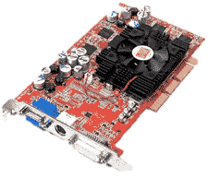
Out-of-band Remote Control
vAMT provides a VNC server for a VM
  Obtain the screen of a VM
  Inject keyboard/mouse inputs to a VM
This remote control does not depend on a VM
  Useful at boot time
  Available even if network failure occurs inside a VM
VNC
VM
VNC
server
management
tool
vAMT
Notes:
The other control method is to use the KVM interface for out-of-band remote GUI control.
To achieve this, vAMT provides a VNC server for a VM.
It obtains the screen of a VM and returns it to a management tool.
When a management tool sends keyboard or mouse inputs to vAMT, vAMT injects them to a VM.
To do so, vAMT directly accesses virtual keyboard, mouse, and video card of a VM.
This out-of-band remote control does not depend on the system state inside a VM.
Therefore, this control method is useful at the boot time of the system.
A management tool can access a VM before a VNC server inside the VM starts.
Even if network failure occurs inside a VM, remote access is still available.
Administrators can fix the problem remotely.

Slide 11
How to Access Turned-off VMs?
PCs always exist as concrete hardware
  AMT can access hardware without regard to its power state
    E.g., power management, VNC connections
VMs are destroyed after power off
  The virtualized system can manage only running VMs
  vAMT cannot access turned-off VMs
PC
VM
VM
power on/off
power off
Notes:
We couldn't implement vAMT simply by providing the same interfaces as AMT.
One issue is how to access turned-off VMs.
PCs always exist as concrete hardware.
So, AMT can access hardware without regard to the power state of a PC.
For example, AMT can perform power management of a turned-off PC.
A management tool can maintain the VNC connection to a turned-off PC via AMT.
On the other hand, VMs are destroyed after power off.
Since the runtime of the virtualized system can manage only running VMs, vAMT cannot access a turned-off VM.
When a VM is destroyed, a management tool cannot maintain the VNC connection.

Slide 12
Accessing Turned-off VMs (1/2)
vAMT accesses a turned-off VM through its config file
  Obtain hardware information written in the config file
    E.g., virtual CPUs, memory
  Create a VM from the config file when power on
vAMT integrates information from a running VM and a config file seamlessly
VM
vAMT
management
tool
config
file
Notes:
To solve these problems, vAMT accesses a turned-off VM through its configuration file.
It obtains hardware information from the configuration file because information on virtual CPUs, memory, and so on, is written in the file.
When a VM is turned on, vAMT creates a new VM from the configuration file and boots it.
vAMT integrates information from a running VM and a configuration file seamlessly.
It returns the latest information when a VM is running, while it returns configuration information when a VM is turned off.

Slide 13
Accessing Turned-off VMs (2/2)
vAMT uses a VNC proxy to access a VM
  The VNC proxy handles access to a turned-off VM
    Return a dummy black screen
    Ignore keyboard/mount inputs
  It redirects requests to a VNC server for a running VM
vAMT switches emulation and redirection automatically
VNC
proxy
VNC
server
VM
management
tool
vAMT
Notes:
To maintain VNC connections to turned-off VMs, vAMT uses a VNC proxy.
The VNC proxy handles remote access when a VM is turned off.
It returns a dummy black screen to emulate a turned-off PC.
It just ignores keyboard and mouse inputs.
For a running VM, the VNC proxy redirects requests to a VNC server in vAMT.
vAMT automatically switches the emulation and redirection according to the power state of a target VM.

Slide 14
How to Manage Migrated VMs?
A VM can be migrated to another host
  Attached vAMT is not migrated together
Possible approaches
  Restart vAMT at the destination host
    Existing network connections to vAMT are tore down
  vAMT remotely accesses a migrated VM
    The source host cannot be shut down forever
vAMT
VM
source host
destination host
Notes:
Another issue is how to manage migrated VMs.
A VM can be migrated to another host. <click>
However, attached vAMT is not migrated together.
As a result, that vAMT cannot manage the migrated VM.
One possible approach is to restart vAMT at the destination host of VM migration.
That vAMT can manage the migrated VM.
One drawback is existing network connections to vAMT are tore down.
A management tool cannot receive pending responses or cannot maintain a VNC connection.
Another approach is vAMT remotely accesses the migrated VM.
A management tool can continue to access vAMT without losing connections, but the source host cannot be shut down forever.

Slide 15
Managing Migrated VMs
Run vAMT in another VM and co-migrate vAMT with a target VM
  Network connections to vAMT are maintained
  The source host can be shut down
D-MORE [Kawahara et al.'14] enables synchronized co-migration of two VMs
  Solve timing issues
VM
vAMT
source host
destination host
Notes:
To solve this dilemma, we run vAMT in another VM and co-migrate vAMT with a target VM. <click>
Thanks to the extra VM, network connections to vAMT are maintained after migration.
Since vAMT is migrated, the source host can be shut down after migration.
We are planning to use our previous work, named D-MORE, to enable synchronized co-migration of two VMs.
D-MORE solves timing issues when a VNC server is migrated together with its target VM.
For example, it can prevent input loss during VM migration.

Slide 16
System Architecture
OpenPegasus
libvirtd
VM
CIM providers
Tomcat
CIMOM
Web
services
WS-Man
server
Axis2
QEMU-KVM
Apache
web server
rfbproxy
vAMT
Notes:
This is the system architecture in our implementation.
We used OpenPegasus to handle WS-Management requests with CIM.
In OpenPegasus, CIM providers return hardware information and control a VM by communicating with the libvirt daemon.
The libvirt daemon accesses QEMU-KVM, which is a user space tool of Linux KVM virtualization software.
To handle SOAP requests, we used Axis2 with Tomcat.
These two types of requests are dispatched by the Apache web server.
We used rfbproxy for a VNC proxy.
It accesses the VNC server in QEMU-KVM.

Slide 17
CIM Providers
CIMPLE generates templates of CIM providers from MOF files
  The MOF files are provided by Intel
    Include the definitions of CIM classes
We have implemented 39/264 providers
  CIM providers access a VM using libvirt
class CIM_Processor : CIM_LogicalDevice {
uint16 CPUStatus;
uint32 EnableDevice(boolean Enabled);
...
};
CIMPLE
CIM
Provider
implement
Notes:
To implement many CIM providers, we used CIMPLE.
CIMPLE generates templates of CIM providers from MOF files.
The files are provided by Intel and include the definitions of CIM classes like this.
This is an example of the CIM_Processor class, which has the CPU status and the method for enabling and disabling the CPU.
There are 264 providers generated, but we have implemented management logic in 39 providers, which are indispensable in real usage.
These CIM providers access a VM using the libvirt library.
For example, to return the value of CPUStatus, the CIM_Processor provider obtains CPU status of the target VM and maps it to the value defined in AMT.
When it disables a CPU, it reduces the number of CPUs assigned to the target VM.

Slide 18
Types of CIM Providers
Instance provider
  Manage multiple instances with different properties for a CIM class
Association provider
  Manage the relationship between instances of different CIM classes
CIM_Processor provider
CIM_Realizes provider
CIM_Chip provider
instances
instances
CPU 0
Chip 0
CPU 1
Chip 1
Notes:
Mainly, there are two types of CIM providers: instance providers and association providers.
The instance provider manages multiple instances with different properties for a CIM class.
For example, the CIM_Processor provider has two instances when a target has two CPU cores.
On the other hand, the association provider manages the relationship between instances of different CIM classes.
For example, the CIM_Realizes provider has two associations between CIM_Processor instances and CIM_Chip instances.
The CIM_Processor provider manages logical information of CPUs, while the CIM_Chip provider manages its physical information.
Management tools can obtain physical information of CPUs from CIM_Processor instances via CIM_Realizes associations.

Slide 19
Web Services
WSDL2Java generates templates of Web services from WSDL files
  The WSDL files are also provided by Intel
We have implemented
20/522 operations
  Web services access a VM
  using libvirt-java
  They returns responses with
  complex data structure
Notes:
To implement Web services, we used WSDL2Java.
Like CIMPLE, WSDL2Java generates templates of Web services from WSDL files.
The files are also provided by Intel.
There are 23 Web services and 522 operations are defined in total, but we have implemented management logic for 20 operations, which are necessary for several existing management tools.
These Web services access a VM using the libvirt-java API.
They returns responses with very complex data structure like this.

Slide 20
Experiments
Objectives
  Confirm that tools for AMT can be used for vAMT
  Compare the performance of vAMT with that of AMT
Xeon W3550 (3.06 GHz)
6 GB memory
AMT 7.1.4
Intel Core i7 (3.4 GHz)
2 GB memory
AMT
1 vCPU
1 GB memory
VM
management
tool
Intel Core i7 (2.93 GHz)
4 GB memory
vAMT
Notes:
We conducted several experiments using vAMT.
One objective is to confirm that management tools for AMT can be used for vAMT.
The other is to compare the performance of vAMT with that of AMT.
For a physical desktop and a virtual desktop, we used two PCs.
To provide a virtual desktop, we created a VM with one virtual CPU and 1 GB of memory.
We ran several management tools in another PC.

Slide 21
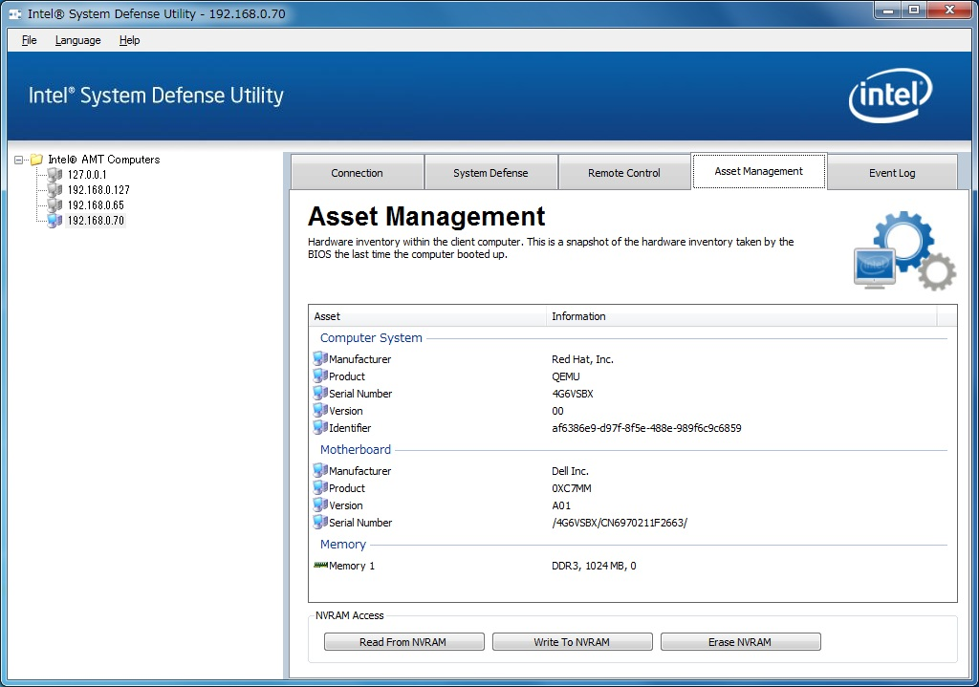

Connection: 97 requests of 26 CIM classes and 5 Web services to vAMT
Notes:
This is a screenshot of Intel System Defense Utility.
This tab shows hardware information. <click>
vAMT returns "Red Hat, Inc." as Manufacturer and "QEMU" as Product.
When this tool connected to vAMT, it sent 97 requests of 26 CIM classes and 5 Web services to vAMT.

Slide 22
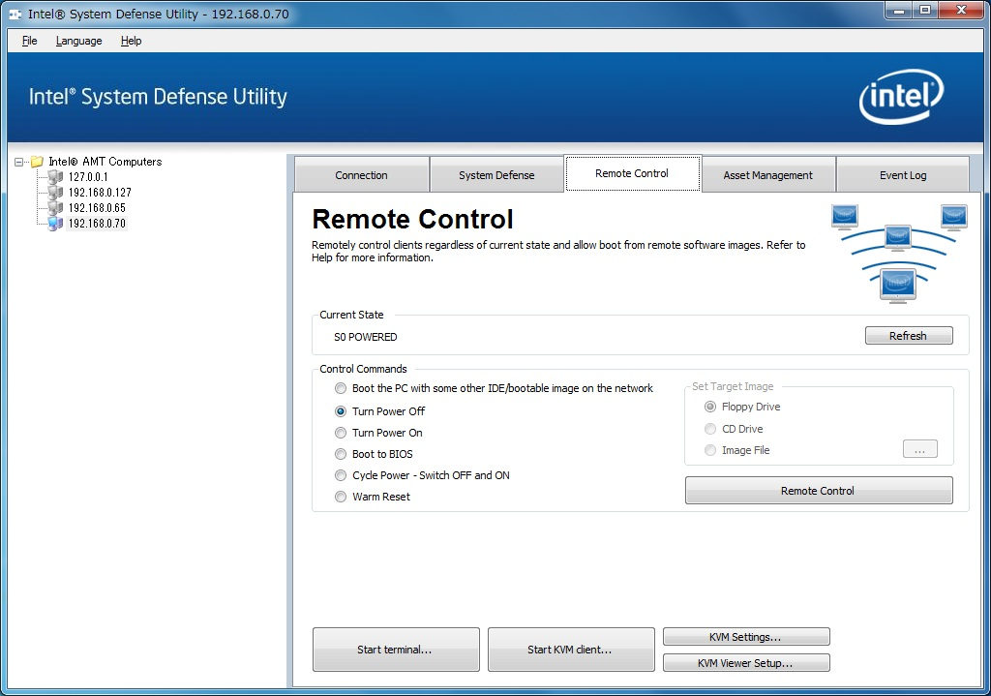
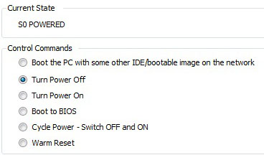
Notes:
This is the tab for power management. <click>
The current power state of a virtual desktop was shown like this.
We could change power state from this tab.

Slide 23
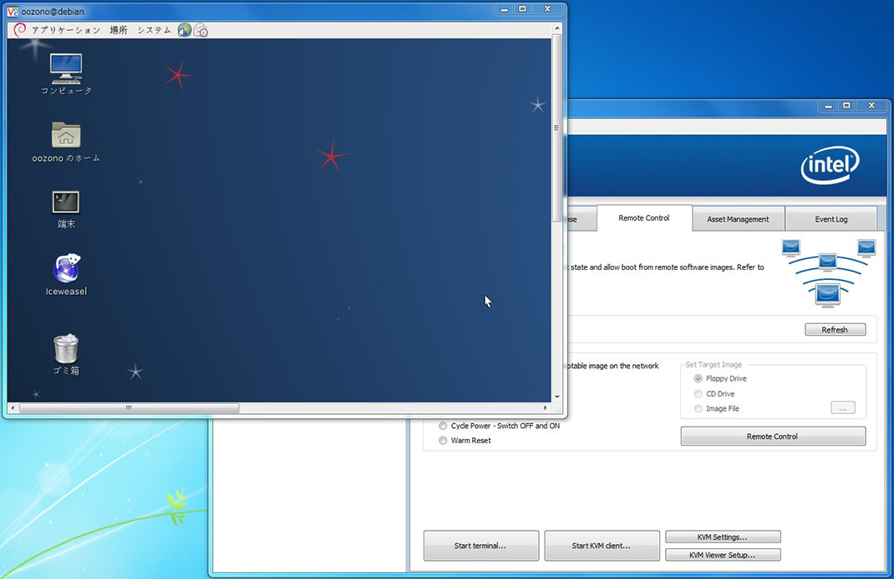
Notes:
When we clicked this button, "Start KVM client", a VNC client started like this.
The client connected to vAMT and could access the virtual desktop.

Slide 24
Obtaining the AMT Version
WinRM sent a request for one CIM class
GetInstance
where InstanceID=AMT
WinRM
vAMT
Version=...
> winrm g cimv2/CIM_SoftwareIdentity?InstanceID=AMT
-r:http://192.168.0.173:16992/wsman
CIM_SoftwareIdentity
InstanceID = AMT
IsEntity = true
VersionString = 7.1.4
Notes:
To examine the performance of vAMT, we first obtained the AMT version from vAMT and AMT.
We used WinRM, which is a command line tool for Windows.
This tool sent a WS-Management request by specifying the CIM_SoftwareIdentity class.
It received an instance whose InstanceID was AMT.
The instance had several properties including VersionString.

Slide 25
Performance Results
Physical desktop with AMT
  More than 2 seconds in a turned-off PC
    AMT was in the sleep mode
Virtual desktop with vAMT
  vAMT was always faster than AMT
    The host CPU was faster than the AMT chip
Notes:
For the physical desktop with AMT, it took more than 2 seconds in a turned-off PC.
This is because AMT was in the sleep mode.
The second access was less than 0.4 second.
In a turned-on PC, the access time was about 0.1 second.
For the virtual desktop with vAMT, it took less than 0.1 second.
So, vAMT was always faster than AMT.
This is because the host CPU used by vAMT was faster than the AMT chip.

Slide 26
Complex Operations
AssetDisplay sent multiple requests for each operation
  CPU information, power off
> AssetDisplay -processor -host 192.168.0.173
Device ID: CPU 0
Stepping: 7
Max Clock Speed: 2930
CPUStatus: CPU Enabled
Role: Central
Family: 198
Upgrade Method: Other
Manufacturer: Intel Corp.
Version: Intel(R) Core(TM) i7 CPU @ 2.93GH
Physical Position: CPU 1
Notes:
To execute more complex operations, we used the AssetDisplay command.
Unlike WinRM, AssetDisplay sent multiple requests for each operation.
We obtained CPU information and turned off a desktop.
For CPU information, the command obtained a device ID, clock speed, CPUStatus, a manufacturer, and so on.

Slide 27
Performance Results
Obtaining CPU information
  AMT was 1.9 times slower than vAMT
    Due to searching association information
Turning the power off
  vAMT was faster than AMT
    Performance difference was small
Notes:
When we obtained such CPU information, AMT was 1.9 times slower than vAMT.
This is due to searching association information between logical and physical devices and between physical device and physical location.
When we turned the power off, vAMT was still faster than AMT.
But the performance difference was small, which is similar to obtaining the AMT version.

Slide 28
Related Work
OpenIPMI lanserv simulator [Minyard]
  Communicate with a virtual IPMI device of QEMU-KVM
  Used for testing management tools for IPMI
CIM extension for virtualization [DMTF'07]
  Enable managing both physical and virtual desktops
  Still require differentiating them
VMware Horizon View, Microsoft SCCM
  Support both physical and virtual desktops
  Provide only agent-based management
Notes:
IPMI is also hardware-level management interface and used for server management.
For IPMI, several simulators have been developed.
OpenIPMI lanserv communicates with a virtual IPMI device of QEMU-KVM.
This is used for testing management tools for IPMI.
To manage VMs through CIM, the CIM extension for virtualization is defined.
This enables managing both physical and virtual desktops.
However, this extension still requires management tools differentiates them.
In addition, AMT does not support this extension.
Finally, VMware Horizon View, Microsoft SCCM, and other tools support both physical and virtual desktops.
But they provide only agent-based management.
We think agent-based management is still useful while the target system is running normally.

Slide 29
Conclusion
vAMT for managing virtual desktops
  Provide the same interfaces as AMT for physical desktops
  Enable unified desktop management
  Worked well with existing management tools for AMT
Future work
  Implement all the CIM providers and Web services
    E.g., packet filtering
  Implement unsupported interfaces
    E.g., serial over LAN (SOL)
Notes:
In conclusion, we proposed vAMT for managing virtual desktops.
vAMT provides the same interfaces as AMT for physical desktops.
Using AMT and vAMT enables unified management of both physical and virtual desktops.
According to our experimental results, vAMT worked well with existing management tools for AMT.
One of our future work is to implement all the CIM providers and Web services.
For example, we need packet filtering to protect virtual desktops under attacks.
Another is to implement unsupported interfaces.
Currently, vAMT supports three interfaces, but AMT provides other interfaces such as serial over LAN.

