Slide 1
VMBeam: Zero-copy Migration of
Virtual Machines for
Virtual IaaS Clouds
Kenichi Kourai
Hiroki Ooba
Kyushu Institute of Technology, Japan
Notes:
I'm Kenichi Kourai from Kyushu Institute of Technology, Japan.
I'm gonna talk about zero-copy migration of virtual machines for virtual IaaS clouds.
This is joint work with my student, who has graduated.

Slide 2
Virtual IaaS Clouds [Williams+ HotCloud'11]
Clouds constructed on existing IaaS clouds
  Secondary cloud service providers (CSPs) can manage their own clouds without having data centers
Guest VMs run inside cloud VMs
  Using nested virtualization [Ben-Yehuda+ OSDI'10]
cloud VM
cloud VM
guest
VM
guest
VM
guest
VM
virtual IaaS
cloud
IaaS
cloud
Notes:
Infrastructure-as-a-Service clouds are widely used as a basis of various services.
They provide users with virtual machines.
Recently, virtual IaaS clouds are emerging.
They are clouds constructed on top of existing IaaS clouds.
Like secondary Internet service providers, secondary cloud service providers can manage their own clouds without having data centers, which take high operational cost.
For example, they can provide value-added services such as intrusion detection in their own clouds.
In virtual IaaS clouds, using a technique called nested virtualization, guest VMs run inside cloud VMs, which are provided by the underlying clouds.

Slide 3
VM Migration in Virtual IaaS
Guest VMs can be migrated between cloud VMs
  Uninterrupted maintenance of cloud VMs
    E.g., update the hypervisor
  Consolidation into a fewer cloud VMs
    Save the cost of secondary CSPs
  Load balancing among cloud VMs
migration
cloud VM
cloud VM
guest
VM
guest
VM
guest
VM
virtual IaaS
cloud
Notes:
VM migration is still important in virtual IaaS clouds.
In traditional IaaS clouds, VMs are migrated between physical hosts.
Similarly, in virtual IaaS clouds, guest VMs can be migrated between cloud VMs.
VM migration enables uninterrupted maintenance of cloud VMs, for example, when the hypervisor inside them is updated.
In addition, VM migration is used to consolidate guest VMs into a fewer cloud VMs.
This saves the cost of secondary CSPs because virtual IaaS clouds can stop unused cloud VMs.
Also, load balancing among cloud VMs can be achieved by VM migration.

Slide 4
Co-located Cloud VMs
Cloud VMs can be co-located at the same host
  The probability is 8.4% at least in Amazon EC2 [Ristenpart+ CCS'09]
Beneficial to both primary/secondary CSPs
  Save cost by consolidating cloud VMs
  Enable faster communication (4.5 Gbps [Williams+ EuroSys'12])
cloud VM
cloud VM
guest
VM
guest
VM
guest
VM
host
...
IaaS
cloud
Notes:
Since a virtual IaaS cloud consists of many cloud VMs, some of them can be co-located at the same host.
This co-location occurs when the underlying IaaS cloud initially creates cloud VMs at the same host or migrates cloud VMs to the same host.
In fact, it is reported that the probability of the co-location was 8.4% at least in Amazon EC2.
The co-location is beneficial to both primary and secondary CSPs.
Primary CSPs can save cost by consolidating cloud VMs into a fewer physical hosts.
Secondary CSPs can enable fast communication between co-located cloud VMs.
For example, 4.5-Gbps communication is possible.

Slide 5
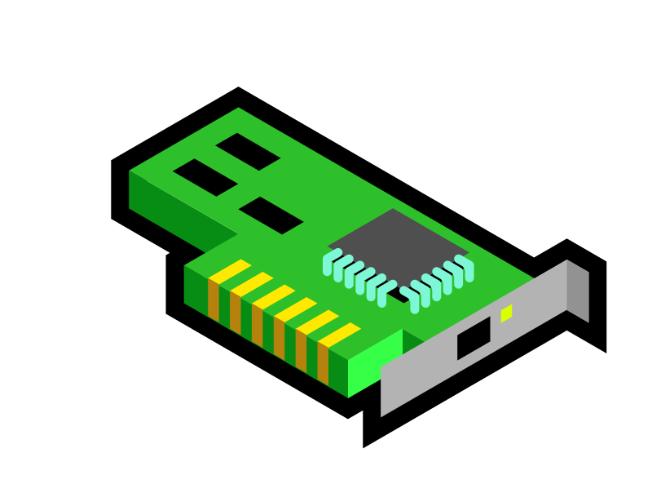
Low Migration Performance
VM migration between co-located cloud VMs is slower than the traditional one
  E.g., 6 minutes for a 4-GB guest VM (3.7x slower)
The root cause is double system loads
  NIC emulation, memory encryption, and memory copies
source cloud VM
destination cloud VM
encrypt
virtual
NIC
decrypt
guest
VM
cloned
guest VM
host
virtual
network
Notes:
So, VM migration between co-located cloud VMs is expected to be faster than traditional one between physical hosts.
However, this is not the case.
According to our experiment, VM migration took 6 minutes for a guest VM with 4 GB of memory.
This is 3.7 times slower.
The root cause of this low migration performance is double system loads.
One host plays two roles of the source and destination of VM migration.
Two virtual NICs have to be emulated for two cloud VMs, respectively.
The transferred memory image of a guest VM is encrypted to prevent eavesdropping and tampering.
In addition, the large memory image has to be copied many times.

Slide 6
Zero-copy Migration
Just relocate the memory of a guest VM between co-located cloud VMs
  No copy of the memory image of a guest VM
  No use of the virtual network
  No encryption of the memory image
source cloud VM
destination cloud VM
guest
VM
cloned
guest VM
memory
relocation
Notes:
To improve the migration performance of guest VMs, we propose zero-copy migration for virtual IaaS clouds.
Zero-copy migration optimizes VM migration between cloud VMs co-located at the same host.
It just relocates the memory of a guest VM at the source cloud VM to the destination one.
By copying no memory image of a guest VM, zero-copy migration can reduce the CPU and memory loads.
Since it uses no virtual network for data transfers, it doesn't suffer from the overhead of network virtualization.
It doesn't need the encryption of the memory image because no data is exposed to the outside of guest VMs.

Slide 7
Challenge
Live migration for negligible downtime
  Transfer the memory of a VM with the VM running
  Re-transfer modified memory regions repeatedly
Naive memory relocation cannot coexist with live migration
  A guest VM cannot continue to run after some pages have been relocated
source cloud VM
destination cloud VM
running
guest VM
cloned
guest VM
relocated
Notes:
A challenge is to support live migration used for achieving negligible downtime.
Live migration enables a guest VM to continue to run during VM migration.
For that, live migration first transfers the entire memory image of a guest VM with the VM running.
After that, it re-transfers modified memory regions repeatedly.
At the final stage, it stops the guest VM and transfers the remaining state.
Naive memory relocation cannot coexist with this live migration.
It takes time to complete the relocation of the entire memory of a guest VM.
After some pages of a guest VM have been relocated, the guest VM cannot continue to run without those pages.
Therefore, the guest VM has to be stopped during VM migration.

Slide 8
Support for Live Migration
Enable a guest VM to run during memory relocation
  Step 1: Share the memory between src/dst guest VMs
    The source guest VM can continue to run
  Step 2: Release the memory of the source guest VM
    After the destination guest VM starts running
source cloud VM
destination cloud VM
running
guest VM
cloned
guest VM
memory
sharing
Notes:
To support live migration, zero-copy migration consists of two steps for relocating the memory of a guest VM.
The first step is to share the memory between a running guest VM at the source cloud VM and a being cloned guest VM at the destination cloud VM.
This inter-guest memory sharing enables the source guest VM to run during memory relocation.
Even if the source guest VM accesses already shared memory, of course, it can access that memory.
The second step is to release the memory of the source guest VM.
This is done after the destination guest VM starts running.
At this time, the source guest VM is already stopped.
As such, the downtime becomes negligible.

Slide 9
No Memory Re-transfer
Zero-copy migration is completed in one iteration
  Not repeat to re-transfer modified memory regions
    Traditional live migration needs multiple iterations
  Modifications are directly reflected to the destination guest VM by memory sharing
  Reduce the migration time and downtime
source cloud VM
destination cloud VM
running
guest VM
cloned
guest VM
shared
Notes:
Using inter-guest memory sharing, zero-copy migration is completed in only one iteration.
Traditional live migration needs multiple iterations because it has to re-transfer memory regions modified by a VM again and again until the re-transfer size becomes small enough.
If the source guest VM modifies its memory frequently, the number of the iterations increases.
In contrast, zero-copy migration doesn't repeat such re-transfers.
Modifications in the source guest VM are directly reflected to the destination one by inter-guest memory sharing.
This can reduce both the migration time and downtime.

Slide 10
Experiments
We have implemented VMBeam in Xen 4.2
  Enable zero-copy migration
We confirmed the effectiveness of zero-copy migration
  Migration performance and system loads
Comparison
  Xen with nested virtualization
  Xen-Blanket [Williams+ EuroSys'12]
    System with nested virtualization
    and fast virtual network
host
CPU: Intel Xeon E5-2665
Memory: 32 GB
NIC: Gigabit Ethernet
Notes:
We have implemented a system called VMBeam for enabling zero-copy migration in Xen 4.2.
To confirm the effectiveness of zero-copy migration in VMBeam, we measured migration performance and system loads.
For comparison, we used two existing systems.
One is the traditional Xen with nested virtualization.
The other is Xen-Blanket, which is the system with nested virtualization and fast virtual network between co-located cloud VMs.

Slide 11
Migration Performance
We measured the migration time and downtime
  VMBeam achieved the shortest migration time
    Up to 7.5x faster than Xen-Blanket
  VMBeam achieved the shortest downtime (0.6s)
16s
Notes:
First, we measured the migration time and downtime.
The left figure shows the migration time.
The red line is our VMBeam, the green line is the traditional Xen, and the blue line is Xen-Blanket.
The migration time was proportional to the memory size, but in VMBeam, the time didn't increase largely.
VMBeam achieved the shortest migration time and could complete the migration of a guest VM with 4 GB of memory in only 16 seconds.
This is 7.5 times faster than Xen-Blanket with fast virtual network.
For downtime, VMBeam also achieved the shortest downtime, which was about 0.6 seconds.
Unlike the migration time, the downtime in Xen-Blanket was the worst.
The root cause of this is under investigation.

Slide 12
System Loads
We measured system loads during VM migration
  VMBeam did not transfer data via virtual network
  It used only 12.5% of CPU time in Xen-Blanket
  It did not access the VM memory (estimated)
0
3
0
Notes:
Second, we measured system loads during VM migration when we migrated a guest VM with 4 GB of memory.
For network, the traditional Xen and Xen-Blanket transferred about 4 GB of data, but VMBeam almost didn't use virtual network.
For CPU, we measured the CPU utilization and calculated the total CPU time.
VMBeam used only 12.5% of CPU time in Xen-Blanket.
This is because the migration time in VMBeam was much shorter.
For memory, we estimated the amount of memory access because we couldn't obtain the statistics from hardware.
In the traditional Xen and Xen-Blanket, the memory data of a guest VM was accessed several times during the transfer, so the memory access was tens of gigabytes.
But VMBeam didn't access the memory at all thanks to inter-guest memory sharing.

Slide 13
Memory-intensive Workload
We changed the memory dirty rate of a VM
  The migration time and downtime in VMBeam were constant
  Those in the other systems increased drastically
Notes:
Finally, we examined how memory writes in a guest VM affected migration performance.
In live migration, memory writes can increase the migration time because modified memory regions are re-transferred.
So, we changed the number of modified pages in a guest VM and measured the migration time and downtime.
As shown in the red lines, these times were constant in VMBeam.
This comes from no memory re-transfers in VMBeam.
On the other hand, these times in the other systems increased drastically, as shown in the blue and green lines.

Slide 14
Related Work
RDMA-based migration [Huang+ Cluster'07]
  Only one copy by InfiniBand
  Need 3 copies when encrypting the memory image
Limiting a migration speed [Clark+ NSDI'05]
  Reduce peak system loads
  Result in longer migration time and downtime
Page-sharing techniques among VMs
[Waldspurger+ OSDI'02][Gupta+ OSDI'08][Milos+ ATC'09]
  Use copy-on-write
  Stop sharing when shared pages are modified
Notes:
RDMA-based migration needs only one copy by InfiniBand, that is, zero copy by software.
The memory image of a VM is directly copied to the destination host using RDMA.
But this method needs 3 copies when the memory image has to be encrypted.
To reduce system loads during VM migration, a technique of limiting a migration speed has been proposed.
This technique simply limits the network bandwidth used by VM migration, but this results in longer migration time and downtime.
Many techniques for page sharing among VMs have been proposed.
Since all of them use copy-on-write, page sharing is stopped when shared pages are modified.

Slide 15
Conclusion
Propose zero-copy migration for virtual IaaS clouds
  Just relocate the memory of a guest VM between co-located cloud VMs
  Support live migration by temporal memory sharing
  Achieve high migration performance and low system loads
Future work
  Switch the traditional and zero-copy migration transparently
Notes:
In conclusion, we proposed zero-copy migration for virtual IaaS clouds.
Zero-copy migration just relocates the memory of a guest VM between cloud VMs co-located at the same host.
Naive memory relocation cannot coexist with live migration, so zero-copy migration supports live migration by temporarily sharing the memory of a guest VM.
We have implemented zero-copy migration and achieved high migration performance and low system loads.
Our future work is to transparently switch the traditional migration and zero-copy migration by considering the location of the source and destination cloud VMs.
To enable this, we need a mechanism to obtain information on VM placement from the underlying IaaS clouds.

