Slide 1
Virtualized Adaptable Computing with Elastic Split-memory Virtual Machines
Kenichi Kourai
Kyushu Institute of Technology
Notes:
I'm Kenichi Kourai from Kyushu Institute of Technology.
I'm gonna talk about Virtualized Adaptable Computing with Elastic Split-memory Virtual Machines.

Slide 2
IaaS Clouds
Provide users with virtual machines (VMs)
  Users can create VMs whenever they want
  They can install their systems in VMs
Consolidate many VMs into a small number of hosts
  Use physical servers
  efficiently
  Reduce cost
VM
VM
VM
IaaS cloud
Notes:
Recently, cloud computing is widely used.
There are various types of clouds.
One of them is Infrastructure-as-a-Service clouds, shortly IaaS clouds.
IaaS clouds provide users with virtual machines, VMs.
VMs are virtual computers created using software.
In IaaS clouds, users can create VMs whenever they want.
Then, they can install their favorite operating systems and applications in the VMs.
Usually, IaaS clouds consolidate many VMs into a smaller number of hosts to use physical servers efficiently and reduce cost.

Slide 3
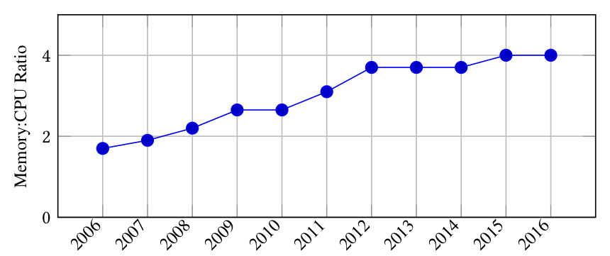
Large-memory VMs
IaaS clouds also provide VMs with a large amount of memory
  Amazon EC2 provides VMs with up to 4 TB of memory
  The ratio of memory size to CPU size is increasing [Nitu+, EuroSys'18]
Required for big
data analysis
  AI and IoT
Notes:
As a recent trend, IaaS clouds also provide VMs with a large amount of memory.
For example, Amazon EC2 provides VMs with up to 4 TB of memory.
Amazon is planning VMs with 16 TB of memory.
In VMs provided by Amazon EC2, the ratio of memory size to CPU size is increasing, as shown in this figure.
In this decade, the average memory size of a VM was doubled.
Such large-memory VMs are required for big data analysis.
Big data can be analyzed more efficiently by maintaining data in memory as much as possible.
Big data analysis is critical in artificial intelligence and Internet of Things.

Slide 4
VM Migration
Enable a running VM to be moved to another host
  Prevent service disruption during host maintenance
  Transfer its entire memory to the destination host
VM
new VM
memory
memory data
memory
original host
destination host
Notes:
Since VMs can be managed by software, they provide many great features.
One of them is VM migration.
VM migration enables a running VM to be moved to another host without stopping the target VM.
Using VM migration, administrators can maintain a host without service disruption after they migrate all the VMs running in that host.
Then, after the maintenance of the host, they can migrate VMs back to the original host.
VM migration first creates a new empty VM at the destination host.
Then, it transfers the memory contents of a VM to the destination and stores them in the memory of the created VM.
As such, it copies the entire memory of the original VM to the new VM at the destination host.
Finally, it transfers VM’s other states and switches to the new VM.

Slide 5
Issues in
Migration of Large-memory VMs
The migration time is proportional to the memory size
  Solved by faster network and parallel transfer
Destination hosts also need to have a large amount of free memory
  It is not cost-efficient to reserve such hosts
VM
4 TB
4-TB free
memory
reserved host
Notes:
However, there are two issues to migrate large-memory VMs.
One is the migration time.
The migration time is the time to complete VM migration.
It is basically proportional to the memory size of a migrated VM.
So, as the memory size of a VM increases, the migration time becomes longer.
This issue can be solved by using faster network and parallel memory transfer.
The other unresolved issue is the availability of the destination host.
Since a large-memory VM runs at the destination host after VM migration, the destination host also needs to have an equal or larger amount of memory than the original host.
But it is not cost-efficient to always reserve such hosts as the destination of VM migration, even if possible in clouds.

Slide 6
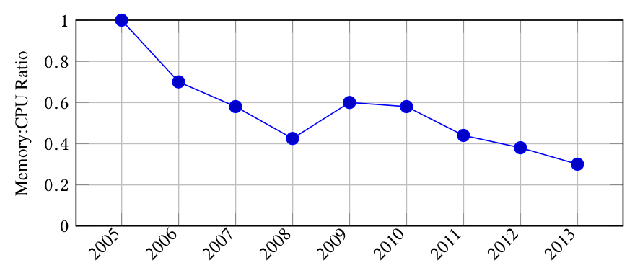
Trend of Physical Servers
The increase in memory capacity is slower
  The memory capacity per CPU core drops by 30% every two years [Nitu+, EuroSys'18]
Larger-capacity memory modules are much more expensive
  E.g., the cost of 128-GB memory is 5x higher than 64-GB one
Notes:
One reason is that the trend of physical servers is opposite to that of VMs.
The increase in memory capacity is slower than that in the number of CPU cores.
This figure shows the change in ratio of memory size to CPU size in physical servers.
The memory capacity per CPU core drops by 30% every two years.
In addition, larger-capacity memory modules are much more expensive.
For example, the cost of 128-GB memory is 5 times higher than 64-GB one.
To equip physical servers with a large amount of memory, larger-capacity memory modules are needed.
So, the cost of such hosts also increases.

Slide 7
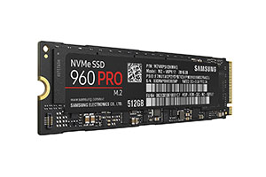

Traditional Approach
Use virtual memory to store part of memory data in storage
  The system can run VMs with a larger amount of memory than physical memory
Recent NVMe SSDs are fast and cheap
  3.4 GB/s (read), 2.5 GB/s (write), $400 for 1 TB
virtual memory
4 TB
$$≈$$
2 TB
2 TB
SSD
Notes:
The traditional approach to this issue is to use virtual memory.
Virtual memory is a mechanism of the operating system and enables transparently storing part of memory data in storage.
Using virtual memory, the system can run VMs with a larger amount of memory than physical memory.
If physical memory becomes full, some data in memory is moved to storage.
It the data in storage is required, it is swapped with some data in memory.
Traditionally, slow HDDs are used as storage for virtual memory, but recent SSDs are fast and cheap.
For example, some product achieves 3.4 GB/s for sequential read and 2.5 GB/s for write.
It costs $400 for 1 TB.

Slide 8
Performance Degradation
Even fast SSDs are slower than memory
  Virtual memory degrades migration performance
    Data is stored in storage during VM migration
  It also degrades application performance after VM migration
    Data is swapped between memory and storage when necessary
VM
VM
2 TB
swap
4 TB
2 TB
SSD
Notes:
However, even fast SSDs are still slower than memory.
The transfer rate of the latest DDR4 memory is 34 GB/s.
This is 10 times faster than SSDs.
So, using virtual memory degrades migration performance.
During VM migration, part of transferred memory data is stored in storage.
This makes the migration time longer.
Virtual memory also degrades application performance after VM migration.
Whenever a VM requires data in storage, the data is swapped between memory and storage.

Slide 9
Migration Performance
The migration time is 2.2x longer in SSD
  11.7x longer in HDD
The downtime is 4 seconds in SSD
  30 seconds in HDD
30s
11.7x
2.2x
4s
0.4s
Notes:
This is the comparison of migration performance.
The left figure shows the migration time of a VM with 12 GB of memory using 10 Gigabit Ethernet.
Compared with normal VM migration with memory only, the migration time is 2.2 times longer when using SSD.
Using slower HDD, the migration time is 11.7 times longer.
The other indicator of VM migration is the downtime.
The downtime is the time during which a VM stops in the final phase of VM migration.
The right figure shows the downtime.
In normal VM migration, the downtime is only 0.4 seconds.
But when using SSD, the downtime increases to 4 seconds.
When using HDD, it reaches 30 seconds.
These increases are not acceptable.

Slide 10
Performance after Migration
The throughput of in-memory database is largely degraded
  By 95% in SSD just after migration
  It takes 21 minutes to restore the performance
Notes:
This is the comparison of application performance after VM migration.
The used application is in-memory database, which stores data in memory.
The throughput of in-memory database is largely degraded.
The performance degradation is 95% in SSD just after VM migration.
The throughput is gradually increasing after that.
But it takes 21 minutes to restore the same performance as before VM migration.
When using HDD, the throughput is not restored at all.

Slide 11
Our Approach: Split Migration
Migrate a VM to multiple hosts
  Divide its memory into smaller pieces
  Transfer them to the main host or sub-hosts
    The main host manages memory locations
  Enable fast migration without accessing storage
VM
VM
4 TB
2 TB
2 TB
main host
sub-hosts
Notes:
So, we propose a new VM migration method called split migration.
Split migration migrates a large-memory VM running in one host to multiple destination hosts, instead of using one destination host and its storage.
The destination hosts consist of one main host and one or more sub-hosts.
Split migration divides VM’s memory into smaller pieces.
Then, it transfers them to the main host or sub-hosts.
The main host manages memory locations.
Since split migration does not access storage during VM migration, it enables fast migration.

Slide 12
Split-memory VM
A VM running across multiple hosts
  VM core runs in the main host
    E.g., virtual CPUs and virtual devices
  Memory is swapped between the main host and sub-hosts
    When the VM requires memory in sub-hosts
VM
swap
2 TB
2 TB
main host
sub-hosts
Notes:
After split migration, a VM is running across multiple hosts.
This VM is called a split-memory VM.
In a split-memory VM, VM core such as virtual CPUs and virtual devices runs in the main host.
VM’s memory is split into the main host and sub-hosts.
When the VM requires memory in sub-hosts, memory is swapped between the main host and sub-hosts.
Specifically, the required memory in a sub-host is transferred to the main host.
Then, unused memory in the main host is transferred to the sub-host.

Slide 13
Prediction of Memory Access
Reducing memory swaps is the key to efficient execution
  Need the prediction of VM’s memory access
Based on Least Recently Used (LRU)
  Not recently used memory will not be used
  Keep track of memory access history of a VM
recently used
memory
access
history
likely to be used
unlikely to be used
not recently used
Notes:
Since split-memory VMs perform memory swaps between the main host and sub-hosts, reducing memory swaps is the key to the efficient execution of split-memory VMs.
Recent network between hosts is being fast, but that is still slower than memory.
So, frequent memory swaps largely degrade VM’s performance.
For less memory swaps, the prediction of VM's memory access is needed.
Our memory access prediction is based on the Least Recently Used algorithm.
This is well known in cache replacement.
Using this algorithm, our system predicts that not recently used memory will not be used in the near future.
To obtain necessary information, our system keeps track of memory access history of a VM.

Slide 14
Efficient Split-memory VMs
Split migration transfers memory likely to be accessed to the main host
  Suppress memory swaps after split migration
Split-memory VMs swap out memory unlikely to be accessed
  Prevent back-and-forth between hosts
VM
unlikely
VM
4 TB
2 TB
2 TB
likely
unlikely
main host
sub-host
Notes:
On the basis of memory access prediction, split migration transfers memory likely to be accessed to the main host.
This suppresses memory swaps after VM migration.
The rest of the memory is transferred to one of the sub-hosts.
When split-memory VMs swap memory between the main host and sub-hosts, they swap out memory unlikely to be accessed.
This prevents the memory from being transferred back and forth between the hosts.

Slide 15

Demo of Memory Transfers
During split migration
red: memory
at a sub-host
main host
sub-host
Notes:
This is the demo of memory transfers during split migration.
This black region represents VM's memory at a sub-host.
Before split migration, there is no VM's memory.
When a sub-host receives memory of a VM, the region becomes red.
Finally, the sub-host receives half of the entire memory.

Slide 16

Demo of Memory Swaps
After split migration
red: memory
at a sub-host
black: memory
at the main host
main host
sub-host
Notes:
The next demo is memory swaps after split migration.
The red region means memory at a sub-host.
The black regions means memory at the main-host.
During the execution of the sort command, a large amount of memory is swapped.

Slide 17
Performance of Split Migration
The migration time is 5% longer
  2.2x shorter than when using SSD
The downtime is 7 ms longer
  3.4 seconds shorter than when using SSD
1.05x
+7ms
Notes:
Here is the performance of split migration.
The left figure shows the migration time.
Compared with normal VM migration with memory only, the migration time is only 5% longer.
This is the overhead of deciding the destination hosts of memory.
This is 2.2 times shorter than when using SSD.
The right figure shows the downtime.
The downtime is only 7 ms longer than normal VM migration.
This is 3.4 seconds shorter than when using SSD.

Slide 18
Performance of a Split-memory VM
The stable throughput of in-memory database is degraded by 0.6%
  Largely degraded only just after migration
  Restored in 5 seconds
Notes:
Here is the performance of a split-memory VM.
Compared with normal VM execution, the stable throughput of in-memory database is degraded by only 0.6%.
The throughput is largely degraded just after migration, but the performance is restored only in 5 seconds.

Slide 19
Effectiveness of Prediction
The recovery time is 55 seconds shorter than random memory swaps
  The throughput is 4.4x higher just after migration
  Even the stable throughput is 7% higher
7%
Notes:
Finally, here is the comparison of our prediction algorithm with the random one.
In the random algorithm, it takes 60 seconds to restore the performance.
So the recovery time is 55 seconds shorter by accurate prediction.
Just after split migration, the throughput of in-memory database is 4.4 times higher than the random algorithm.
Even the stable throughput after recovery is 7% higher.

Slide 20
Unified Migration
Future Direction
A split-memory VM still degrades performance due to memory swaps
  Running the VM in one host is desirable if possible
Migrate a split-memory VM to one large host
  Transfer memory in parallel
VM
VM
2 TB
2 TB
4 TB
sub-host
main host
destination host
Notes:
I present our future direction of this research.
The performance of a split-memory VM is improved by memory access prediction.
But a split-memory VM still degrades performance when memory swaps are unavoidable.
So, it is desirable to run the VM in one host if possible and improve the performance.
Unified migration migrates a split-memory VM running across multiple hosts to one large host.
It transfers VM core and memory in the main host to the destination host.
In parallel, it also transfers memory in sub-hosts to the destination one.

Slide 21
Partial Migration
Future Direction
Presented in today’s poster session
A split-memory VM is stopped even when only several hosts are maintained
  Continuing to run the VM is desirable
Migrate part of a split-memory VM to other hosts
  Between main hosts or between sub-hosts
VM
2 TB
2 TB
2 TB
main host
sub-host 1
sub-host 2
Notes:
Since a split-memory VM runs across multiple hosts, it is necessary that all of the hosts run normally.
Even when only some of the hosts are stopped for maintenance, a split-memory VM has to be stopped.
It is desirable to continue to run the VM even during the maintenance of several hosts.
Partial migration migrates part of a split-memory VM to other hosts.
For example, it can transfer VM core and memory in the main host to another main host.
It can transfer memory in sub-hosts to other sub-hosts.
Unified migration and partial migration will be presented in the poster session.

Slide 22
Considering Host/network Difference
Future Direction
Which destination hosts are used is critical
  Performance depends on that of hosts and their network
Split migration selects the best hosts
  Consider CPU, memory, and network latency/ bandwidth
VM
4 TB
sub-host?
main host?
sub-host?
destination host
Notes:
The performance of a split-memory VM depends on that of hosts and their network.
If the CPUs and memory of hosts are slow, the execution of a split-memory VM is affected.
If the network between the main host and sub-hosts is slow, the performance of memory swaps is affected.
Which destination hosts are used is critical for split-memory VMs.
So, split migration needs to select the best combination of hosts.
It has to consider CPUs and memory of selected hosts.
Also, it has to consider network latency and bandwidth.

Slide 23
Intrusion/Fault Detection
Future Direction
Intrusion and faults can be detected by monitoring VM’s memory
  It is difficult to monitor split-memory VMs
Transparently monitor the distributed memory of a split-memory VM
  Analyze the system state in the memory
VM
4 TB
IDS
2 TB
2 TB
main host
sub-host
Notes:
VMs often suffer from attacks from the outside and attackers attempt to intrude into VMs.
System faults occur inside VMs due to bugs.
Such intrusion and faults can be detected by monitoring VM’s memory from the outside.
Since the system state is stored in the memory, it is possible to find signs of intrusion and faults.
But it is difficult to monitor split-memory VMs because its memory is distributed across multiple hosts.
So it is necessary to transparently monitor the distributed memory of the VM.
Then IDS and fault detectors analyze the system state in the memory and detect intrusion and faults.

Slide 24
Fault Tolerance of Sub-hosts
Future Direction
Several sub-hosts used by a split-memory VM can be crashed
  Part of VM’s memory is lost
Replicate the memory in sub-hosts
  Update all the replicas whenever swapping out memory
VM
replica
2 TB
2 TB
2 TB
main host
sub-host
Notes:
Hardware faults can occur in several sub-hosts.
So, some of the sub-hosts used by a split-memory VM can be crashed.
This results in losing part of VM’s memory.
At this time, a split-memory VM cannot run correctly.
Partial migration cannot be used because the crashed sub-hosts cannot transfer memory data.
The solution is to replicate the memory in sub-hosts.
Whenever swapping out memory from the main host to a sub-host, all the replicas have to be updated.

Slide 25
Conclusion
Split migration and split-memory VMs
  Split migration migrates a large-memory VM to multiple hosts
    Using the memory of smaller hosts
  Split-memory VMs swap memory between hosts
  VM’s memory access is predicted to reduce memory swaps
Notes:
In conclusion, I presented split migration and split-memory VMs.
Split migration migrates a large-memory VM to multiple hosts.
This enables using the memory of smaller hosts even if one large host is not available.
After split migration, split-memory VMs run, swapping memory between hosts.
To reduce memory swaps and improve the performance, VM’s memory access is predicted.

Slide 26
Collaborators
Masato Suetake
Takahiro Kashiwagi
Hazuki Kizu
Yuji Muraoka
Koki Yamato
Notes:
These students are my collaborators.

