Slide 1
Efficient Page-cache Encryption for
Smart Devices with
Non-volatile Main Memory
Kenichi Kourai, Naoto Fukuda, and Tomohiro Kodama
Kyushu Institute of Technology, Japan
Notes:
I'm Kenichi Kourai from Kyushu Institute of Technology.
I'm gonna talk about Efficient Page-cache Encryption for Smart Devices with Non-volatile Main Memory.
This is joint work with my students, who have graduated.

Slide 2
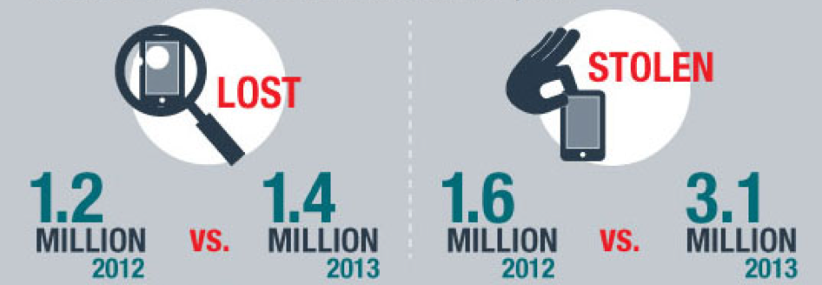
Theft of Smart Devices
Smart devices are at higher risk of theft
  Much smaller and more lightweight than laptops
  3.1M devices were stolen in the U.S. (2013)
Users suffer from larger damages
  A larger amount of more sensitive information
  E.g., personal and customer information
2014 Annual State of
the Net Survey
Notes:
Recently, smart devices such as smart phones and tablets are widely used.
They are at higher risk of theft because they are much smaller and more lightweight than laptop PCs.
In fact, 3.1 million devices were stolen in the U.S. in 2013.
Since smart devices store a larger amount of more sensitive information than traditional cellular phones, users suffer from large damages on device theft.
For example, personal information such as passwords and credit card numbers and customer information such as phone numbers and e-mail addresses can leak.

Slide 3

Full Disk Encryption (FDE)
A mechanism for encrypting the entire disk partitions
  Recent OSes enable FDE to protect sensitive data
  E.g., dm-crypt in Android OS
Attackers cannot decrypt data
  Unless they know user's PIN or password
PIN
encrypted
disk
?
FDE
OS
Notes:
In case of device theft, recent operating systems for smart devices enable full disk encryption by default to protect sensitive data in a disk.
Full disk encryption is a mechanism for encrypting the entire disk partitions.
For example, Android uses dm-crypt in Linux and encrypts the partition where applications' data is located.
To use full disk encryption, a user inputs a PIN or password at boot time.
A key is generated from the input information and the master key is decrypted using it.
So, even if attackers obtain encrypted data from a disk using physical attacks, they cannot decrypt it unless they know user's PIN or password.

Slide 4
Information Leak from Memory
Non-volatile main memory (NVMM) is emerging
  E.g., STT-MRAM and NVDIMM
  Keep data without a power supply
Attackers can steal sensitive data from NVMM more easily
  Any data in NVMM is not destroyed by power-off
Notes:
However, recently, information leak from memory is being critical.
This is because non-volatile main memory such as STT-MRAM and NVDIMM is emerging.
Unlike traditional volatile memory such as DRAM, non-volatile memory can keep data without a power supply.
So, it is expected that non-volatile main memory replaces DRAM in smart devices to reduce power consumption.
On the other hand, attackers can mount physical attacks and steal sensitive data from non-volatile main memory more easily than from DRAM.
Any data in non-volatile main memory isn't destroyed even if attackers power off stolen devices to prevent the systems from erasing sensitive data.

Slide 5
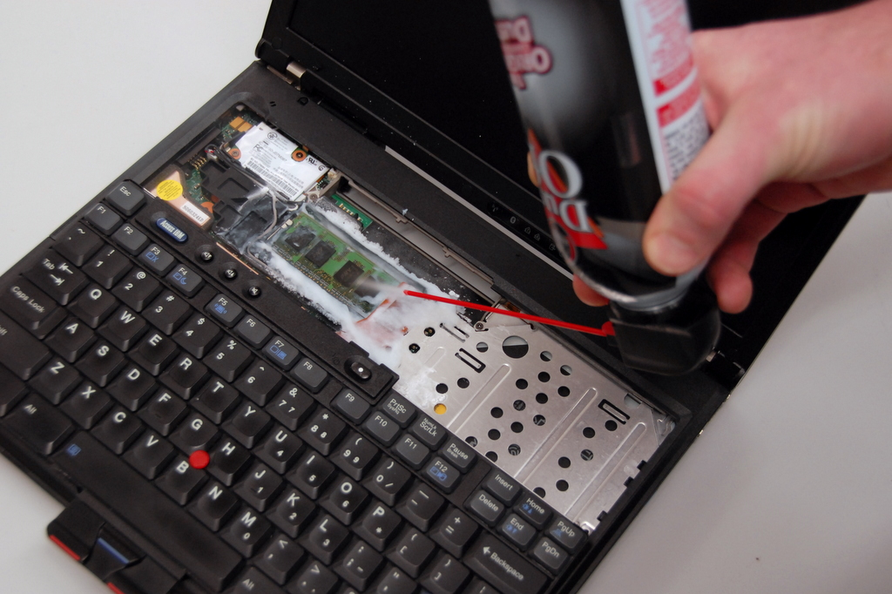
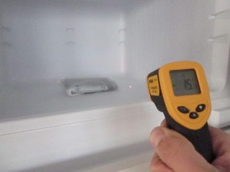
Cold boot Attack [Halderman et al.'08]
Real threat for currently used DRAM
  Cool memory modules to delay data destruction without a power supply
  Attach the modules to attacker's device
Also reported for Android devices [Muller et al.'13]
Notes:
Non-volatile main memory isn't widely used yet, but information leak from memory is already a real threat.
Even for currently used DRAM, the cold boot attack is possible to physically steal sensitive data.
This attack cools the memory modules of a device, removes them from the device, and attaches them to attacker's device.
Usually, data in volatile memory is gradually destroyed while a power isn't supplied to the memory modules.
Cooling memory modules can delay this data destruction without a power supply.
The cold boot attack has been also reported for Android devices.
Instead of removing memory modules, the reported attack resets a device and boots it using attacker's system.

Slide 6
Our Focus: the Page Cache
Preserve disk data for faster file access
  Data read from a disk
  Data written by applications
Part of the disk data leaks even under FDE
  The size of the page cache is increasing
application
OS
encrypted
disk
filesystems
page cache
FDE
Notes:
There are various data in memory, but we focus on the page cache.
The page cache is used for making file access faster by the operating system and preserves disk data temporarily.
When an application reads a file, the operating system reads file blocks from a disk and stores them in the page cache.
If an application accesses the same file blocks later, the operating system can return the data in the page cache immediately.
When an application writes data to a file, the operating system stores it in the page cache and writes it back to a disk later.
As a result, part of the disk data leaks even if a disk is encrypted by full disk encryption.
Recently, the amount of memory equipped with smart devices is increasing.
Since most of the free memory is used as the page cache, the size of the page cache is also increasing.
This means the amount of stolen data tends to increase.

Slide 7
Cache-Crypt
Efficient page-cache encryption
  Keep data in the page cache encrypted
    Decrypt it only when applications access files
    Protect it from physical attacks
  Independent of individual filesystems
application
OS
VFS
Cache-
Crypt
encrypted
page cache
decrypted
data
encrypted
data
filesystems
Notes:
To prevent information leak from the page cache, we propose efficient page-cache encryption called Cache-Crypt.
Cache-Crypt keeps data in the page cache encrypted while the data isn't accessed.
Cache-Crypt decrypts necessary data only when applications access files.
So, it can protect data in the page cache even if attackers physically eavesdrop on the entire main memory.
As illustrated in this figure, the virtual filesystem invokes Cache-Crypt and accesses the encrypted page cache.
Cache-Crypt is independent of individual filesystems.
It is easy to use Cache-Crypt with full disk encryption, which is performed in the layer below filesystems.

Slide 8
Threat Model
Attackers eavesdrop on the page cache using physical attacks
  Not consider information leak from the other kernel memory or process memory
    Use process memory encyption [Peterson'10] [Papadorpoulos et al.'17]
  Not consider data theft inside the system
    Intrusion or malware installation
Notes:
We assume that attackers eavesdrop on the page cache using physical attacks such as the cold boot attack.
We don't consider information leak from the other kernel memory or process memory.
For process memory, several encryption techniques have been proposed.
Also, we don't consider data theft inside the system.
Intrusion into the system can be detected by intrusion detection systems.
Malware installed in the system can be detected by malware detection.

Slide 9
Design Issue
Cache-Crypt should be well integrated with FDE (dm-crypt)
  Avoid redundant cryptographic operations
  Avoid the increase in management cost
    E.g., key management
encrypt
decrypt
decrypt
encrypt
decrypted
data
Cache-
Crypt
encrypted
page cache
dm-crypt
encrypted
data
OS
encrypted disk
Notes:
One design issue is how well Cache-Crypt is integrated with full disk encryption, specifically, dm-crypt.
First, Cache-Crypt needs to avoid redundant cryptographic operations.
Without integration, when data is read from an encrypted disk, dm-crypt first decrypts it.
Then, Cache-Crypt encrypts it again to store the data in the encrypted page cache.
Conversely, when modified data in the encrypted page cache is written back to a disk, Cache-Crypt first decrypts it.
Then, dm-crypt encrypts it again.
Second, Cache-Crypt needs to avoid the increase in management cost.
Without integration, Cache-Crypt also needs encryption keys.
So it needs new management tools.

Slide 10
Direct Read from a Disk
dm-crypt directly stores encrypted data from a disk to the page cache
  Decryption by dm-crypt is bypassed
    Metadata is still decrypted
  Register cryptographic information to Cache-Crypt
    Decryption key and sector numbers
crypto info
Cache-Crypt
encrypted
page cache
dm-crypt
encrypted data
encrypted disk
OS
Notes:
In Cache-Crypt, when data is read from an encrypted disk, dm-crypt directly stores the data in the page cache.
Decryption by dm-crypt is bypassed at this time.
Instead, dm-crypt registers cryptographic information needed for later decryption to Cache-Crypt.
That information includes the decryption key used in dm-crypt and associated sector numbers used as initialization vectors for decryption.
Note that metadata is still decrypted as usual by dm-crypt.
Unlike file data, metadata is processed by the virtual file system and individual filesystems.
If dm-crypt doesn't decrypt metadata, Cache-Crypt would have to repeat decryption and encryption.
This increases performance overhead and complicates the implementation.
In addition, metadata does usually not include sensitive information.

Slide 11
Read from the Page Cache
Cache-Crypt decrypts data in the page cache
  Using registered cryptographic information
  Metadata is already decrypted
Only one decryption is performed
application
decrypt
OS
VFS
Cache-
Crypt
encrypted
page cache
decrypted
data
encrypted
data
Notes:
When an application issues the read system call, Cache-Crypt decrypts data in the page cache using the registered cryptographic information.
Note that metadata is already decrypted in the page cache.
Then, the virtual filesystem stores the decrypted data in application's buffer.
The application can handle the returned data without being aware of encryption by Cache-Crypt.
As in dm-crypt only, only one decryption is performed.

Slide 12
Write to the Page Cache/Disk
Cache-Crypt encrypts data in application's buffer
  Decrypt data in the page cache if necessary
dm-crypt directly writes it back to a disk
  Encryption by dm-crypt is bypassed
encrypt
VFS
Cache-
Crypt
encrypted
page cache
decrypt
dm-crypt
write
OS
Notes:
When an application writes data to a file using the write system call, Cache-Crypt encrypts the data in application's buffer and stores it in the page cache.
The application isn't aware of encryption by Cache-Crypt.
At this time, Cache-Crypt also decrypts data in the page cache if necessary.
If the start and end of the written data aren't aligned to the boundary of 512-byte blocks used by dm-crypt, Cache-Crypt decrypts only the first and last blocks in advance.
Note that it doesn't decrypt in-between blocks because they are completely overwritten.
When the data in the page cache is written back, dm-crypt directly writes encrypted data to a disk.
Encryption by dm-crypt is bypassed, but metadata is encrypted at this time.
As in dm-crypt only, only one encryption is performed.

Slide 13
Retrieving Cryptographic Information
dm-crypt cannot register cryptographic information before encryption
  It is not invoked until writeback
Cache-Crypt retrieves necessary information from dm-crypt
  When the page cache is allocated
page
cache
block
device
dm-crypt
config
crypt
device-mapper
table
Notes:
Unlike file read, dm-crypt cannot register cryptographic information to Cache-Crypt before Cache-Crypt encrypts written data.
dm-crypt isn't invoked until data in the page cache is written back to a disk.
This means Cache-Crypt cannot use information registered by dm-crypt.
So, Cache-Crypt retrieves necessary information from dm-crypt when the page cache is allocated for written data.
First, Cache-Crypt finds the block device associated to the page cache and obtains the device-mapper table.
The device mapper is a framework used by dm-crypt.
Then, Cache-Crypt finds the device-mapper target for dm-crypt in the table and obtains the dm-crypt configuration.

Slide 14
Performance Issues
Write performance largely degrades
  The system call just stores data in the page cache
    Without immediate disk access
  Encryption is performed in the critical path
Encryption and decryption can be repeated
  When the same block is accessed little by little
VFS
page
cache
VFS
Cache-
Crypt
encrypted
page cache
Notes:
The naive implementation of Cache-Crypt causes two performance issues.
First, write performance largely degrades because the write system call just stores data in the page cache without immediate disk access.
In dm-crypt, encryption of written data can be performed asynchronously on writeback to a disk.
However, in Cache-Crypt, the encryption has to be performed in the critical path of the system call.
Second, in Cache-Crypt, encryption and decryption can be repeated excessively to the same 512-byte block.
When the same block is accessed little by little, the block is decrypted and encrypted many times.

Slide 15
Delayed Encryption
Defer encryption of the page cache
  Keep unencrypted data temporarily
  Encrypt the page cache asynchronously
The delay is a trade-off between security and performance
  It takes not a short time for physical attacks
VFS
Cache-
Crypt
unencrypted
unencrypted
data
encrypted
page cache
Notes:
To reduce such overhead, Cache-Crypt defers encryption of the page cache.
For file write, Cache-Crypt stores unencrypted data in the page cache temporarily.
For file read, once it decrypts the page cache, it keeps the data for a while.
If the page cache isn't accessed for a specified period, Cache-Crypt encrypts the page cache asynchronously.
Written data is encrypted later outside the critical path of the write system call.
While an application accesses one block continuously, the page cache isn't encrypted.
The encryption delay is a trade-off between security and performance.
Longer delay can increase performance, but a larger amount of unencrypted data increases the risk of information leak.
Fortunately, it takes not a short time to mount physical attacks.
For example, the cold boot attack needs to cool memory modules.

Slide 16
Secure Key Management
Protect the cryptographic key of dm-crypt using ARMORED [Götzfried et al.'13]
  Store the key in CPU debug registers
    Prevent key theft by physical attacks
  Perform cryptographic operations using only CPU registers
Cache-Crypt
dm-crypt
Notes:
Cache-Crypt assumes to protect the cryptographic key of dm-crypt using ARMORED.
If the key is stored in memory, it can be stolen by physical attacks.
As a result, attackers could decrypt data in the page cache using that stolen key.
Since ARMORED stores the key in CPU debug registers, it can prevent the key theft by physical attacks.
In addition, ARMORED performs cryptographic operations using only CPU registers, instead of memory.
So, it can also prevent the leak of intermediate results of encryption and decryption processing.

Slide 17
Experiments
We conducted experiments to examine the performance of Cache-Crypt
  Using the fio benchmark
Comparison
  Cache-Crypt with/without delayed encryption
  Unintegrated page-cache encryption
  dm-crypt only
CPU: Intel Xeon E3-1270 v3
Memory: 8 GB of DRAM
Disk: Intel X25-E SSD
OS: Linux 3.5.7
Notes:
We conducted several experiments to examine the performance of Cache-Crypt.
We measured the performance of file access using the fio benchmark.
For comparison, we used Cache-Crypt without delayed encryption, page-cache encryption that is not integrated with dm-crypt, and dm-crypt only.
In this experiment, we used DRAM, but using STT-MRAM and NVDIMM-N will result in almost the same performance.
We encrypted SSD with dm-crypt.
We used Linux modified for Cache-Crypt.

Slide 18
Throughput with Disk Access
Cache-Crypt was comparable to dm-crypt
  Write throughput was 30% lower without delay
  Even read throughput was 17-28% lower without integration
Notes:
First, we measured the throughput when disk access was performed.
We invalidated the page cache before this experiment and issued fsync after the write benchmark.
We read and wrote data sequentially and randomly.
The result shows Cache-Crypt was comparable to dm-crypt.
For both read and write, the throughput was the same.
When delayed encryption was disabled, write throughput was 30% lower.
This is because encryption was performed in the critical path of the write system call.
In contrast, read throughput was not affected.
When page-cache encryption was not integrated with dm-crypt, even read throughput was 17 to 28% lower.
This is the overhead of redundant encryption and decryption both in Cache-Crypt and dm-crypt.

Slide 19
Throughput without Disk Access
Cache-Crypt was 12-19% lower than dm-crypt
  Due to checking encryption status, locking pages, and resetting the timer
  Throughput was much lower without delay
Notes:
Next, we measured the throughput without disk access.
We re-read data from and re-wrote data to the page cache and didn't write back data using fsync.
In this experiment, the throughput in Cache-Crypt was 12 to 19% lower than that in dm-crypt.
This is because the overhead of Cache-Crypt couldn't be hidden by slow disk access.
The overhead is checking encryption status, locking and unlocking pages for the check, and resetting the timer for delayed encryption.
When delayed encryption was disabled, throughput was much lower due to relatively large overhead of encryption and decryption.

Slide 20
Impact of Delayed Encryption
We measured throughput with asynchronous writeback
  Sequential write: no impact of delay
  Random read/write: large impact of short delay
Notes:
We examined the impact of delayed encryption in detail.
In this experiment, we enabled asynchronous writeback so that the delay time affected the throughput.
First, we measured the throughput of sequential write.
As shown in the left figure, there was no impact of delay.
This is because the encryption of the page cache was performed in parallel using a free CPU core.
Second, we measured the throughput of random read/write.
As shown in the right figure, there was large impact of short delay.
This is because written data was often encrypted and then decrypted on later read.
As a result, the impact of delayed encryption depended on workloads.

Slide 21
Related Work
TransCrypt [Sharma'06]
  Optionally encrypt the page cache
  No optimization or evaluation
Keypad [Geambasu et al.'11]
  Store decryption keys in the server
  Always store encrypted data in the page cache
AMD SME/Intel TME
  Encrypt the entire memory by hardware
  Promising but inflexible
Notes:
Like full disk encryption, encrypted file systems also decrypt files on disk read and encrypt them on disk write.
TransCrypt can optionally encrypt the page cache, as in Cache-Crypt.
However, it doesn't provide any optimization like delayed encryption or evaluate the performance of page-cache encryption.
Keypad is a filesystem that enhances data security on smart devices.
It encrypts files and stores the decryption keys only in the server.
If attackers steal devices and access files, users can notice that via the server.
Encrypted data is always stored in the page cache, so it has to be decrypted every access.
Memory encryption by hardware has been studied for several decades.
Recently, AMD started to ship processors with Secure Memory Encryption and Intel announced Total Memory Encryption.
These technologies are promising but inflexible.
Integration with full disk encryption and optimization may be difficult.

Slide 22
Conclusion
Cache-Crypt for efficiently encrypting the page cache in memory
  Well integrated with FDE
    Avoid redundancy and take advantage of FDE
  Perform delayed encryption
  Performance degradation up to 19%
Future work
  Apply Cache-Crypt to Android devices
  Integrate Cache-Crypt with ARMORED
Notes:
In conclusion, we proposed Cache-Crypt for efficiently encrypting the page cache in memory.
Cache-Crypt can prevent part of the disk data from being stolen by physical attacks.
It is well integrated with full disk encryption to avoid redundant cryptographic operations and take advantage of full disk encryption.
To reduce cryptographic overhead, Cache-Crypt performs delayed encryption.
We have implemented Cache-Crypt in Linux and confirmed that the performance degradation was up to 19%, compared with dm-crypt only.
One of out future work is to apply Cache-Crypt to Android devices.
Then, we need to examine additional power consumption.
Another direction is to integrate Cache-Crypt with ARMORED, which protects cryptographic keys but causes extra overhead.

