Slide 1
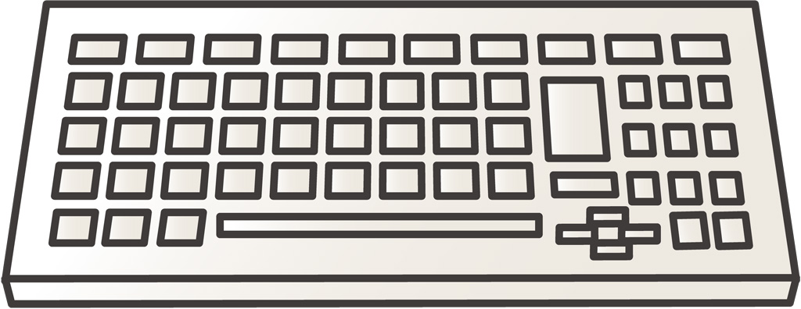
Virtual Machine Migration for Secure Out-of-band Remote Management in Clouds T.Unoki, S.Futagami, K.Kourai (Kyushu Institute of Technology)
OUT-OF-BAND REMOTE MANAGEMENT
図
Clouds provide users with a method for indirectly accessing VMs
Using VMs’ virtual devices
E.g., virtual keyboards and video cards
Users can manage VMs even on network configuration errors inside VMs
admin
steal
virtual
device
INFORMATION LEAK FROM VIRTUAL DEVICES
virtualized system
Virtual devices are managed by system admins
Not all of the admins are trusted in clouds
28% of cybercrimes are caused by insiders
35% of admins have accessed sensitive information
Untrusted admins can steal I/O data via virtual devices
E.g., typed password and video screen
password
user
SECURE OUT-OF-BAND REMOTE MANAGEMENT
Prevent information leak from virtual devices
Virtualize the entire virtualized system
Run virtual devices outside the virtualized system
These are called shadow devices
Admins cannot access shadow devices
Intercept I/O requests and redirect them to shadow devices
Enable the migration of VMs with shadow devices
VM migration moves VMs to other hosts
Save, transfer, and restore the state of shadow devices
As well as other VM states
Encrypt and decrypt the state in shadow devices
Prevent information leak
VSBypass
USShadow
virtualized system
source
destination
migration
sender
migration
receiver
shadow device
save
restore
user
shadow device
shadow device
We compared VSBypass and USShadow with the traditional system
The throughput was almost the same
The response time was 1.2 ms longer
The migration time was almost the same
The downtime increased by 0.3 seconds
PERFORMANCE

