Slide 1
Detecting System Failures with GPUs and LLVM
Yuichi Ozaki, Sousuke Kanamoto,
Hiroaki Yamamoto, and Kenichi Kourai
Kyushu Institute of Technology, Japan
Notes:
Hello.
I’m Sousuke Kanamoto from Kyushu Institute of Technology.
I’m gonna talk about Detecting System Failures with GPUs and LLVM.

Slide 2

System Failures
The scale of computer system is being larger
  System failures are unavoidable
System failures cause a huge financial loss
  E.g., Amazon lost $72 million during Prime Day’s one-hour failure
System Failure
Notes:
Recently, the scale of computer systems is being larger and the complexity is increasing.
As a consequence, system failures are unavoidable. (*)
Once a system failure occurs, services provided by the system often stop.
This leads service providers to a huge financial loss. (*)
For example, it is estimated that Amazon lost $72 million during Prime Day’s one-hour failure.

Slide 3
Failure Detection
Necessary to detect system failures as early and accurately as possible
  Rapid recovery can minimize a financial loss
Two methods for detecting system failures
  black-box and white-box monitoring
target system
monitor
system monitor
Notes:
To reduce a huge financial loss due to system failures, rapid recovery from system failures is important.
For this purpose, it is necessary to detect system failures as early as possible after system failures occur.
If possible, it is desirable to detect symptoms of system failures before systems completely stop services.
In addition, it is necessary to detect system failures as accurately as possible.
Traditionally, there are mainly two methods for detecting system failures: black-box and white-box monitoring.

Slide 4
Black-box Monitoring
External monitors examine the state of the systems and services
  Slow responses may mean symptoms of failures
Difficult to obtain detailed information on system failures
  Cannot access the internal state of the systems
System Failure
？
target
system
ping
system monitor
connect to services
Notes:
An example of black-box monitoring is heartbeat monitoring via networks.
External monitors can examine not only the state of the entire systems but also the state of each service by periodically connecting to all the services.
If the responses are slow, they may be symptoms of system failures.
If there are no responses, a system failure probably occurs.
However, it is difficult to obtain detailed information on target systems when system failures occur because external monitors cannot access the internal state of the systems. (*)
Therefore, they cannot identify which types of failures occur or the root causes. (*)

Slide 5
White-box Monitoring
Internal monitors run inside the systems
  Can obtain more detailed information
  Notify remote hosts of failure information
May not work correctly on system failures
  Cannot detect system failures or identify the root causes
target host
remote host
Stop
monitor
system monitor
notify
OS
Notes:
In white-box monitoring, on the other hand, internal monitors run inside target systems and notify remote hosts of system failures.
They can obtain more detailed information than black-box monitoring.
In particular, when they are embedded into the OS kernel, they can identify failure types and root causes more easily.
However, once a system failure occurs, internal monitors would not work correctly in a high probability.
For example, if the OS kernel stops, (*) they cannot detect system failures or identify the root causes. (*)

Slide 6
Our Approach: GPUSentinel
Run system monitors in GPUs for more reliable white-box monitoring
  Occupy one GPU and run autonomously
  Start the monitors before system failures occur
Analyze OS data stored in main memory
  Enable accurate failure detection
main memory
target host
remote host
monitor
system monitor
notify
OS
CPU
GPU
Notes:
To achieve more reliable white-box monitoring, we propose GPUSentinel, which runs system monitors in GPUs.
In GPUSentinel, system monitors start to run at the boot time of the target system.
They occupy one GPU and run autonomously.
Even if the target system uses GPUs for graphics or computing, GPUSentinel is available by installing another GPU.
To monitor the target system from a GPU, system monitors analyze OS data stored in main memory.
Using detailed information at the OS level, GPUSentinel enables accurate failure detection.

Slide 7
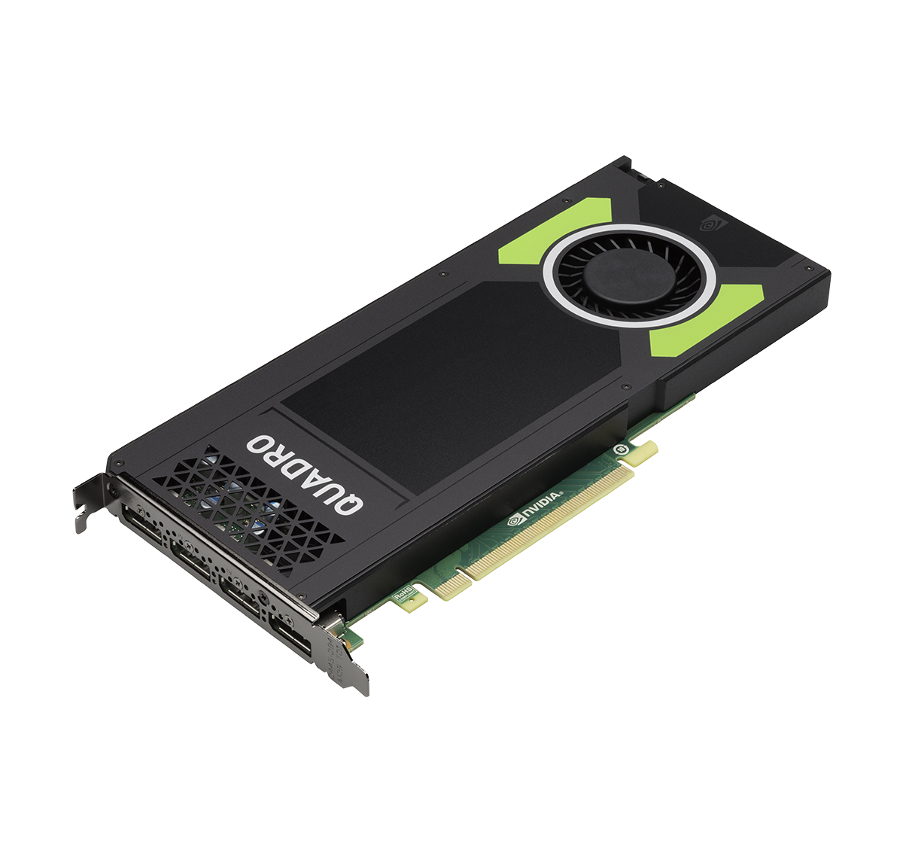
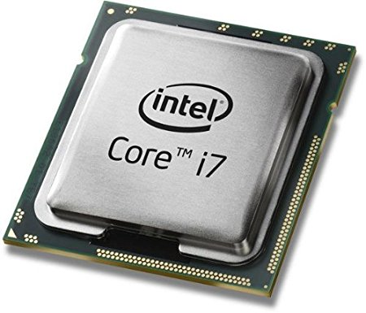
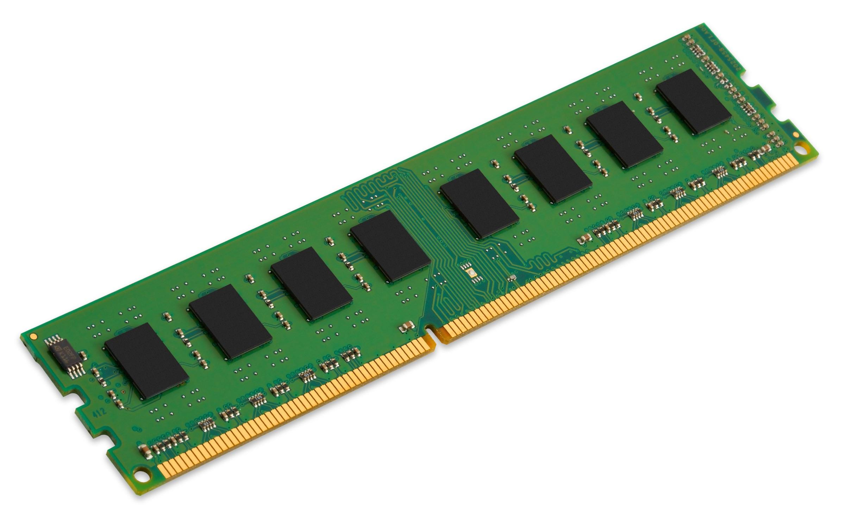
Advantages of Using GPUs
High reliability
  Run independently of CPUs and main memory
High performance
  Enable parallel monitoring using many cores
Low cost
  General-purpose hardware
system monitor
CPU
main memory
GPU
Notes:
Using GPUs for failure detection has three advantages.
First, system monitors in a GPU can continue to run in a high probability even when system failures occur.
This is because GPUs run independently of CPUs and main memory.
Second, a GPU enables various system monitors to efficiently run at the same time because it has many cores.
Therefore, system monitors in a GPU can investigate various symptoms of system failures in parallel.
Third, GPUs are general-purpose hardware.
So we can choose low-cost ones.

Slide 8
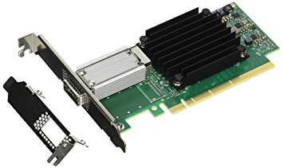
Detectable Failures
System failures that can be found from data stored in main memory
  E.g., running out system resources and resource starvation
No hardware failures
  GPUs cannot access the other hardware
main
memory
PCIe bus
CPU
NIC
Notes:
GPUSentinel can detect system failures that can be found from data stored in main memory.
For example, system failures caused by running out system resources is detectable.
Also, system failures caused by resource starvation is detectable.
To detect these system failures, system monitors in a GPU can examine the amount of free memory and consumed CPU time.
If these values are abnormal, GPUSentinel can detect that state as symptoms of a system failure.
On the other hand, GPUSentinel cannot detect hardware failures because GPUs cannot access hardware except for main memory.

Slide 9
Accessing Main Memory
Use Mapped Memory in CUDA
  Map main memory onto the GPU address space
    Via a process address space
Free memory runs out by mapping the entire main memory
  CUDA pins all the memory pages
process
main memory
system monitor
CPU
GPU
Notes:
To enable system monitors in a GPU to autonomously access main memory, GPUSentinel uses the mapped memory mechanism provided by CUDA.
It first maps main memory onto a process address space.
Then, it maps that memory regions onto the GPU address space.
Even after system failures, system monitors in a GPU can access main memory.
However, if GPUSentinel simply maps the entire main memory, free memory runs out and the system stops working.
When using mapped memory, CUDA pins the memory.
At this time, all the memory pages are locked and become in use.

Slide 10
Modified Memory Management
Enable mapping the entire main memory to a GPU
  Provide a special device called /dev/pmem
  Increase the reference count of no pages on mapping /dev/pmem
  Lock no pages when CUDA pins them
process
/dev/pmem
OS
Notes:
To solve this problem, we have modified the memory management of the Linux kernel so as to provide a special device called /dev/pmem.
When /dev/pmem is mapped onto the process address space, the modified Linux kernel does not increase the reference count of each memory page to prevent the page from being in use.
This does not raise a problem because the process itself does not use the mapped main memory in GPUSentinel.
In addition, when CUDA pins the mapped memory pages, the modified Linux kernel does not lock them.

Slide 11

Address Translation of OS Data
Translate OS addresses into GPU addresses
  A virtual address into a physical address
    Using the page tables of the OS
    Subtracting a fixed value for several areas in Linux
  The physical address into a GPU address
    Adding a fixed value
virtual address
physical address
GPU address
OS
virtual memory
main memory
GPU
Notes:
When system monitors in a GPU access OS data in main memory, it is necessary to translate OS addresses into GPU addresses.
First, GPUSentinel translates a virtual address of OS data into a physical address using the page tables of the OS kernel.
At this time, when a virtual address is in several specific areas, GPUSentinel performs address translation by subtracting a fixed value.
Next, GPUSentinel translates the physical address into a GPU address.
For this translation, it adds a fixed value to the physical address.

Slide 12
LLView Framework
Transform programs with LLVM for transparent address translation
  Use LLVM Pass for transforming bitcode
  Replace load instructions
    Load OS data in the GPU address space
  Replace kernel variables with virtual addresses
%1 = bitcast i64* %0xffffffff82011500 to i8*
%2 = call i8* @g_map(i8* %1)
%3 = bitcast i8* %2 to i64*
%4 = load i64, i64* %3
%5 = udiv i64 %4, 250
%1 = load i64, i64* %jiffies
%2 = udiv i64 %1, 250
Notes:
To transparently perform this address translation, GPUSentinel provides a framework called LLView.
LLView compiles the programs of system monitors using LLVM.
Then, it uses the Pass framework for transforming bitcode.
Using Pass, it replaces load instructions so that bitcode performs address translation and executes the load instruction for the translated address.
In addition, LLView replaces the kernel variables with the corresponding virtual
addresses.
In this example, the jiffies variable is replaced with its virtual address and the g_map function is invoked for address translation.

Slide 13
Developing System Monitors
LLView enables developers to write system monitors as Linux kernel modules
  Reuse the source code of the Linux kernel
    E.g., data structures, global variables, macros, and inline functions
#include <linux/sched.h>
__global__
void kernel(...)
{
struct task_struct *p = &init_task;
do {
// monitor task_struct
p = list_entry(p->tasks.next,
task_struct , tasks);
} while (p != &init_task);
}
Notes:
LLView enables developers to write the programs of system monitors as OS kernel modules.
Developers can reuse the source code of the Linux kernel, for example, data structures, global variables, macros, and inline functions.
This example is the program of a system monitor for obtaining process information.
It includes sched.h header file and uses the task_struct structure.
It traverses the process list, which is a circular list starting with init_task, using the list_entry macro.
Like this, developers can write the programs of system monitors in C.

Slide 14
Compiling System Monitors
We modified clang so that CUDA's device code is compiled as C
  Difficult to compile the Linux kernel as C++
  Provide wrapper functions for CUDA functions
device code
clang
bit
code
opt/ llc
assembly code
ptxas/ fat
binary
fat binary
host code
clang++
object file
system monitor
Notes:
However, it is difficult to compile CUDA's device code including the source code of the Linux kernel because device code is usually compiled as C++.
For example, variable names in C can conflict with the reserved words in C++.
So we have modified the Clang compiler front end so that device code is compiled as C.
For several functions that CUDA provides, LLView provides wrapper functions written in C.
As illustrated in this figure, LLView compiles device code using modified clang and transforms the generated bitcode.
Then, it embeds the generated fat binary into the executable file.

Slide 15
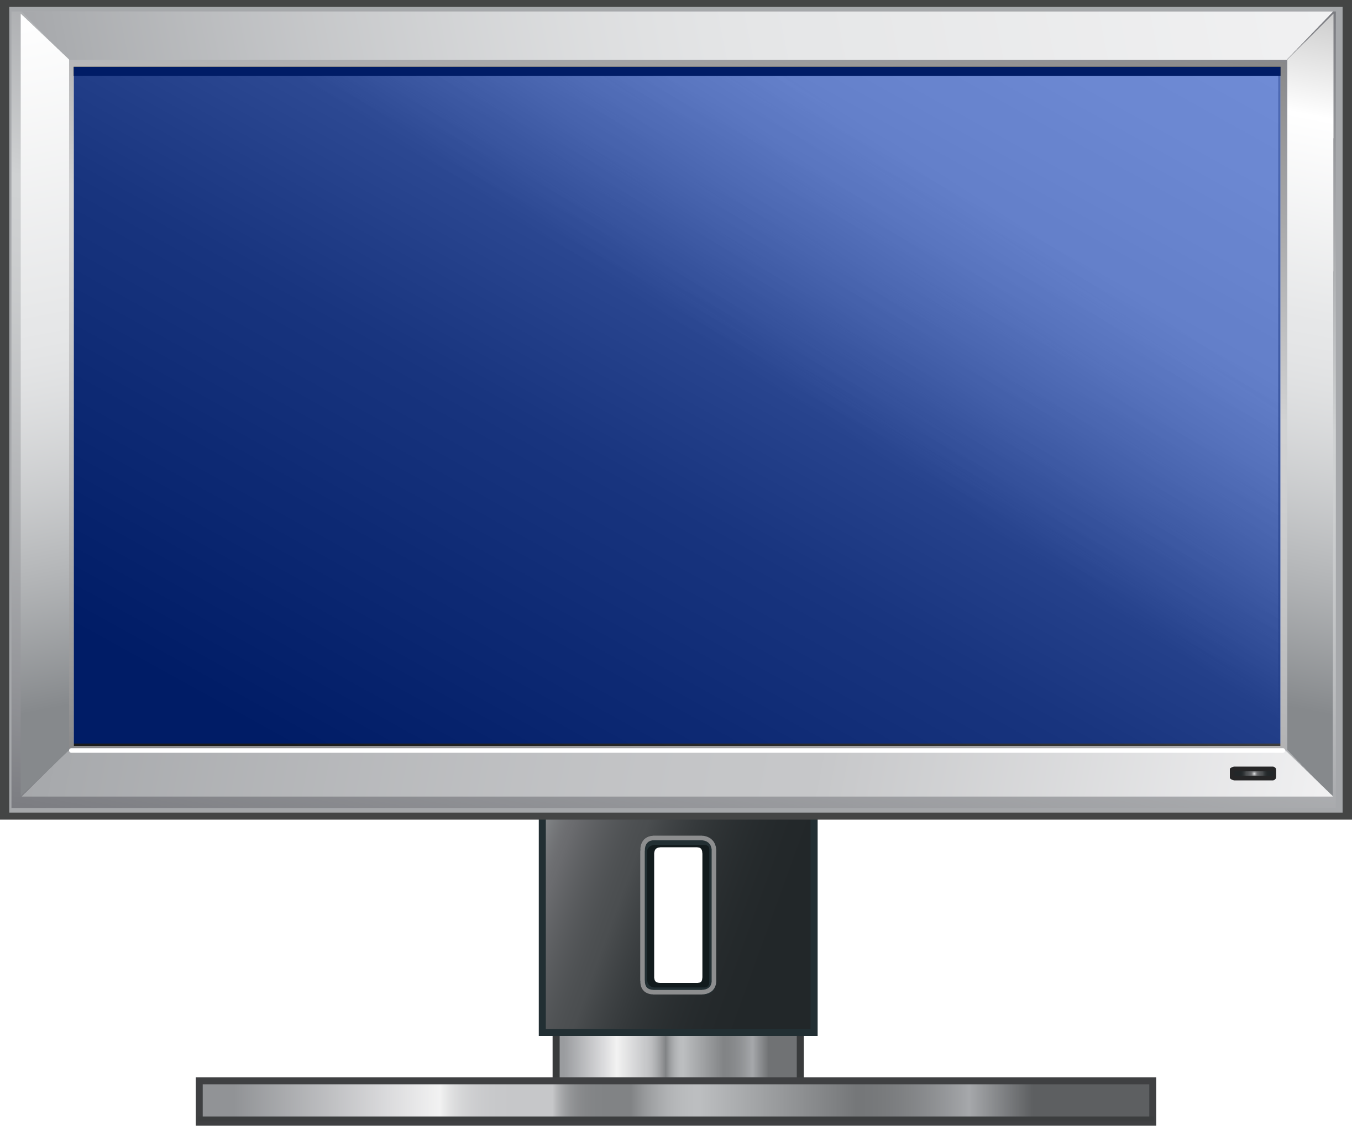
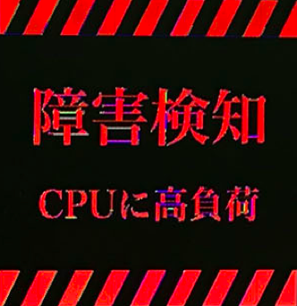
Direct VRAM Output
Enable reliable notification of system failures to remote hosts
  Write graphics data to VRAM
    Display images and characters on the screen
  Use remote console in IPMI and KVM switches
  Require a GPU allocating VRAM to main memory
target host
main memory
system monitor
VRAM
GPU
Notes:
GPUSentinel provides two reliable notification mechanisms of system failures to remote hosts.
In preparation for system failures, these mechanism do not rely on the OS functions.
A mechanism called direct VRAM output enables system monitors to display images and characters on the screen (*) by writing graphics data to the VRAM allocated in main memory. (*)
Using remote console in IPMI and KVM switches, remote system administrators can receive notification of system failures.
One limitation is that this mechanism requires a GPU that allocates VRAM in main memory.

Slide 16
Direct GPU Communication
Notify remote hosts of system failures more flexibly
  Enable a remote host to directly access GPU memory using GPUDirect RDMA
  Send requests with RDMA writes
  Receive responses with RDMA reads
target host
RDMA write
system monitor
GPU
memory
RDMA read
GPU
remote host
Notes:
Therefore, GPUSentinel also provides a mechanism called direct GPU communication.
This mechanism uses GPUDirect RDMA, which enables a remote host to directly access GPU memory.
GPUSentinel maps GPU memory into the physical address space of the target system and uses the RDMA feature provided by NICs.
A thread in a GPU polls GPU memory and waits for a remote host to write a request with an RDMA write. (*)
If it receives a request, (*) it writes requested information to GPU memory.
(*) Then, the remote host reads that information by polling GPU memory with RDMA reads.

Slide 17
Experiments
We confirmed that system monitors in a GPU could detect system failures
  Deadlocks, CPU anomaly, and out-of-memory
Notes:
We conducted several experiments to confirm that system monitors in GPUSentinel could detect system failures.
For the experiments, we have developed three system monitors that detected deadlocks, CPU anomaly, and out-of-memory.
We used two GPUs of NVIDIA GeForce for failure detection and Intel HD Graphics for failure notification.
We ran Linux 4.4, NVIDIA GPU driver, and CUDA 8.0.

Slide 18
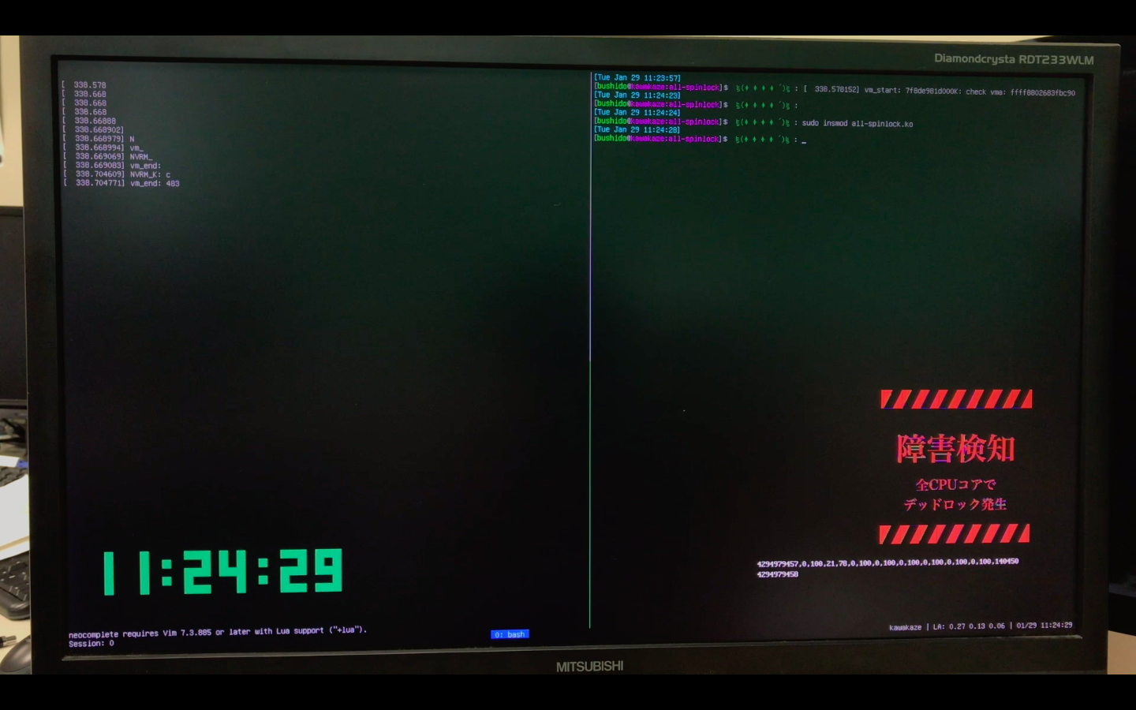
Detection of Deadlocks
We installed a kernel module that caused deadlocks of 8 threads with spinlocks
  Detected when there were no context switches for 1 second
  Took 1.7 seconds after the installation
Notes:
First, we created a Linux kernel module that caused deadlocks of 8 threads.
This module made all the threads wait for the release of a spinlock.
(movie)
This movie shows how our system monitor in a GPU could detect deadlocks.
At first, we ran a screen saver of a clock.
Immediately after we installed the kernel module, the entire system stopped the response and the notification image was shown.
The system monitor detected a deadlock when there were no context switches for 1 second.
For deadlock detection, it took 1.7 seconds after the module installation.

Slide 19
Detection of CPU Anomaly
We ran a program that intensively used CPUs
  Detected when the utilization of all CPUs exceeded 90% for 5 seconds
  Showed the process name as a root cause
Notes:
Second, we ran a program that intensively used 8 CPU cores in the target system.
This program ran 4 processes for a while, stopped them, and ran 8 processes.
This figure shows changes in CPU utilization observed by our system monitor in a
GPU.
It is shown that the program increased the number of processes at time 17 second.
After that, CPU anomaly was detected when the utilization of all CPUs exceeded 90% for 5 seconds.
At this time, the system monitor displayed the image for failure notification and the process ID as a root cause on the screen.

Slide 20
Detection of Out-of-memory
We ran a program that used a large amount of memory
  Detected when both free memory and swap space became less than 30%
  Took 57 seconds after swapping started
Notes:
Third, we ran a program that used a large amount of memory in the target system.
This program allocated 20 GB of memory and write data to it.
This figure shows changes in amounts of free memory and swap space observed by our system monitor in a GPU.
Out-of-memory was detected when both the ratios became less than 30%.
At this time, the system monitor displayed the notification image and the ID of the process consuming the largest amount of memory on the screen.
It took 57 seconds to detect out-of-memory after swapping started because the swap space was consumed slowly.

Slide 21
Related Work
SHFH [Zhu et al.’12]
  Detect system hang using only minimum metrics
  Cannot detect failures that make the OS hang
Falcon [Leners et al.’11]
  Detect failures using spies in various layers
  The target is only crash failures
VM introspection [Garfinkel et al.’03]
  Monitor the internal state of VMs from the outside
  GPUSentinel applies this technique to GPUs
Notes:
SHFH detects system failures using only minimum performance metrics.
It is implemented as a real-time user process and a kernel module.
Therefore, it cannot detect system failures that make the OS hang.
Falcon runs spies in different layers of the system.
Using the spies, it detects the failure of a higher layer from the lower layer, but the target is only a crash failure.
When the target system runs in a virtual machine, VM introspection can be used to monitor the internal state of VMs from the outside.
GPUSentinel applies this technique to not-virtualized systems by using GPUs.

Slide 22
Conclusion
GPUSentinel for reliable failure detection
  Monitor OS data in main memory from GPUs
  Allow developing system monitors by reusing the source code of the OS with LLView
  Provide reliable failure notification
  Three system monitors could detect failures
Future work
  Support all the metrics proposed in SHFH
  Recover from failures by rewriting OS data
Notes:
In conclusion, we proposed GPUSentinel for reliable failure detection by running system monitors in GPUs.
GPUSentinel monitors OS data in main memory from GPUs.
It allows users to develop system monitors by reusing the source code of the OS kernel with LLView.
In addition, GPUSentinel provides reliable failure notification mechanisms.
Using GPUSentinel, we confirmed that three system monitors could detect system failures.
One of our future work is to support all of the performance metrics proposed in SHFH.
Another direction is to recover from system failures by rewriting OS data in main memory.
Thank you for listening.

