Slide 1
Secure Monitoring of Virtual Machines with Memory Split into Multiple Hosts
Kenichi Kourai (in collaboration with Kouki Yamato)
Kyushu Institute of Technology
Notes:
I'm Kenichi Kourai from Kyushu Institute of Technology.
I'm gonna talk about Secure Monitoring of Virtual Machines with Memory Split into Multiple Hosts.
This is joint work with my student.

Slide 2
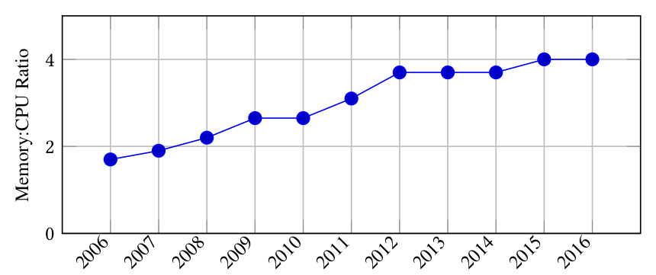
Large-memory VMs
Recent clouds provide virtual machines (VMs) with a large amount of memory
  Amazon EC2 provides VMs with up to 24 TB of memory (2019)
  The ratio of memory size to CPU size is increasing [Nitu et al.’18]
Required for big data analysis
  Critical in AI and IoT
VM
VM
VM
ratio
cloud
year
Notes:
Recently, cloud computing is widely used.
As a recent trend, clouds provide virtual machines with a large amount of memory.
For example, Amazon EC2 starts providing VMs with 24 TB of memory in this October.
In VMs provided by Amazon EC2, the ratio of memory size to CPU size is increasing, as shown in this figure.
In this decade, the ratio was doubled.
Such large-memory VMs are required for big data analysis.
Big data can be analyzed more efficiently by maintaining data in memory as much as possible.
Big data analysis is critical in artificial intelligence and Internet of Things.

Slide 3
VM Migration
Move a VM to another host without stopping the VM
  Maintain a host without service disruption after VM migration
Migration process
  Create a new empty VM at the destination host
  Transfer the memory data in the original VM to the new VM
  Transfer the other states, e.g., virtual CPUs and devices
VM
new VM
24 TB
memory
memory data
24 TB
memory
original host
destination host
Notes:
Since VMs are managed by software, they provide many useful features.
One of them is VM migration.
VM migration enables moving a running VM to another host without stopping the target VM.
Using VM migration, administrators can maintain a host without service disruption after they migrate all the VMs running in that host.
Then, after the maintenance of the host, they can migrate VMs back to the original host.
VM migration first creates a new empty VM at the destination host.
Then, it transfers the memory data in the original VM to the destination and stores it in the memory of the new VM.
Finally, it stops the original VM, transfers the other states of the VM, for example, virtual CPUs and devices, and switches to the new VM.

Slide 4
Issues of Migrating Large-memory VMs
The migration time is proportional to the memory size
  Solved by faster network, e.g. 100-Gbps Ethernet
  Reduced by parallel memory transfer [Song et al.'13]
The destination host needs sufficient free memory
  It is not cost-efficient to always reserve large hosts for VM migration
  Inflexibility of reserving large hosts leads to higher cost
VM
24 TB
24+ TB
free memory
reserved host
Notes:
However, there are two issues to migrate large-memory VMs.
One is the migration time.
The migration time is the time to complete VM migration.
It is basically proportional to the memory size of a migrated VM.
This issue can be solved by using faster network like 100-Gbps Ethernet although such fast network is costly.
Fortunately, the migration time can be reduced by parallel memory transfer.
The other issue is the availability of the destination host.
Since a large-memory VM runs at the destination host after VM migration, the destination host also needs to have an equal or larger amount of memory than the original host.
But it is not cost-efficient to always reserve large hosts as the destination for VM migration.
In addition, inflexibility of reserving large hosts leads to higher cost in clouds.

Slide 5

Split Migration [Suetake et al.'16]
Migrate a large-memory VM to multiple small hosts
  Divide its memory into smaller pieces
  Transfer them to a main host or sub-hosts
Predict future memory access of the VM
  Likely accessed memory to the main host
  The other memory to sub-hosts
VM
VM
24 TB
12 TB
12 TB
main host
sub-hosts
Notes:
To solve the latter issue, we have developed a new VM migration method called split migration.
Split migration migrates a large-memory VM running in one host to multiple small destination hosts, instead of using one large destination host.
It first divides VM’s memory into smaller pieces.
Then, it transfers them to a main host or sub-hosts.
This animation is the record of memory transfer during split migration.
When this sub-host received the memory of a VM, the region becomes red.
Finally, the sub-host received half of VM's memory.
Split migration predicts future memory access of the VM.
On the basis of this prediction, it transfers likely accessed memory to the main host.
The other memory is transferred to sub-hosts.

Slide 6

Split-memory VMs
Run a migrated VM across multiple hosts
  VM core runs in the main host
Perform remote paging between the main host and each sub-host
  Move memory data to the main host when the VM requires it
  Move unused memory data to the sub-host
remote
memory
VM
remote
paging
12 TB
12 TB
main host
sub-hosts
Notes:
After split migration, a VM is running across multiple hosts.
This VM is called a split-memory VM.
In a split-memory VM, VM core such as virtual CPUs and devices runs in the main host.
VM’s memory is distributed across the main host and sub-hosts.
To enable a VM in the main host to access remote memory in sub-hosts, a split-memory VM performs remote paging between the main host and each sub-host.
When the VM requires memory data in a sub-host, the data is moved to the main host.
Instead, unused memory in the main host is moved to the sub-host.
This animation is the record of memory transfer during the sort of big data in a split-memory VM.
Memory data in various regions were moved between hosts.

Slide 7
Performance of Split Migration
The migration time is only 5% longer
  Overhead of sending extra information
The stable throughput of in-memory database is almost the same
  Degraded just after split migration, but restored in 5 seconds
Notes:
Here is the performance of split migration.
The left-hand side figure shows the migration time.
Compared with normal VM migration, the migration time is only 5% longer.
This overhead comes from sending extra information for split migration.
The right-hand side figure shows the performance of a split-memory VM after split migration.
Compared with normal VM execution, the stable throughput of in-memory database is almost the same.
The throughput is degraded just after split migration, but it is restored only in 5 seconds.

Slide 8
Research Issues
Various issues arise by introducing split-memory VMs
  How do we migrate split-memory VMs flexibly and efficiently?
  How do we improve the performance of split-memory VMs?
  How do we make split-memory VMs more reliable?
  How do we use various types of underlying hosts and networks?
  How do we monitor split-memory VMs securely?
Notes:
Various research issues arise by introducing split-memory VMs.
How do we migrate split-memory VMs flexibly and efficiently?
How do we improve the performance of split-memory VMs?
How do we make split-memory VMs more reliable?
How do we use various types of underlying hosts and networks?
How do we monitor split-memory VMs securely?
In this talk, we focus on the last issue.

Slide 9
IDS Offloading [Garfinkel et al.'03]
Intrusion detection systems (IDS) are widely used
  Easily disabled by intruders into VMs
IDS offloading runs IDS outside target VMs securely
  Intruders cannot disable offloaded IDS
  IDS analyzes the memory of VMs to obtain system states
  It analyzes the file system in virtual disks to access files
VM
VM
IDS
offloaded
IDS
memory
intruder
Notes:
To detect attacks against VMs, intrusion detection systems are widely used.
They monitor system states, files, and network packets.
However, they are easily disabled by intruders into VMs because they often run inside VMs.
To protect IDS from such intruders, a technique called IDS offloading has been proposed.
This technique enables IDS to securely run outside its target VMs.
Even if attackers intrude into VMs, they cannot disable offloaded IDS.
To obtain the internal state of the target system from the outside of VMs, IDS analyzes the memory of VMs.
To access files, it analyzes the file system used in the virtual disks of VMs.

Slide 10
IDS Offloading for Split-memory VMs
Not easy to monitor split-memory VMs using existing mechanisms
  The memory of a split-memory VM is distributed
  Offloaded IDS cannot seamlessly access remote memory
    IDS itself has to obtain memory data in sub-hosts explicitly
    Troublesome for IDS developers
VM
offloaded
IDS
local
memory
remote
memory
main host
sub-host
Notes:
However, it is not easy to monitor split-memory VMs using existing mechanisms for IDS offloading.
Unlike a normal VM running in one host, the memory of a split-memory VM is distributed across multiple hosts.
If IDS is offloaded to the main host, it cannot seamlessly access remote memory existing in sub-hosts as local memory.
Even if it is offloaded to one of the sub-hosts, it cannot seamlessly access the memory in the main host or the other sub-hosts.
Remote paging does not work when offloaded IDS accesses VM's remote memory.
As a result, IDS itself has to obtain memory data in sub-hosts explicitly.
This is a troublesome task for the developers of offloaded IDS.

Slide 11
Our Approach: VMemTrans
Enable IDS to transparently access remote memory in sub-hosts
  Provide the VMemTrans runtime to IDS
  The runtime hides the difference between local memory in the main host and remote memory
  IDS can monitor a split-memory VM as if the target were a normal VM
VM
VM's entire
memory
offloaded
IDS
local
memory
remote
memory
run
time
main host
sub-host
Notes:
So we propose VMemTrans to support IDS offloading for split-memory VMs.
VMemTrans offloads IDS to the main host and provides the runtime to IDS.
The VMemTrans runtime enables IDS to transparently access remote memory existing in sub-hosts.
It hides the difference between local memory existing in the main host and remote memory.
Using VMemTrans, IDS can monitor a split-memory VM as if the target were a normal VM, whose memory is not distributed.

Slide 12
Access to Remote Memory
Share the entire memory of a split-memory VM
  Detect IDS's access to memory that does not exist in the main host
  Suspend the execution of IDS
Obtain memory data from a sub-host
  Make it visible to IDS as part of VM's memory
  Resume the execution of IDS
VM
offloaded
IDS
local
memory
remote
memory
run
time
shared
memory
main host
sub-host
Notes:
To enable acess to VM's memory, VMemTrans shares the entire memory of a split-memory VM with IDS.
When IDS accesses VM's remote memory that does not exist in the main host, the VMemTrans runtime automatically detects that access.
At this time, the execution of the IDS is suspended to wait for the data of that remote memory.
Next, the runtime obtains data of the accessed remote memory from the corresponding sub-host.
Then, it makes the memory data visible to IDS as part of VM's memory.
Finally, it resumes the execution of the IDS and then IDS can access remote memory.

Slide 13
Two Methods for Obtaining Remote Memory
Self paging
  The VMemTrans runtime itself obtains memory data
  Not affect the memory performance of a split-memory VM
Proxy paging
  Let a split-memory VM perform remote paging
  Can keep all the memory data used by IDS in the main host
VM
remote
paging
cache
remote
memory
run
time
local
memory
remote
memory
run
time
main host
sub-host
main host
sub-host
self paging
proxy paging
Notes:
VMemTrans provides two methods for obtaining data of VM’s remote memory existing in sub-hosts.
One is self paging.
As inferred by the name, the VMemTrans runtime itself directly obtains memory data from sub-hosts and caches it.
Since this method does not change the memory layout of a split-memory VM, it does not affect the memory performance of the VM.
However, the runtime can keep only a limited amount of memory data as cache due to memory limitation.
This can degrade IDS performance.
The other method is proxy paging.
This method lets a split-memory VM perform remote paging to obtain VM's remote memory.
It can keep all the memory data used by IDS in the main host.
But this method can degrade IDS performance due to the communication overhead between the runtime and the VM.

Slide 14
Support for Offloaded Legacy IDS
Provide an execution environment for legacy IDS
  Intercept and emulate system calls
  Provide the same file systems as in a split-memory VM
  Construct the shadow proc file system
    Emulate the proc file system used by IDS
    Provide system states to offloaded IDS
execution environment
VM
legacy
IDS
memory
run
time
shadow file
system
virtual
disk
Notes:
Using VMemTrans, legacy IDS can be offloaded from split-memory VMs.
Legacy IDS means not-modified traditional IDS.
VMemTrans provides an execution environment for legacy IDS to analyze the internals of a target VM.
It intercepts system calls issued by IDS and emulates some of them to return necessary information on the operating system running in the VM.
Also, it provides the same file systems as in the VM to monitor files.
In particular, it constructs the shadow proc file system to emulate the proc file system in the VM.
The proc file system is used by IDS to monitor system states, for example, processes and networks.
VMemTrans provides the same information to offloaded IDS.

Slide 15
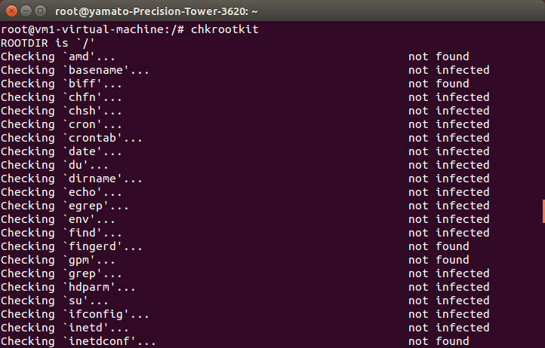
Offloading Chkrootkit
We offloaded legacy IDS called chkrootkit
  Chkrootkit examines system states and several files to detect rootkits
    Rootkit: installed malicious program
  Access the proc file system
  to obtain system states
Offloaded chkrootkit could
obtain the same result
Notes:
Using VMemTrans, we offloaded legacy IDS called chkrootkit.
Chkrootkit examines system states and several files to detect rootkits.
Rootkits are malicious programs that are installed in the system.
Chkrootkit accesses the proc file system to obtain various system states.
This figure shows part of the execution result.
Compared with traditional IDS offloading for a normal VM, offloaded chkrootkit could obtain the same result for a split-memory VM.

Slide 16
Performance of VMemTrans
The construction time of the shadow proc filesystem
  VMemTrans was 58% slower than traditional IDS offloading
  Self paging was 41% faster than proxy paging
The number of paging for obtaining remote memory
  Proxy paging was 31% less than self paging
41%
31%
58%
Notes:
Here is the performance of VMemTrans.
We compared the time needed for constructing the shadow proc file system between traditional IDS offloading and VMemTrans.
For VMemTrans, we compared the construction time between self paging and proxy paging.
VMemTrans was at least 58% slower than traditional IDS offloading due to accessing remote memory, but the increase was only 0.1 seconds.
Self paging was 41% faster than proxy paging.
On the other hand, for the number of paging, proxy paging was 31% less than self paging.
This means a trade-off exists between self paging and proxy paging.

Slide 17
Conclusion
We introduced split migration of large-memory VMs
  Split-memory VMs run with remote paging
We presented VMemTrans to support IDS offloading for split-memory VMs
  Enable IDS to transparently access remote memory
  Support legacy IDS
  Showed the trade-off between self paging and proxy paging
Future work
  Offload IDS to not only the main host but also any host
  Continue the monitoring after a split-memory VM is migrated
Notes:
In conclusion, we introduced split migration of large-memory VMs.
After the migration, split-memory VMs run with remote paging.
Then, we presented VMemTrans to support IDS offloading for split-memory VMs.
VMemTrans enables IDS to transparently access remote memory using the runtime.
It supports legacy IDS by providing an execution environment to IDS.
We showed the trade-off between self paging and proxy paging.
Our future work is to offload IDS to not only the main host but also any host, including sub-hosts and the other hosts.
This increases the flexibility.
Another direction is to continue the monitoring after a split-memory VM is migrated to another host.

