Slide 1
Optimizing VMs across Multiple Hosts with Transparent and Consistent Tracking of Unused Memory
Soichiro Tauchi*, Kenichi Kourai*, and Lukman Ab. Rahim**
*Kyushu Institute of Technology, Japan
**Universiti Teknologi Petronas, Malaysia
Notes:
I’m Kenichi Kourai from Kyushu Institute of Technology.
I’m gonna talk about Optimizing VMs across Multiple Hosts with Transparent and Consistent Tracking of Unused Memory.
This is joint work with my student and Lukman at UTP.

Slide 2
Large-memory Virtual Machines (VMs)
VMs with a large amount of memory are widely used
  E.g., instances with 24 TB of memory in Amazon EC2
  For in-memory database and big data analysis
VM migration becomes more difficult
  Require destination hosts with sufficient free memory
  Neither cost-efficient nor flexible to always preserve such hosts
VM
24 TB
migrate
24-TB free
memory
source host
destination host
Notes:
Recently, virtual machines with a large amount of memory are widely used.
For example, Amazon EC2 provides High Memory instances with 24 TB of memory.
Using such large-memory VMs enables fast in-memory databases and efficient big data analysis.
One advantage of using VMs is service continuity by VM migration.
VM migration moves a VM running in one host to another without stopping it.
It is used on host maintenance, load balancing, and power saving.
VM migration transfers the entire memory of a VM from the source to destination host.
Since it requires a destination host with sufficient free memory, it becomes more difficult to migrate larger-memory VMs.
Even in public clouds, it would be neither cost-effective nor flexible to always preserve many large hosts.

Slide 3
Split Migration [Suetake+, CLOUD'18]
Migrate a VM to multiple destination hosts
  Divide its memory into small fragments
  Transfer them to the main host and sub-hosts
Run a split-memory VM after the migration
  Perform remote paging between hosts
  Remote page-in to the main host and remote page-out to sub-hosts
VM
VM
remote
paging
migrate
24 TB
12 TB
12 TB
source host
main host
sub-hosts
Notes:
To address this issue, split migration has been proposed.
It divides a large-memory VM into small pieces and transfers them to multiple smaller hosts.
One destination host running the VM core is called the main host.
The VM core consists of virtual CPUs and virtual devices.
The other hosts providing part of a VM's memory are called sub-hosts.
Split migration transfers the VM core and likely accessed memory to the main host and the rest of the memory to the sub-hosts.
After split migration, the migrated VM runs across multiple hosts.
This VM is called a split-memory VM.
A split-memory VM can run by performing remote paging between hosts.
When the VM core requires the memory existing in a sub-host, that memory is moved from the sub-host to the main host.
This is called a remote page-in.
In exchange, the least likely accessed memory is moved from the main host to that sub-host.
This is called a remote page-out.

Slide 4
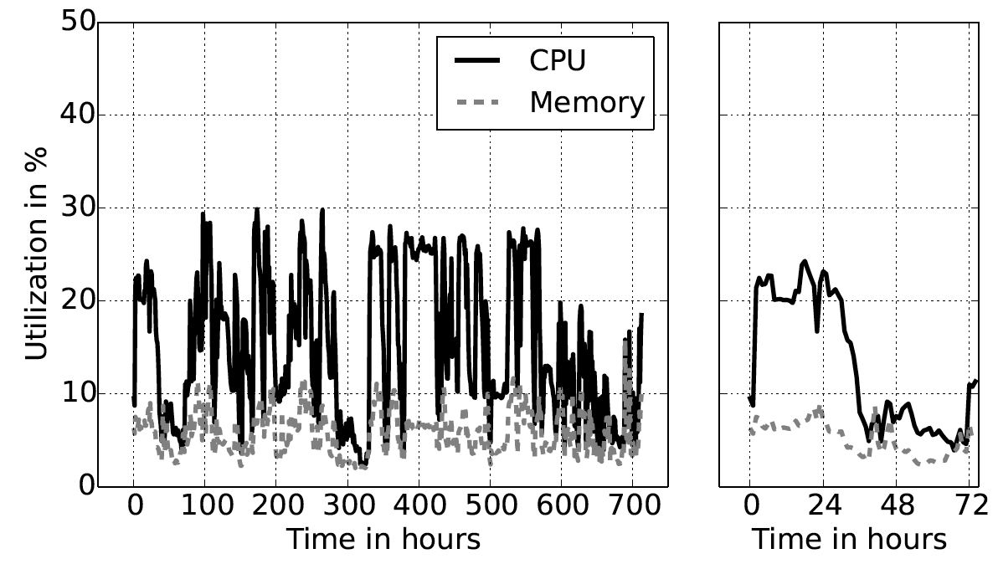
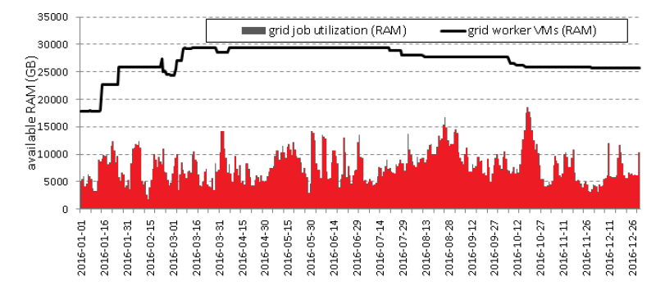
Unused Memory in VMs
There are often unused regions in a VM's memory
  Only 10% is used for VMs running web applications [Shen+, CCGrid'15]
  VMs for scientific computing have a large amount of unused memory [Klusácek+, JSSPP'17]
  50% is used in the clusters of Google and Alibaba [Shan+, OSDI'18]
assigned
used
[Shen+, CCGrid'15]
[Klusácek+, JSSPP'17]
Notes:
As such, the memory of a VM is transferred via the network when necessary.
But there are often unused regions in the memory.
For example, most of the memory is unused just after the guest OS boots in a VM.
Even used memory regions become unused again if the guest OS releases them after the termination of applications.
In addition, it is reported that only 10% of the memory is used on average for VMs running web applications in clouds, as shown in the left figure.
It is also revealed that VMs used for scientific computing have a large amount of unused memory, as shown in the right figure.
Only about 50% of the memory is used in the clusters of Google and Alibaba.

Slide 5
Data Transfers for Unused Memory
Split migration takes a long time for large-memory VMs
  Need to transfer even unnecessary data of unused memory
Unnecessary remote paging degrades the performance of split-memory VMs
  Perform remote page-ins whenever a VM needs memory at sub-hosts
  Tend to select unused memory for remote page-outs by LRU
VM
remote page-in
VM's memory
1
2
3
4
used memory
remote page-out
unused memory
main host
sub-host
Notes:
Split migration needs to transfer even unnecessary data contained in the unused memory of a VM to the destination hosts.
Therefore, it takes a longer time to migrate larger-memory VMs.
After split migration, remote paging transfers the memory data from a sub-host for a remote page-in even when a split-memory VM starts to access unused memory at that sub-host.
Then, remote paging tends to select unused memory at the main host on the basis of LRU and transfers it to the sub-host for a remote page-out.
Such unnecessary remote paging degrades the performance of the split-memory VM.
In particular, the virtual CPU of a VM is suspended during a remote page-in.

Slide 6
Previous Approaches for One-to-one Migration
Avoid transferring data of unused memory in a VM
  Scan the entire memory to identify zero-filled memory [QEMU]
    This overhead is too large for VM migration using fast networks
  Detect modified memory since a VM boots [Li+, KVM Forum'15]
    Always suffer from the overhead before VM migration
  Identify unused memory at the guest-OS level [Ma+, CLUSTER'12] ...
    Need to modify the guest OS in a VM
VM
VM
1
4
1
2
3
4
1
2
3
4
migrate
unused memory
source host
destination host
Notes:
For the traditional one-to-one migration, various techniques have been proposed to avoid transferring unused memory.
One category of the techniques obtains information on unused memory at the VM level.
QEMU scans the entire memory of a VM to identify unused memory, which is filled by zero.
But this overhead is too large for VM migration using fast networks.
Another technique detects modified memory since a VM boots.
This suffers from the overhead of always detecting the modification.
The other category obtains information on unused memory at the guest-OS level.
Using information of the guest OS is more efficient, but it needs to modify the guest OS.
In addition, there are no such approaches for split migration and remote paging.

Slide 7
Our Approach: FCtrans
Optimize network transfers in split migration and remote paging
  Avoid transferring unused memory to achieve efficient split migration
  Transparently and efficiently track the memory usage of a VM
    Without modifying the guest OS in the VM
  Transfer used memory to the main host as much as possible
    Suppress remote paging after split migration
VM
VM
VM's memory
migrate
1
2
3
4
1
4
2
3
1
4
source host
main host
sub-host
Notes:
We propose FCtrans, which optimizes network transfers in split migration and remote paging.
To achieve efficient split migration, FCtrans avoids transferring unused memory to the destination hosts, as in the previous approaches.
Unlike the previous ones, FCtrans transparently and efficiently tracks the memory usage of a VM without modifying its guest OS.
In addition, FCtrans transfers used memory to the destination main host as much as possible.
As a result, it can suppress remote paging after the migration.

Slide 8
Optimizing Remote Paging
Eliminate unnecessary transfers for unused memory
  Perform local page-ins, instead of remote page-ins, when a VM needs unused memory at sub-hosts
    Immediately allocate the memory reserved in the main host to the VM
  Perform no remote page-outs
    As long as the memory reserved for the VM is left in the main host
local page-in
VM
no remote page-in
VM's memory
1
2
3
4
no remote page-out
reserved
memory
main host
sub-host
unused memory
Notes:
To optimize remote paging, FCtrans eliminates unnecessary network transfers for unused memory even when remote paging is required after split migration.
When a VM starts to access unused memory existing in a sub-host, FCtrans performs a local page-in without a network transfer, instead of a remote page-in.
In other words, it just allocates memory reserved in the main host to the VM.
As a result, the VM does not need to wait for the completion of a remote page-in and then its virtual CPU is resumed immediately.
FCtrans performs a remote page-in only for used memory existing in sub-hosts.
In addition, as long as there is a sufficient amount of memory reserved for the VM in the main host, FCtrans does not perform remote page-outs.
It performs remote page-outs only when the reserved memory runs out.
This can reduce the overhead caused by remote page-outs.

Slide 9
Tracking the Memory Usage
Easy to detect changes from unused to used for each memory region
  Configure all the regions as unused on VM creation
  Not allocate physical memory to the VM
Trap the first access to unused memory regions
  Allocate physical memory to the VM
VM
access
1. trap
FCtrans
1
2
3
4
2. allocate
source host
Notes:
To track the memory usage of a VM, FCtrans detects both changes from unused to used memory and from used to unused memory.
When a VM starts to use an unused memory region, that access has to be immediately detected not to apply the optimization to that region errorneously.
It is easy to detect changes from unused to used memory.
FCtrans configures all the memory regions as unused on VM creation.
This means it does not allocate physical memory to the VM.
When the VM accesses an unused memory region for the first time, FCtrans can trap that access.
It allocates physical memory to the VM and updates that region as used in the memory usage of the VM.

Slide 10
Reducing the Detection Overhead
The detection overhead by traps is quite high
  E.g., 13% during the boot of the guest OS
  Need the memory usage only during and after split migration
Start to track the memory usage on starting the migration
  Obtain the memory usage at once from the guest OS
    Using the technique mentioned later
VM
memory
usage
guest OS
FCtrans
1
2
3
4
source host
Notes:
However, this detection overhead by traps is quite high.
For example, it is 13% during the boot of the guest OS because many memory regions are newly accessed.
Actually, FCtrans needs information on the memory usage only during and after split migration.
So, it starts to track the memory usage at the time of starting split migration.
This can suppress performance degradation until split migration is applied to a VM.
However, FCtrans needs to know the latest memory usage at this time.
So, it obtains information on the memory usage at once from the guest OS.
This technique will be mentioned later.

Slide 11
Detecting Changes to Unused Memory
Not easy to detect changes from used to unused
  Difficult to know that a memory region is no longer used
  Cannot change any regions back to unused once they become used
The guest OS in a VM knows unused regions
  Manage regions that are used once but releases as free memory
  It should be avoided to modify the guest OS
VM
OS's memory
used memory
guest OS
1
2
3
4
free memory
1
2
3
4
source host
Notes:
Unlike the changes from unused to used memory, it is not easy to detect a memory region is changed from used to unused.
This is because FCtrans cannot know that the memory region is no longer used.
Even if a VM does not access a memory region for a long time, it is not guaranteed that the VM does not use that region in the future.
In contrast, the guest OS in the VM knows whether the memory region is in use or not.
It manages memory regions that are used once but released as free memory.
From the viewpoint of a VM, such free memory is still in use.
So, FCtrans needs to obtain information from the guest OS, but it should be avoided to modify the guest OS.

Slide 12
Using VM Introspection (VMI)
Transparently obtain the memory usage of the guest OS
  Analyze the data structure of the guest OS in a VM's memory
  E.g., the buddy system manages memory allocation in Linux
Merge the memory usage of the VM and the guest OS
  Reclaim free memory by deallocating physical memory from the VM
  Change that region back to unused
VM
OS's memory
guest OS
1
2
3
4
1. VMI
FCtrans
1
2
3
4
2. reclaim
source host
Notes:
So, FCtrans obtains information on the memory usage of the guest OS using VM introspection (VMI).
VMI is a technique for analyzing the data structure of the guest OS from the outside of the VM.
For example, FCtrans can identify free memory by examining the buddy system in Linux.
Then, FCtrans periodically merges information on the memory usage of both a VM and its guest OS.
If a memory region is free, FCtrans reclaims that region.
Specifically, it deallocates physical memory from the VM and changes that memory region back to unused.
It is tolerable to detect the change from used to unused memory with some delay.
Even if FCtrans transfers already unused memory, that does not lead to data loss.

Slide 13
Race Condition
Not easy to consistently reclaim free memory using VMI without stopping the VM
  VMI is applied asynchronously to a running VM
  A memory region might become in use at the time of reclamation
    Even if it is free at the time of check
  Reclaminig non-free memory leads to data loss
VM
Region 4 is free
OS's memory
1
2
3
4
old info
guest OS
FCtrans
1
2
3
4
reclaim errorneously
source host
Notes:
It is not easy to consistently reclaim free memory using VMI without stopping the VM.
This is because VMI is applied asynchronously to a running VM.
Let us consider FCtrans finds a free memory region.
After that, it reclaims that region.
However, the guest OS might reuse the memory region between checking free memory and reclaiming it.
As such, a race condition can be caused.
If FCtrans reclaims such a non-free memory region, necessary data is lost because the physical memory is deallocated and its data is erased.

Slide 14
Consistent Reclamation of Free Memory (1/2)
Find a memory region that is allocated but free using VMI
  Speculatively deallocate physical memory from the VM
    To detect and defer any access to that region
  Atomically save the data of that region at the same time
    In preparation for the race condition
  Disable remote paging for that region
VM
OS's memory
guest OS
1
2
3
4
1. VMI
FCtrans
4
1
2
3
4
2. save
2. deallocate speculatively
source host
Notes:
To address this race condition, FCtrans provides a mechanism for consistent reclamation of free memory.
It first finds a memory region that is allocated to a VM but free in the guest OS, using VMI.
Then, it speculatively deallocates physical memory allocated to that memory region from the VM.
This is necessary to detect and defer any access to that region during the reclamation process.
At the same time, FCtrans atomically saves the data of that region in preparation for the race condition.
In addition, it temporarily disables remote paging for that region during this reclamation process.
This guarantees that region is neither paged in from a sub-host nor paged out to a sub-host.

Slide 15
Consistent Reclamation of Free Memory (2/2)
Re-check that the region is still free using VMI
  Complete the reclamation of that region if so
Otherwise, abort the reclamation process
  Roll back the speculative memory deallocation
    Allocate physical memory and restore its data
  Pending modification is applied after the rollback
VM
Region 4 is not free
OS's memory
guest OS
1
2
3
4
3. VMI
FCtrans
4
1
2
3
4
5. restore
4. reallocate
source host
Notes:
Next, FCtrans checks again that memory region is still free, using VMI.
If the region is free, FCtrans completes the reclamation of the region.
It changes the region back to unused.
Otherwise, the race condition may occur because the region might be reused and modified during the reclamation process.
So, FCtrans aborts the reclamation process.
It rolls back the speculatively performed memory deallocation.
Specifically, it allocates new physical memory to the VM and restores the saved data.
If FCtrans defers access after the memory deallocation, such access is correctly reflected in the memory region after the rollback.
FCtrans also enables remote paging after the completion or abort of the reclamation process.
Then, it handles pending remote page-ins and page-outs.

Slide 16


Experiments
We examined performance improvement by FCtrans
  Compared with the original split migration and remote paging
We used NICT StarBED
  3 hosts with 384 GB of memory as source, main, and sub hosts
  Run a VM with up to 352 GB of memory
Hosts
CPU: Intel Xeon E5-2683 v4 x2
Memory: 384 GB
NIC: 10 GbE
OS: Linux 4.18
Virtualization: QEMU 2.11.2
VM
vCPU: 64
Memory: 2-352 GB
OS: Linux 4.14
Notes:
We examined the performance improvement of split migration and remote paging by FCtrans.
For comparison, we used the original split migration and remote paging.
In our experiments, we used three hosts provided by the NICT integrated testbed named StarBED.
These hosts consisted of one source host, one destination main host, and one destination sub-host.
Each host was equipped with 384 GB of memory and 10 Gigabit Ethernet.
We used QEMU-KVM and the modified Linux kernel.
We ran a VM with up to 352 GB of memory.
Upon split migration, we equally divided the memory of the VM.

Slide 17
Performance of Split Migration
We performed split migration of a VM just after the boot
  FCtrans could reduce the migration time by 75-97%
    Most of the memory was unused
We changed the amount of used memory in a 352-GB VM
  FCtrans could reduce the migration time by 4-96%
Notes:
We first performed split migration just after a VM was booted.
In this case, most of the memory was unused in the VM.
As shown in the left figure, FCtrans could reduce the migration time by 75-97%.
This is because the amount of network transfers was largely reduced.
Even for a VM with 352 GB of memory, the size of the transferred data was only 7 GB and the migration time was only 15 seconds.
Next, we performed split migration after we used the specified amount of memory in a VM.
As shown in the right figure, the migration time was almost constant in the original split migration.
However, it was proportional to the amount of used memory in FCtrans.
FCtrans could reduce the migration time by 4-96%.

Slide 18
Performance of a Split-memory VM (Benchmark)
We ran a memory benchmark in a split-memory VM
  The benchmark modified 8-320 GB of the 352-GB memory
FCtrans could improve the throughput by 49-85%
  Remote page-ins almost did not occur thanks to local ones
  Remote page-outs started after the reserved memory ran out
Notes:
We examined the performance of accessing unused memory in a split-memory VM.
We first performed split migration of a VM and then ran a memory benchmark in the VM.
This benchmark modified the specified amount of memory.
As shown in the left figure, FCtrans could improve the throughput by 49-85% thanks to the optimization of remote paging.
The middle figure shows the changes of remote page-ins while the benchmark modified 256 GB of memory.
FCtrans could successfully replace remote page-ins with local ones.
The right figure shows the changes of remote page-outs.
The number of remote page-outs was zero for the first 300 seconds, but it suddenly increased after that.
This is because the memory reserved for local page-ins ran out.

Slide 19
Performance of a Split-memory VM (memcached)
We ran a real application in a 352-GB split-memory VM
  Set 100-GB data to memcached and sent requests
  Ran the memory benchmark that wrote 256-GB data together
FCtrans could improve the throughput by 19%
  Remote page-outs increased by 68% due to fast memory access
Notes:
To examine the performance improvement using a real application, we ran an in-memory database called memcached in a split-memory VM.
We set 100 GB of data to memcached in advance and sent requests to it.
We also ran the memory benchmark.
As shown in the left figure, FCtrans could improve the throughput by 19% on average.
Since the amount of used memory exceeded that of memory available in the main host, remote paging occurred even in FCtrans.
However, FCtrans performed only a small number of remote page-ins thanks to local ones, as shown in the middle figure.
In contrast, FCtrans increased the number of remote page-outs by 68%, as shown in the right figure.
This is because the memory benchmark could access unused memory faster without remote page-ins.

Slide 20
Performance of Free Memory Reclamation
We reclaimed 8-192 GB of free memory in a VM
  Compared with memory ballooning [Waldspurger, OSDI'02]
  FCtrans could reduce the reclamation time by 53-62%
We ran memcached in the VM during the reclamation
  FCtrans could improve the throughput by 4-12x
Notes:
We measured the time needed for reclaiming free memory in the guest OS.
For comparison, we applied traditional memory ballooning to reclaim the free memory of a VM.
Memory ballooning changes the memory size of a VM with the help of the balloon driver installed in the guest OS.
As shown in the left figure, the reclamation time was proportional to the amount of reclaimed free memory.
Compared with memory ballooning, FCtrans could reduce the reclamation time by 53-62%.
Next, we examined the impact of the memory reclamation on a target VM.
We ran memcached in a VM and measured its throughput during the reclamation of free memory.
As shown in the right figure, FCtrans could improve the throughput by a factor of 4-12.

Slide 21
Conclusion
We proposed FCtrans for efficient split migration and remote paging
  Avoid transferring the data of unused memory
  Merge the memory usage of a VM and its guest OS
  Consistently reclaim free memory in the guest OS using VMI
  Significantly improve the performance of split migration and split-memory VMs
Future work
  Further reduce the overhead of free memory reclamation
  Apply FCtrans to other migration methods, e.g., [Kashiwagi+, CLOUD'20]
Notes:
In conclusion, we proposed FCtrans to achieve efficient split migration and remote paging.
FCtrans avoids transferring unused memory to the destination hosts on split migration and between hosts on remote paging.
To efficiently and transparently identify unused memory, it merges the memory usage of a VM and its guest OS, using VMI.
To avoid modifying the guest OS, it consistently reclaims free memory in the guest OS.
FCtrans could significantly improve the performance of split migration and a split-memory VM.
One of our future work is to further reduce the overhead of the reclamation of free memory.
Another direction is to apply FCtrans to other migration methods such as partial migration of split-memory VMs.

