Slide 1
Reliable and Accurate Fault Detection with GPGPUs and LLVM
Yuichi Ozaki, Sousuke Kanamoto, Hiroaki Yamamoto, and Kenichi Kourai
Kyushu Institute of Technology, Japan
Notes:
I’m Kenichi Kourai from Kyushu Institute of Technology.
I’m gonna talk about Reliable and Accurate Fault Detection with GPGPUs and LLVM.
This is joint work with my students.

Slide 2
Fault Detection
Systems in clouds are getting larger and more complex
  It is difficult to avoid system faults
  One system fault can result in a system failure
System faults should be detected reliably and accurately
  Fault detectors have to always detect system faults
  Detailed information is necessary to identify root causes
fault
fault detector
Notes:
Recently, the systems used for cloud computing are getting larger and more complex.
As a consequence, it becomes difficult to avoid system faults.
Once a system fault occurs, it sometimes results in a system failure, and services provided by the system stop.
This leads service providers to a huge financial loss.
To reduce such loss, system faults should be detected as reliably and accurately as possible before a system failure.
Fault detectors have to always detect system faults whenever faults occur in a target system.
In addition, accurate fault detection is also necessary.
Earlier detection of system faults can lower the probability of leading to a system failure.
Obviously, more information helps system administrators correctly identify system faults and their root causes.

Slide 3
Black-box Monitoring
Run fault detectors in remote hosts
  E.g., heartbeat monitoring of hosts and services
  System faults probably occurs if there is no response
Cannot achieve accurate fault detection
  Fault detectors cannot identify fault types
  It is difficult to obtain detailed information
fault
detector
heartbeat
target
system
remote host
target host
Notes:
Traditionally, black-box monitoring is performed to detect system faults.
An example of black-box monitoring is the heartbeat monitoring of a target host.
Fault detectors in a remote host can examine the state of not only the target host but also each service.
If there are no responses, system faults probably occur.
However, this monitoring method cannot achieve accurate fault detection.
Since fault detection by black-box monitoring is coarse-grained, fault detectors cannot identify which types of system faults exactly occur.
Furthermore, it is difficult to obtain detailed information on the target system when system faults occur because fault detectors cannot access the internal state of the system.
So, the root causes of system faults cannot be identified as well.

Slide 4
White-box Monitoring
Run fault detectors inside target systems
  Can obtain more detailed information
  Easily identify fault types and root causes in the OS
Cannot achieve reliable fault detection
  Fault detectors may not work correctly once a system fault occurs
  System faults can stop the OS or terminate detector processes
target system
fault
detector
OS
target
host
Notes:
For more accurate fault detection, white-box monitoring can be used.
In this monitoring method, fault detectors run inside a target system.
They can obtain more detailed information than black-box monitoring.
In particular, when they are embedded into the OS kernel, they can identify fault types and root causes more easily.
However, white-box monitoring cannot achieve reliable fault detection.
Once a system fault occurs, fault detectors may not work correctly.
For example, they cannot detect system faults or identify the root causes if the OS kernel stops.
Even if the OS kernel continues to run correctly, detector processes may be terminated by the OS kernel, for example, the out-of-memory (OOM) killer in Linux, when system memory runs out.

Slide 5
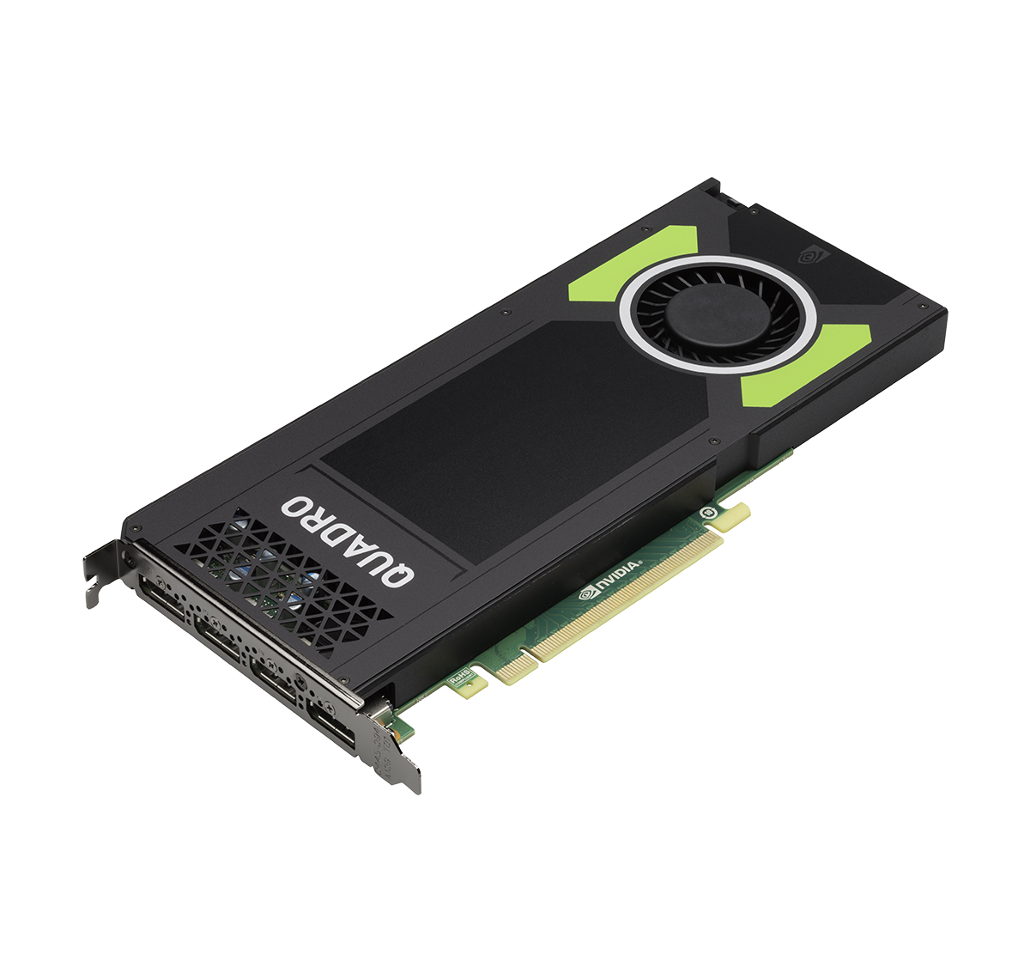
Our Approach: GPUSentinel
Achieve more reliable white-box monitoring with GPUs
  Run fault detectors in a dedicated GPU
  System faults are not easily propagated to fault detectors in a GPU
Monitor OS data in main memory to detect system faults
  Can detect system faults that run out of system resources
  E.g., out-of-memory and deadlocks with spinlocks
target system
monitor
fault
detector
OS
target
host
CPU
memory
GPU
Notes:
To achieve more reliable white-box monitoring, we propose GPUSentinel.
As shown in this figure, GPUSentinel runs fault detectors in a GPU.
Fault detectors in a GPU can continue to run with a high probability even when system faults occur in the target system.
This is because GPUs are physically isolated from CPUs and main memory, on top of which the target system runs.
System faults in the target system are not easily propagated to fault detectors in a GPU.
To monitor the target system from a GPU, GPUSentinel inspects OS data stored in main memory.
It can detect system faults that run out of system resources or cause resource starvation.
If the values of OS data are abnormal, GPUSentinel can detect that state as symptoms of system faults.
In addition, it can analyze the root causes.

Slide 6
Monitoring OS data from GPUs
Map the entire main memory onto a GPU with CUDA
  Use a special device provided by the modified Linux kernel
  Prevent all the memory pages from becoming in use
Access OS data in main memory from a GPU with DMA
  Translate the virtual address of OS data into a GPU address
  Transform programs to perform this address translation with LLVM
GPU memory
address
translation
DMA
LLVM
main memory
fault
detector
detector
program
OS data
CPU
GPU
Notes:
To access the entire main memory from a GPU, GPUSentinel maps main memory onto a GPU with CUDA's mapped memory.
However, simply mapping the entire memory makes all the memory pages become in use.
To address this issue, we have added a special device to the Linux kernel.
When GPUSentinel maps main memory via this device, the modified Linux kernel prevents memory pages from being in use.
GPUSentinel enables fault detectors in a GPU to transparently access OS data in main memory using DMA.
Fault detectors know only the virtual addresses of OS data, but they need to access mapped main memory using GPU addresses.
To automatically perform this address translation, GPUSentinel transforms the programs of fault detectors using LLVM.
Specifically, it inserts the address translation before the load instruction in the intermediate representation.

Slide 7
Easy Development of Fault Detectors
Develop fault detectors like OS kernel modules
  Reuse the source code of the Linux kernel
  E.g., Data structures, global variables, inline functions, and macros
Write fault detectors in C
  CUDA programs are usually written in C++
  Modify clang so that CUDA programs are compiled as C
CUDA
program
clang
bit
code
opt
bit
code
llc / ptxax / fatbinary
fat binary
fault
detector
clang++
object file
Notes:
Even if the address translation is automated, it is still a troublesome task to develop fault detectors that monitor OS data.
To obtain OS data, fault detectors have to find its location in main memory and analyze data structures used in the OS kernel.
For ease of development, GPUSentinel enables developers to write the programs of fault detectors like OS kernel modules.
Developers can reuse the source code of the OS kernel as much as possible, for example, data structures.
In addition, GPUSentinel enables developers to write fault detectors in C.
CUDA programs are usually written in C++.
So, it is difficult to reuse the source code of the Linux kernel written in C.
GPUSentinel uses a modified version of clang compiler so that CUDA programs are compiled as C.
In GPUSentinel, CUDA programs are compiled as in this figure.

Slide 8
Metrics for Detecting System Hangs
Obtain 8 metrics by analyzing OS data in a GPU
  Metrics on CPUs
    CPU utilization for the kernel (sys) and processes (usr)
    # of timer interupts (int)
  Metrics on CPU scheduling
    # of context switches (cs) and uninterruptible processes (sleep)
  Metrics on memory
    Free memory (free) and # of swap-outs (swp)
  Metric on kernel panic
    Spinlock acquired on panic (panic)
kernel_cpustat
jiffies
rq
task_struct
vm_stat
panic_lock
fault
detector
Notes:
GPUSentinel obtains 8 metrics by analyzing OS data in a GPU.
The metrics on CPUs are the CPU utilization for the kernel and processes and the number of timer interrupts.
For these metrics, fault detectors obtain consumed CPU times and the value of the variable incremented by timer interrupts from the kernel memory.
The metrics on CPU scheduling are the numbers of context switches and uninterruptibly sleeping processes.
Fault detectors obtain these numbers from the kernel data structures for scheduling and processes.
The metrics on memory are the amount of free memory and the number of swap-outs.
Fault detectors obtain these values from the data structures for virtual memory.
Finally, the metric on kernel panic is the state of the spinlock acquired by the kernel on panic.

Slide 9
Examples of Fault Detectors
Provide 7 fault detectors by combining the 8 metrics
  Detect infinite loops with
    Interrupts disabled (F1)
    Interrupts/preemption enabled (F2)
    Interrupts enabled but preemption disabled (F3)
  Detect indefinite waits due to
    Resources not released (F4)
    Sleep while holding a lock (F5)
    Abnormal resource consumption (F6)
  Detect a kernel panic (F7)
 | CPU |  |  | scheduling |  | memory |  | panic
 | sys | usr | int | cs | sleep | free | swp
F1 |  |  | ✔︎
F2 | ✔︎ | ✔︎
F3 | ✔︎ | ✔︎ |  | ✔︎
F4 |  |  |  |  | ✔︎
F5 | ✔︎ | ✔︎ |  | ✔︎
F6 |  |  |  |  |  | ✔︎ | ✔︎
F7 |  |  |  |  |  |  |  | ✔︎
Notes:
Using the combination of these 8 metrics, GPUSentinel currently provides 7 fault detectors.
These detectors detect 7 types of system faults shown in this table.
The first three faults are related to infinite loops.
Fault F1 is a loop with interrupts disabled, that is, a deadlock with spinlocks.
F2 is a loop with interrupts and preemption enabled.
F3 is a loop with interrupts enabled but preemption disabled.
The next three faults are related to indefinite waits.
Fault F4 is a wait due to resource not being released.
F5 is a wait due to sleep while holding a lock.
F6 is a wait due to abnormal resource consumption.
Finally, fault F7 is a kernel panic.

Slide 10
Experiments
We conducted several experiments using GPUSentinel
  Confirmed that GPU-based fault detectors could detect system faults
  Compared with OS-based fault detectors
  Examined the performance impact of GPUSentinel
target host
CPU | Intel Xeon E5-1603 v4
memory | DDR4 8 GB
GPU | NVIDIA Quadro M4000
OS | Linux 4.4.64
CUDA | 8.0.61
Notes:
We conducted several experiments using GPUSentinel.
First, we confirmed GPU-based fault detectors could detect system faults.
Second, we compared GPU-based fault detectors with OS-based ones running on CPUs and main memory.
Third, we examined the performance impact of GPUSentinel on the target system and that of the target system on GPUSentinel.
In this experiment, we used a target host shown in this table.

Slide 11
Detectability of System Faults
We injected system faults into the Linux kernel
  Developed kernel modules that caused faults F1-F7
  GPUSentinel could detect all the faults in 1 sec at most
    Identified the thread names of the root causes for F1-F3 and F5
We reproduced the actual fault reported in Bugzilla
  Caused a deadlock by accessing a directory in XFS
  GPUSentinel could detect this fault after 32 processes accessed it
infinite loops |  |  | indefinite waits |  |  | panic
F1 (no interrupt) | F2 (no interrupt /preemption) | F3 (no preemption) | F4 (deadlock) | F5 (lock holder) | F6 (out-of-memory) | F7
✔︎ | ✔︎ | ✔︎ | ✔︎ | ✔︎ | ✔︎ | ✔︎
Notes:
To inject kernel-level faults, we have developed 7 Linux kernel modules.
For fault F1, the kernel module caused a deadlock using spinlocks.
For F2 and F3, kernel threads executed an infinite loop.
For F4, the kernel module caused a deadlock using an erroneous mutex lock.
For F5, one kernel thread indefinitely slept.
For F6, the kernel module allocated a large amount of memory.
For F7, the kernel module caused a kernel panic.
As shown in this table, GPUSentinel could detect all of the 7 faults.
For F1 to F3 and F5, GPUSentinel could identify the thread names involved in the faults as the root causes.
In addition to fault injection, we caused the actual fault reported in Bugzilla.
When we accessed the XFS filesystem, we suffered from a deadlock and got stuck.
GPUSentinel could detect this fault as F4 successfully.

Slide 12
Comparison with OS-level Fault Detectors
We compared GPU-based detectors with OS-level ones
  Monitored the same metrics inside the OS kernel
    Driven by timer interrupts
  OS-level detectors could not detect F1 and F7
We needed to modify the kernel to develop such detectors
  Necessary kernel variables were not exported to kernel modules
  Not easy to develop new fault detectors
F1 (no interrupt) | F2 | F3 | F4 | F5 | F6 | F7 (panic)
✘ | ✔︎ | ✔︎ | ✔︎ | ✔︎ | ✔︎ | ✘
Notes:
To show the advantage of GPU-based fault detection, we compared our fault detectors with OS-based ones.
We have developed OS-based fault detectors that monitor the same metrics as the ones used in GPUSentinel.
These detectors were created as Linux kernel modules and were driven by timer interrupts.
As shown in this table, these fault detectors could detect system faults except for F1 and F7.
Since F1 and F7 disabled interrupts, timer-driven fault detectors were not invoked.
It should be noted that we needed to modify the Linux kernel to additionally export several kernel variables to the kernel modules.
This means it is not easy to develop new fault detectors.
In GPUSentinel, fault detectors can access any kernel variables.

Slide 13
Performance Overhead
A fault detector continuously performed DMA in a GPU
  The STREAM benchmark accessed main memory on CPUs
The fault detector degraded STREAM performance by 33%
  STREAM degraded detector performance by 20%
  The overhead was negligible in the realistic number of GPU threads
-33%
-20%
Notes:
Finally, we examined the impact on memory-intensive application and fault detector.
As a memory-intensive application in the target system, we ran the STREAM benchmark.
In a GPU, we ran a memory-intensive fault detector that continued to copy data from main memory.
The left-hand side figure shows the throughput of the STREAM benchmark.
As the number of GPU threads increased, the throughput decreased.
The overhead reached up to 33%, but actual fault detectors do not obtain memory data so much as in this experiment.
The right-hand side figure shows the throughput of the fault detector.
The fault detector was affected by the memory pressure of the STREAM benchmark.
The performance degradation was 20% at maximum, but that was negligible in the realistic number of GPU threads.

Slide 14
Conclusion
We proposed GPUSentinel for reliable and accurate fault detection
  Monitor OS data in main memory from GPUs
  Provide a development framework using LLVM
  Developed 7 GPU-level fault detectors
    Could detect injected system faults successfully
Future work
  Support the detection of various types of system faults
  Detect faults in the hypervisors of virtualized systems
Notes:
In conclusion, we proposed GPUSentinel for reliable and accurate fault detection by running fault detectors in GPUs.
To detect system faults, GPUSentinel monitors OS data in main memory from GPUs.
To support the easy development of fault detectors, GPUSentinel provides a development framework that enables developers to use the source code of the OS kernel as much as possible.
Using GPUSentinel, we have developed 7 GPU-based fault detectors and confirmed they could detect system faults successfully.
One of our future work is to support other types of system faults.
Another direction is to detect faults in the hypervisor of a virtualized system running virtual machines.

