Slide 1
Memory-virtualizing and -devirtualizing
VM Migration with Private Virtual Memory
Yuji Muraoka and Kenichi Kourai
Kyushu Institute of Technology, Japan
Notes:
I’m Kenichi Kourai from Kyushu Institute of Technology.
I’m gonna talk about Memory-virtualizing and -devirtualizing VM migration with Private Virtual Memory.
This is joint work with my student.

Slide 2
Memory-virtualizing VM Migration
Large-memory VMs are widely used in clouds
  E.g., instances with 24 TB of memory in Amazon EC2
  Cannot migrate a VM if there is no host with sufficient memory
Leverage virtual memory at the destination host
  Store part of a VM's memory in swap space on a disk
  Perform page-ins from swap space to physical memory if necessary
VM's
memory
transfer
page-out
physical
memory
swap
space
page-in
source host
destination host
Notes:
Recently, large-memory virtual machines are widely used in clouds.
For example, instances provided by Amazon EC2 have up to 24 TB of memory.
A VM can be migrated to another host when the host is maintained.
The migration of a large-memory VM requires a large host with sufficient memory that can accommodate the entire memory of the VM.
If there is no such destination host, the VM cannot be migrated.
Even in such a case, memory-virtualizing VM migration is possible.
It leverages virtual memory at the destination host.
It can transparently store part of the memory of a VM in swap space on a disk.
When the VM requires memory data in swap space, the system performs page-ins and moves the data from swap space to physical memory.
In exchange for this, the system performs page-outs and moves unlikely accessed data from physical memory to swap space.

Slide 3
Issues of Using Traditional Virtual Memory
The migration time increases due to excessive paging
  Always cause page-outs after physical memory becomes full
  Need page-ins to update memory if the memory exists in swap space
The downtime also increases
  The memory of the device emulator is paged out at destination
  Need page-ins when the device emulator starts to run
swap
space
first
transfer
VM's
memory
page-out
physical
memory
device
emulator
retransfer
page-in
source host
destination host
Notes:
However, traditional virtual memory is not suitable for VM migration.
First, the migration time increases due to excessive paging.
VM migration first transfers the memory data of a VM to physical memory at the destination host.
After the physical memory becomes full, the following transfers always cause page-outs to store the received memory data in physical memory.
Then, VM migration retransfers memory data updated during the migration.
If the memory to be updated exists in swap space, it needs to be first paged in.
The downtime of a VM also increases.
In the final phase, VM migration stops the VM and transfers the rest of the state consistently.
When the device emulator host restores the state of virtual devices at the destination, its memory is often paged out by VM migration.
At this time, many page-ins are needed to run the device emulator.

Slide 4
Split Migration [Suetake+, CLOUD'18]
Distribute a VM's memory to multiple small hosts
  Run the migrated VM by exchanging memory data between the hosts
  No paging occurs during VM migration
New issues arise by using multiple hosts
  More costly than memory-virtualizing VM migration
  Subject to host/network failures
physical
memory
main host
VM's
memory
transfer
remote paging
physical
memory
sub-host
source host
Notes:
To address these issues, split migration has been proposed.
It divides the memory of a VM into small fragments and transfers them to multiple smaller hosts, one main host and several sub-hosts.
After split migration, the VM runs by exchanging memory data between the main host and a sub-host using remote paging.
Since no paging occurs during VM migration, split migration can improve migration performance.
However, new issues arise by using multiple hosts.
First, split migration is more costly than memory-virtualizing VM migration.
It requires one or more sub-hosts in addition to the main host.
For efficient remote paging, a high-speed network such as InfiniBand is necessary.
In addition, migrated VMs are subject to host and network failures.

Slide 5
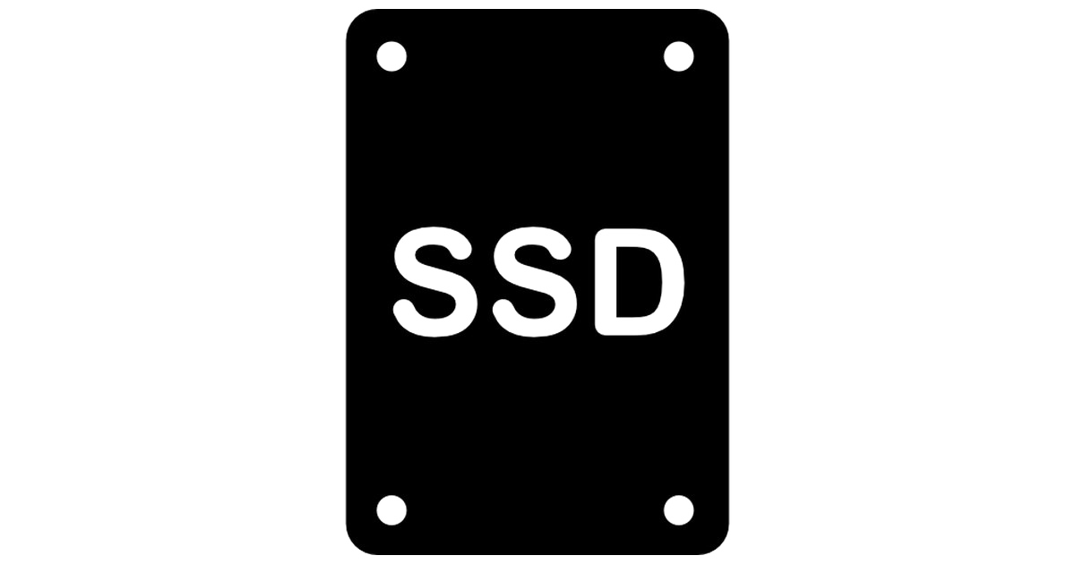
Revisiting Memory-virtualizing VM Migration
Reduce overhead by using NVMe SSDs as swap space
  NVMe SSDs become faster and less expensive recently
  The endurance is not critical because swap space is used temporarily
Only using NVMe SSDs cannot address the issues
  Paging itself is not eliminated
  Special-purpose memory management is needed
swap space
VM's
memory
transfer
physical
memory
device
emulator
paging
paging
source host
destination host
Notes:
So, we revisit memory-virtualizing VM migration.
Recently, NVM-e SSDs become faster and less expensive.
Using them as swap space, the overhead of memory-virtualizing VM migration could be reduced.
Too many writes to swap space shrink the lifespan of NVM-e SSDs, but swap space is used only when there is no large host.
Migrated VMs usually do not cause excessive paging thanks to memory access locality.
However, only using NVM-e SSDs cannot completely address the issues of memory-virtualizing VM migration.
This is because paging itself is not eliminated at all.
So, we need special-purpose memory management for VM migration and migrated VMs.

Slide 6
Our Approach: VMemDirect
Provide private virtual memory per VM
  Assign a fixed amount of physical memory
  Use an NVMe SSD as private swap space
Migrate a VM to a small host using private virtual memory
  Avoid paging caused by the device emulator at destination
  The device emulator runs outside private virtual memory
private virtual memory
swap
space
VM's
memory
private
swap space
transfer
physical
memory
device
emulator
source host
destination host
Notes:
We propose VMemDirect for efficient memory-virtualizing VM migration.
VMemDirect provides private virtual memory per VM, instead of using system-wide virtual memory, at the destination host.
A fixed amount of physical memory is assigned to private virtual memory when starting VM migration.
A fast and inexpensive NVM-e SSD is used as private swap space for private virtual memory.
VMemDirect migrates a VM to a small destination host with insufficient memory using private virtual memory.
Since the device emulator runs outside private virtual memory, its memory is not paged out by VM migration.
So, VMemDirect can avoid performance degradation due to page-ins caused for the device emulator in the final phase.

Slide 7
Direct Memory Transfer
Transfer memory data without relying on paging
  Store directly to either physical memory or private swap space
  No data in physical memory is paged out
  No memory data in private swap space is paged in
Retransfer updated memory data to the same locations
  Update data in physical memory or private swap space directly
private virtual memory
VM's
memory
private
swap space
source
host
destination
host
physical
memory
transfer
Notes:
VMemDirect directly transfers the memory data of a VM to either physical memory or private swap space, instead of relying on paging at the destination host.
At the source host, VMemDirect divides the memory of a VM into two, based on memory access prediction.
As a destination, it selects physical memory for likely accessed memory and private swap space for the other.
At the destination host, it stores memory data in the specified locations.
No data in physical memory is paged out.
No memory data in private swap space is paged in.
VMemDirect retransfers memory data updated during VM migration to the same locations.
Then, it directly updates data in either physical memory or private swap space.
Even if it updates data in private swap space, it does not cause page-ins or page-outs.

Slide 8
Memory-devirtualizing VM Migration
Migrate a VM running on private virtual memory
  Transfer memory data without paging
  Read directly from both physical memory and private swap space
Can perform memory-virtualizing VM migration as well
  Store directly to either physical memory or private swap space at destination
private virtual memory
private
swap space
VM's
memory
source
host
destination
host
physical
memory
transfer
Notes:
In addition to memory-virtualizing VM migration, VMemDirect supports efficient memory-devirtualizing VM migration.
This migration method migrates a VM running on private virtual memory to the destination host with sufficient memory.
VMemDirect directly reads memory data from both physical memory and private swap space and transfers it to physical memory at the destination host.
It does not perform paging to transfer memory data in private swap space.
VMemDirect can perform both memory-devirtualization and memory-virtualization at the same time.
It directly reads memory data from both physical memory and private swap space at the source host.
Then, it stores that data directly to either physical memory or private swap space at the destination host.

Slide 9
Chunk Queues for Efficient Paging
Achieve accurate LRU with 2^{m} chunk queues (m=8)
  Move a memory chunk from the i-th to (i+2^{m-1})-th queue if accessed
  Periodically compress 2^{m} queues into 2^{m-1} queues for aging
Achieve efficient LRU for paging
  Page-in: Append a memory chunk to the last queue in O(1)
  Page-out: Search for a non-empty queue from the 1st one in O(2^{m})
least recently used
page-out
1
1
2
accessed
2
:
:
129
compress
129
:
:
256
256
page-in
most recently used
Notes:
Since access to swap space becomes much faster by using NVM-e SSDs, the paging mechanism itself becomes a new bottleneck.
To achieve accurate and efficient LRU management for paging, VMemDirect uses "2 to the power of m" queues called chunk queues.
The first queue manages the least recently used memory chunks.
The last queue manages the most recently used ones.
At first, all memory chunks are added to the first queue.
If a memory chunk is accessed, VMemDirect moves it from the i-th queue to the (i+"2 to the power of m-1")-th queue.
For aging, it periodically compresses the "2 to the power of m" queues into the former "2 to the power of m-1" queues.
Upon a page-in, VMemDirect can append a memory chunk to the last queue in order 1.
For a page-out, it can find a victim memory chunk by searching for a non-empty queue from the first one in order "2 to the power of m".
In the current implementation, m is 8.

Slide 10
Asynchronous Paging
Method 1: Perform page-ins for 256 pages in a memory chunk synchronously
  Perform page-outs asynchronously
Method 2: Perform only one page-in for a faulting page synchronously
  Perform the rest of the page-ins and page-outs asynchronously
page-in thread
page-out thread
page-in thread
page-out thread
Method 1
Method 2
memory
chunk
page-in
page-out
page-in
page-out
private swap space
private swap space
Notes:
To strictly use a fixed amount of physical memory, page-ins and page-outs need to be performed synchronously.
However, such synchronous paging degrades the performance of a migrated VM.
So, VMemDirect performs asynchronous paging to handle page-ins as fast as possible.
It provides two methods.
In method 1, the page-in thread performs page-ins for 256 pages in a memory chunk synchronously when a page fault occurs.
Then, the page-out thread asynchronously performs page-outs.
As a result, the page-in thread can handle the next page fault without waiting for the completion of page-outs.
In more aggressive method 2, the page-in thread performs only one page-in for a faulting page synchronously.
Then, the page-out thread asynchronously performs the rest of the page-ins and all the page-outs.

Slide 11
Experiments
Examine performance improvement in VMemDirect
  The performance of VM migration and migrated VMs
Comparison
  Naive migration: Use traditional virtual memory at a destination host
  Split migration: Use two destination hosts
  Ideal migration: Use a destination host with sufficient memory
 | source host | destination (main) host | sub-host
CPU | Xeon Silver 4110 x2 | EPYC 7262 | Xeon Silver 4110 x2
memory | 256 GB | 128 GB | 128 GB
NIC | 10 GbE
SSD | - | Samsung 970 PRO 1TB | -
 | VM
CPU | 4
memory | 120 GB or 12 GB
Notes:
We conducted several experiments to examine the performance improvement in VM migration and migrated VMs by VMemDirect.
For comparison, we examined the performance of naive migration, split migration, and ideal migration.
Naive migration performed memory-virtualizing VM migration using traditional system-wide virtual memory.
Split migration migrated a VM to two destination hosts.
Ideal migration migrated a VM to the destination host with sufficient memory.
We used three servers in this table.

Slide 12
Migration Performance
The migration of an active VM was 58% faster
  11% faster than split migration
  Only 4% slower than ideal migration
The downtime was reduced by ~500 ms
  Comparable to ideal migration
-58%
migration time
downtime
-500 ms
Notes:
First, we examined the migration performance.
We migrated an idle VM and an active VM with 120 GB of memory.
The active VM modified its memory repeatedly.
As shown in the left-hand side figure, in VMemDirect, the migration of the idle VM was only slightly faster than naive migration.
But the migration of the active VM was 58% faster.
This means VMemDirect could successfully transfer modified memory without paging.
VMemDirect was 11% faster than split migration and only 4% slower than ideal migration.
As shown in the right-hand side figure, the downtime was reduced by about 500 ms for both VMs.
This is because VMemDirect could avoid paging for the device emulator.
VMemDirect was comparable to ideal migration.

Slide 13
Performance of Private Virtual Memory
A memory benchmark was 3.2x faster in the migrated VM
  2x faster than split migration
The memcached performance was restored only in 10 sec
  Naive migration needed a much longer time
  Split migration degraded performance by 7%
memcached
benchmark
3.2x
Notes:
Next, we examined the performance of private virtual memory after VM migration.
We ran a memory benchmark that caused excessive paging in a migrated VM.
As shown in the left-hand side figure, in VMemDirect, the memory benchmark was 3.2 times faster than after naive migration.
This is thanks to direct memory transfer based on memory access prediction, efficient LRU management, and asynchronous paging.
In this experiment, performing only asynchronous page-outs was better.
VMemDirect was twice faster than split migration due to paging with an NVM-e SSD.
Finally, we ran memcached in a VM and migrated it.
As shown in the right-hand side figure, in VMemDirect, the memcached performance was completely restored only in 10 seconds.
In contrast, naive migration needed a much longer time.
Split migration degraded performance by 7% on average.

Slide 14
Conclusion
We proposed VMemDirect for efficient memory-virtualizing VM migration using private virtual memory
  Create private swap space on an NVMe SSD per VM
  Transfer memory data directly to physical memory or private swap space without paging
  Improved VM performance dramatically
Future Work
  Compare performance using various types of SSDs
  Create private swap space on persistent memory, e.g., Intel Optane
Notes:
In conclusion, we proposed VMemDirect for efficient memory-virtualizing and -devirtualizing VM migration using private virtual memory.
VMemDirect creates private swap space on a fast and inexpensive NVM-e SSD per VM.
It transfers memory data directly to physical memory or private swap space without paging.
Our experimental results show that VMemDirect could improve the performance of VM migration and migrated VMs dramatically.
Our future work is to compare the performance of VMemDirect using various types of SSDs.
Another direction is to create private swap space on Intel Optane DC persistent memory, instead of NVM-e SSDs.

